Slide 1
Statistical architecture and data integration
Anna Długosz Janusz Dygaszewicz
Deputy Director Director
ICT Systems, Geostatistics ICT Systems, Geostatistics
and Census Department and Census Department
Belgrade Workshop on Data Integration: Realising the Potential of Statistical and Geospatial Data

Slide 2
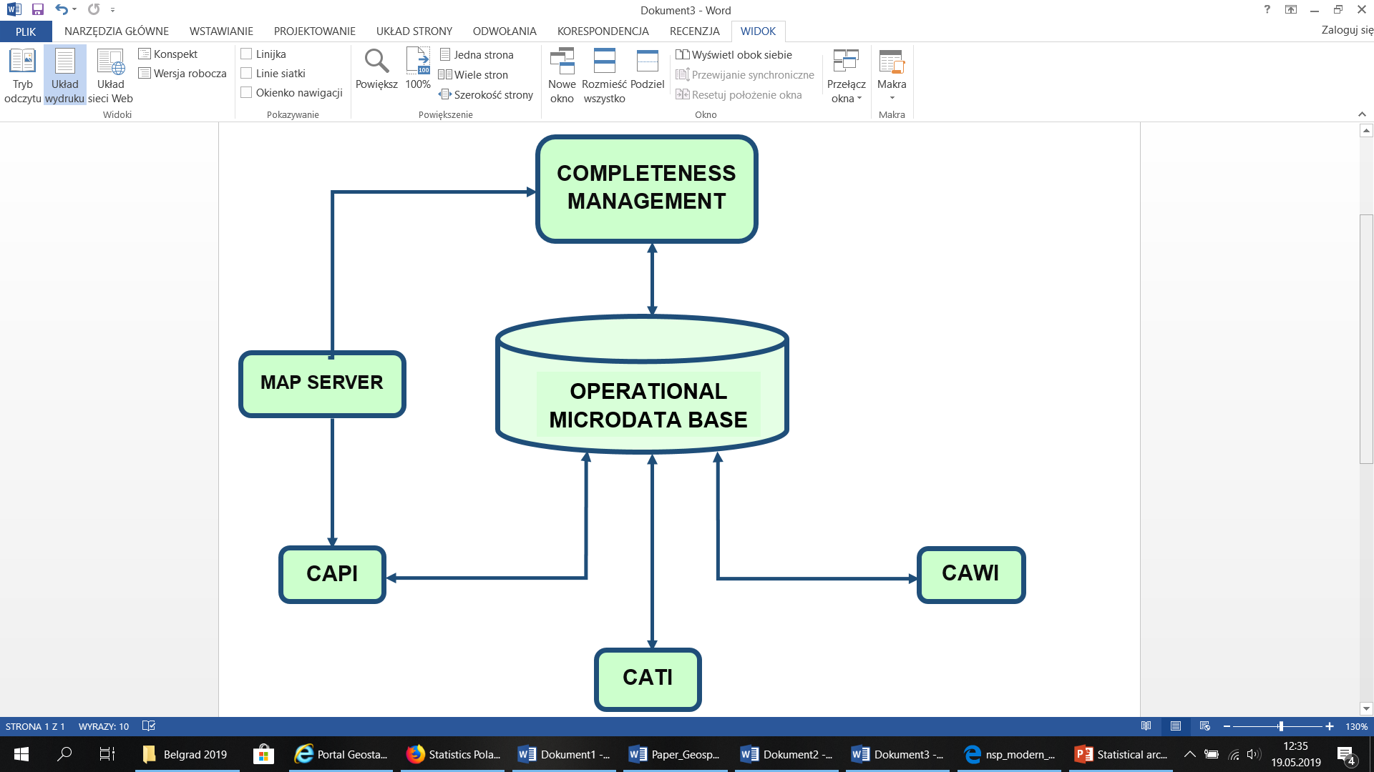
Data integration
The previous round of Census: Agricultural Census 2010 and Population and Housing Census 2011

Slide 3

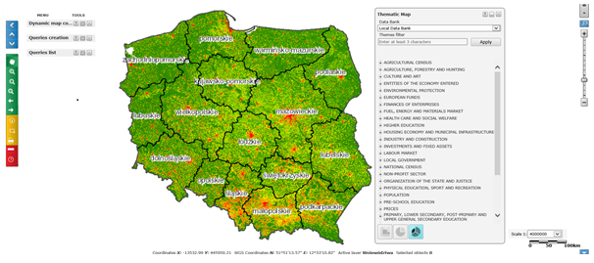
Dissemination of statistical information

Slide 4
Our way to improvement
For several years Statistics Poland has collected data from administrative sources, social network, sensors, GPS technology etc.
Data integration and geospatial information are becoming increasingly important in our statistical production process.
But data silos have been a hindrance to data integrity, data integration and a barrier to production efficiency.

Slide 5
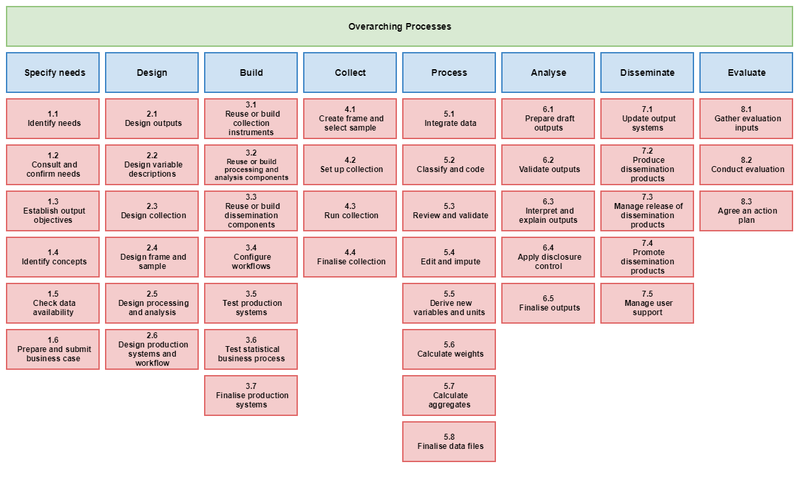
Generic Statistical Business Process Model
(GSBPM)

Slide 6
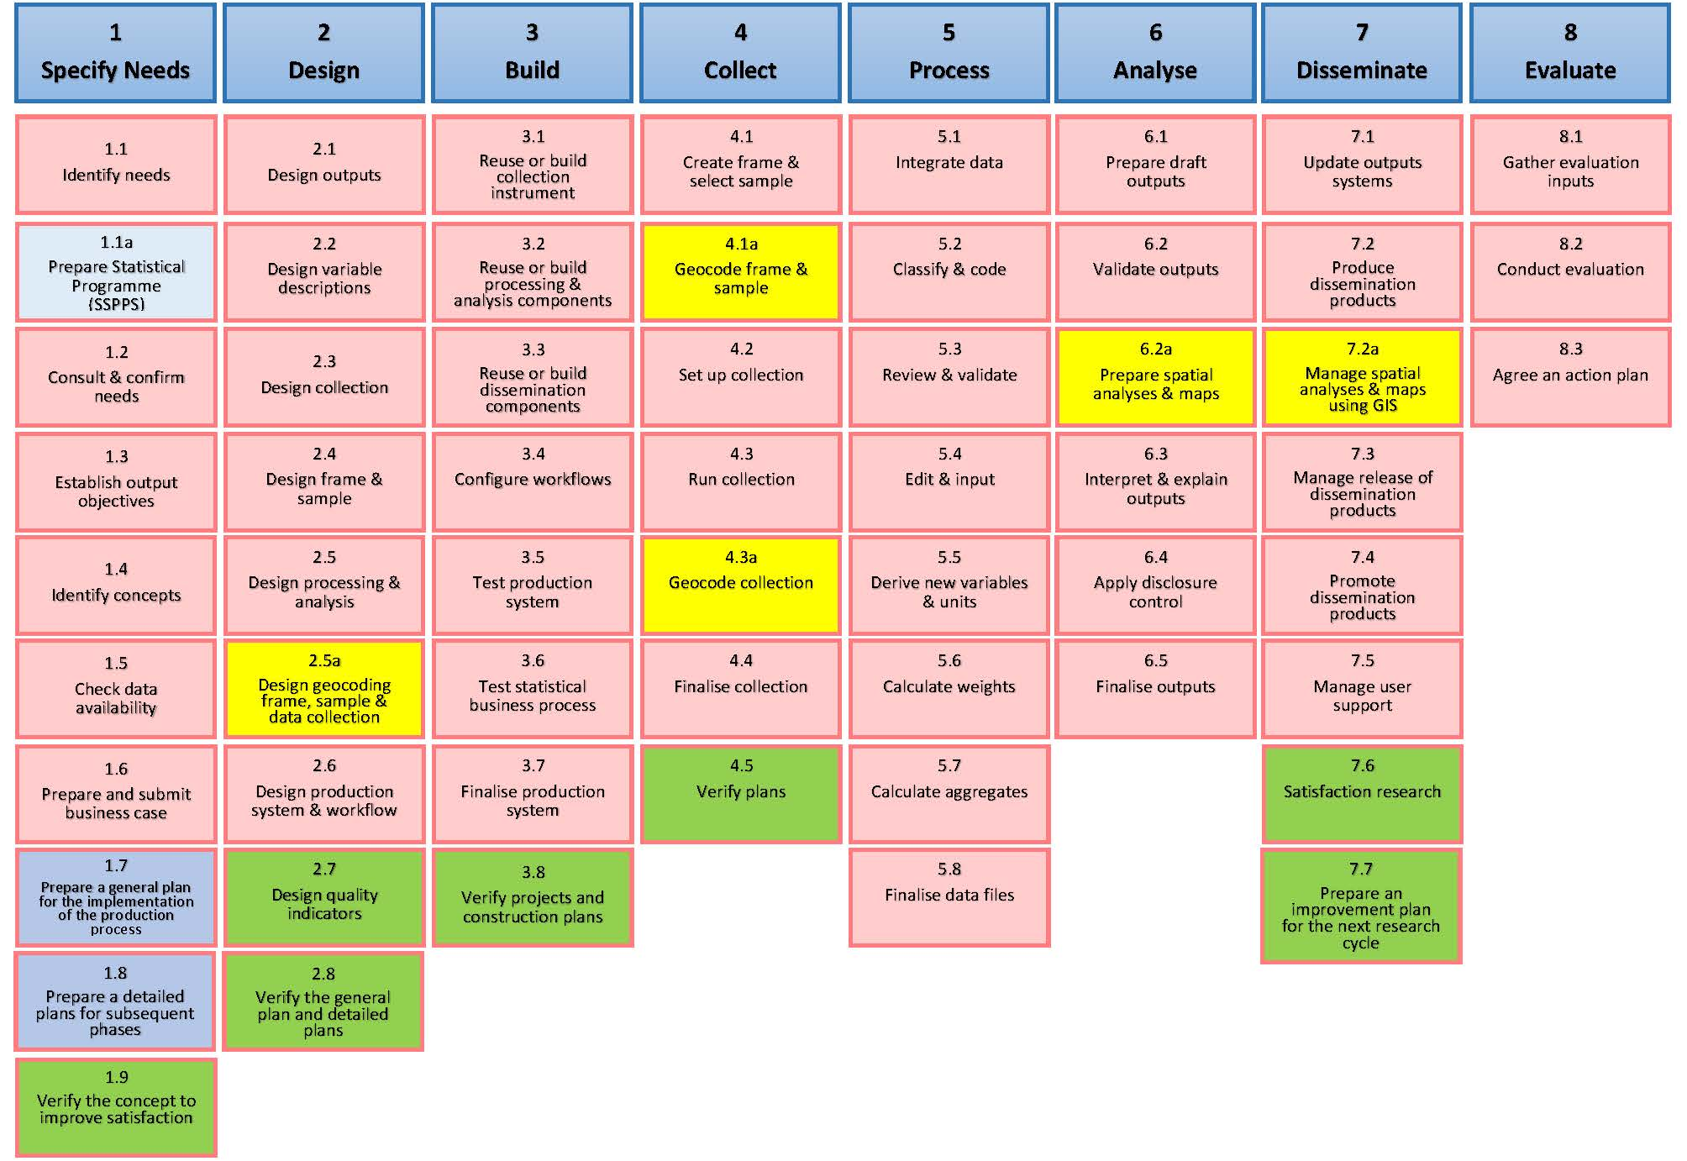
Model of the Statistical Production Process

Slide 7
Model of the Statistical Production Process

Slide 8
The Reference Architecture Framework

Slide 9
The Reference Architecture Framework
  Critical elements of the solution – „Data Repositories”:
    a registry data repository (SJS)
    a raw data repository (SDS)
    an operational data repository (SDO)
    an analysis data repository (SDA)
    a geospatial data repository (SDG)
    a publication data repository (SDP)
    a metadata repository

Slide 10
Collect

Slide 11
Process

Slide 12
Analyse

Slide 13
Disseminate

Slide 14
The geospatial data repository

Slide 15
The metadata repository

Slide 16
Thank you for your attention!

