Slide 1
The Good, the Bad and the Ugly
A comparison of conventional sampling vs. sampling from a frame with rasterized population values vs. sampling from a spatial grid
Brian Blankespoor, Talip Kilic,
Siobhan Murray, Michael Wild
DEC-DG

Slide 2
Why do we need a sampling frame?
Probability surveys (PS) are still the core instrument to gather socio-economic data in developing countries.
For a PS a sampling frame is required, and each unit of the target population requires a selection probability greater than zero.
  This allows to derive population estimates, as well as to quantify the precision and the confidence interval of the (target-) population estimates.
Specific for developing and transition countries is the strong reliance on area frames.
The resulting sampling design is usually a stratified two-stage cluster design (STR2ST).
  1st stage units are sampled by PPS and 2nd stage units at random.

Slide 3
Requirements of an ideal sampling frame
        Completeness – each element is once and only once represented
        Timeliness – the sampling frame needs to be up to data (i.e. full coverage of the population at the time of the survey)
        Informativeness – provides information about the population elements (i.e. useful for stratification).

Slide 4
What is the problem with conventional sampling frames?
The target population is the population of interest.
The frame population is the population contained in our frame data (i.e. the last census).
The sample is than taken from this frame, and will eventually have two sub-populations, namely respondents and non-respondents.
Sample
Non-Respondents
Respondents
Frame Population
Target Population

Slide 5
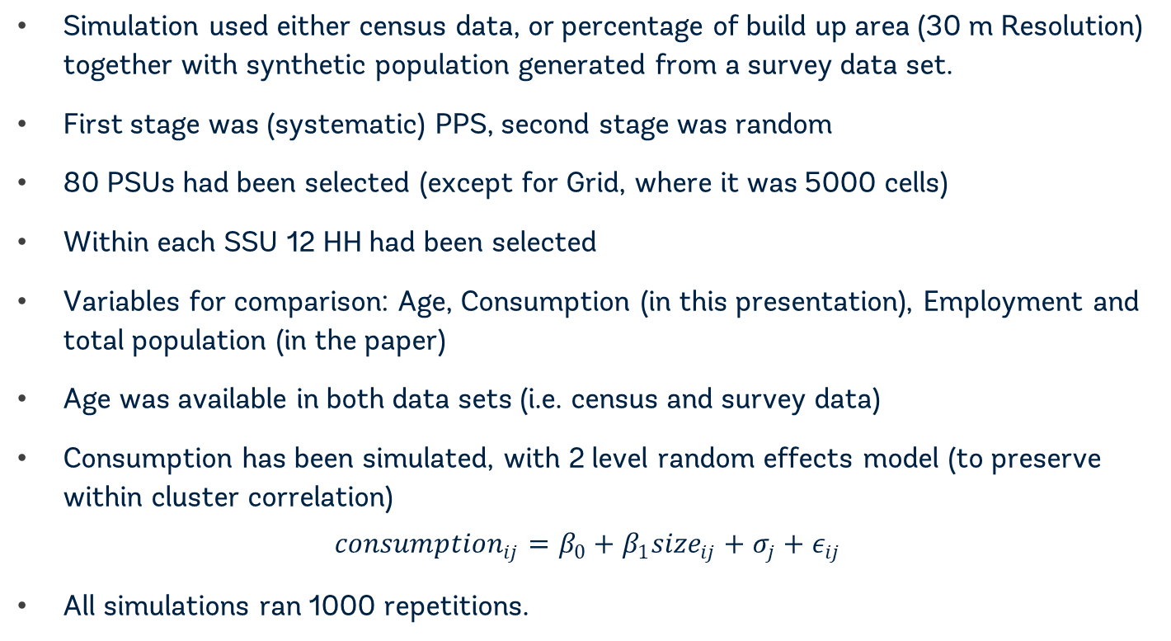
Simulation Set Up:
Simulation used either census data, or percentage of build up area (30 m Resolution) together with synthetic population generated from a survey data set.
First stage was (systematic) PPS, second stage was random
80 PSUs had been selected (except for Grid, where it was 5000 cells)
Within each SSU 12 HH had been selected
Variables for comparison: Age, Consumption (in this presentation), Employment and total population (in the paper)
Age was available in both data sets (i.e. census and survey data)
Consumption has been simulated, with 2 level random effects model (to preserve within cluster correlation)
$${consumption}_{ij}=β_{0}+β_{1}{size}_{ij}+σ_{j}+ε_{ij}$$
All simulations ran 1000 repetitions.

Slide 6
Spatial distribution of the census population
Urban
Rural
Distribution of census population by using share of build up area

Slide 7
The Good: Results of Malawi PPS census frame
Consumption
0.91 % RMSE
Age
1.23 % RMSE

Slide 8
Why not reconciling with administrative data?
In a country, with a reliable and stable administrative structure, this is the usual approach.
  Eurostat countries will do their censuses only based on administrative and other auxiliary data from 20/21 onwards.
However this option is (in most cases) not feasible for developing and transition countries.
But there is other reliable auxiliary information, namely remote sensing data.
  Could maybe even act as a substitute.

Slide 9
The Bad: Results of Malawi PPS, aggregate population densities frame
Consumption
1.31 % RMSE
Age
1.87 % RMSE

Slide 10
What to do without any frame information at all?
Sometimes there is no frame population at all (except some aggregates at national or provincial level), or the frame is severely outdated (i.e. DRC 1984).
Since estimation is usually done for highly aggregated domains (i.e. provinces), EAs are just an arbitrarily delimitation
However due to logistical constraints, this was the most useful approach so far.
As the logistical constraints fade away, new sampling approaches may as well include new delimitations.
  i.e. A regular grid.

Slide 11
The Ugly: Results of Malawi PPS, gridded population frame (Worldpop)
Consumption
2.21 % RMSE
Age
3.96 % RMSE

Slide 12
Conclusions so far
All results based on the build-up area, or Worldpop for all different design options show a reasonably low RMSE.
However the two PPS designs options exhibit only half the RMSE of the random sample option when it comes to consumption
    Since total household consumption is strongly related to household size, the measure of size used for the PPS is correctly applied and this result is not surprising.
Therefore using remote satellite imagery as an auxiliary source of information or even as a substitute for a census based frame is a usable solution.
    The PPS design can even be based on the % of build up area alone, however carefully gridded population data (i.e. Worldpop) delivers better results.

Slide 13
Thank you!

Slide 14
Appendix I: Result table census only

Slide 15
Appendix II: Result table hybrid frame

Slide 16
Appendix III: Result table hybrid frame

