Slide 1

Statistics as a Service
Jerker Moström
Statistics Sweden
Workshop on Data Integration: Realising the Potential of Statistical and Geospatial Data Belgrade, Serbia, 21-23 May 2019

Slide 2
Background
New open data policy in Statistics Sweden
Statistical data on small areas as open data
Until now, mainly commission based services
Introduction of a new sub-LAU level geography in official statistics
Until now, LAU has been the lowest level (with a few exceptions)
An open, non commission-based, service for user-defined areas of interest (”Statistics as a Service”)

Slide 3
Current situation - ”Data on map”
Existing internal tool to provide user-defined data
A customer can submit an address, point-of-interest or route (with a defined perimeter) or a user-defined area (polygon)
The tool conducts a spatial operation and runs on micro-data (geospatial data = physical address location + statistical data unit record data) + performs disclosure controls
Returns a standardised report with requested statistical variables in a simple format
Typical customers are banks, insurance companies and other companies planning for new establishments

Slide 4
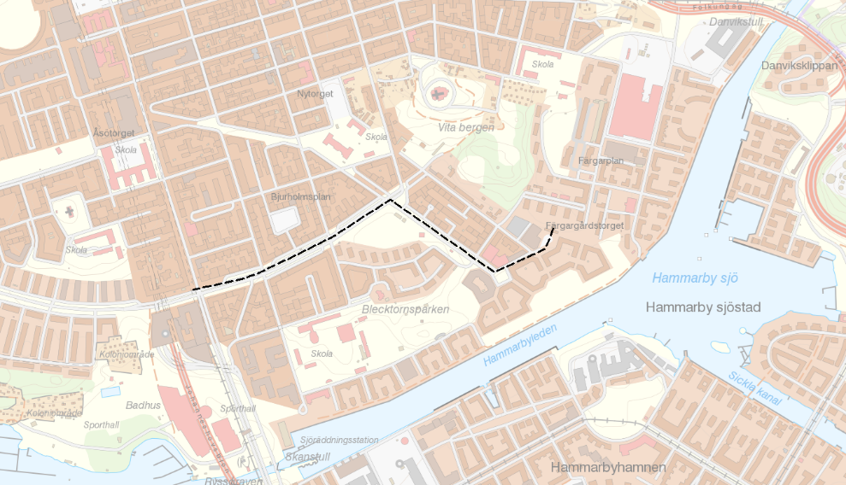
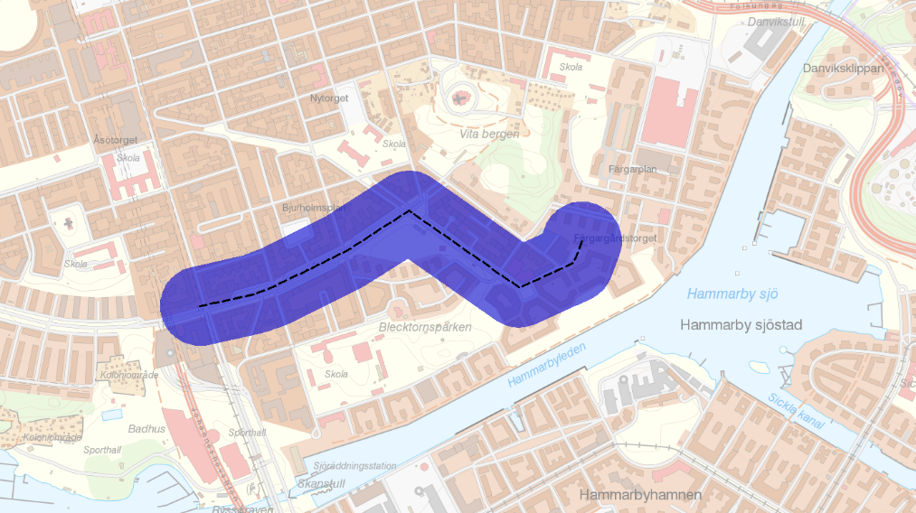
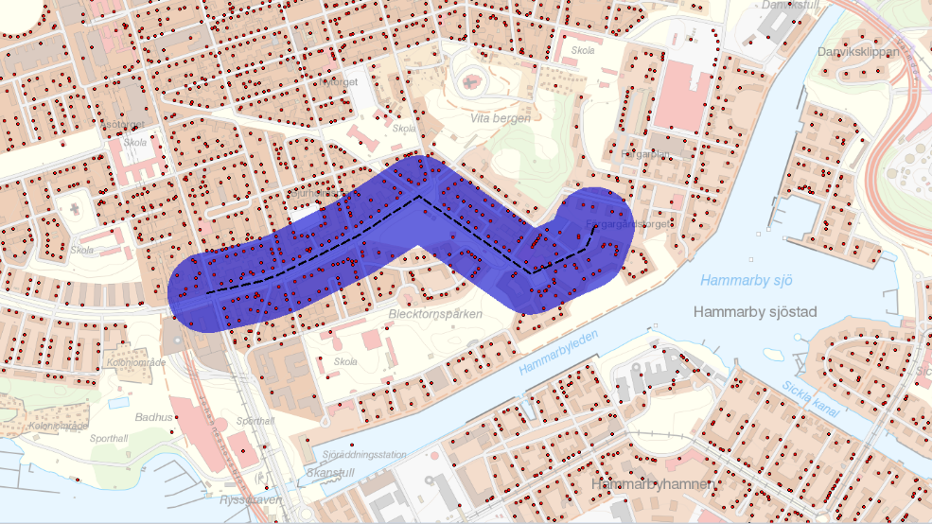
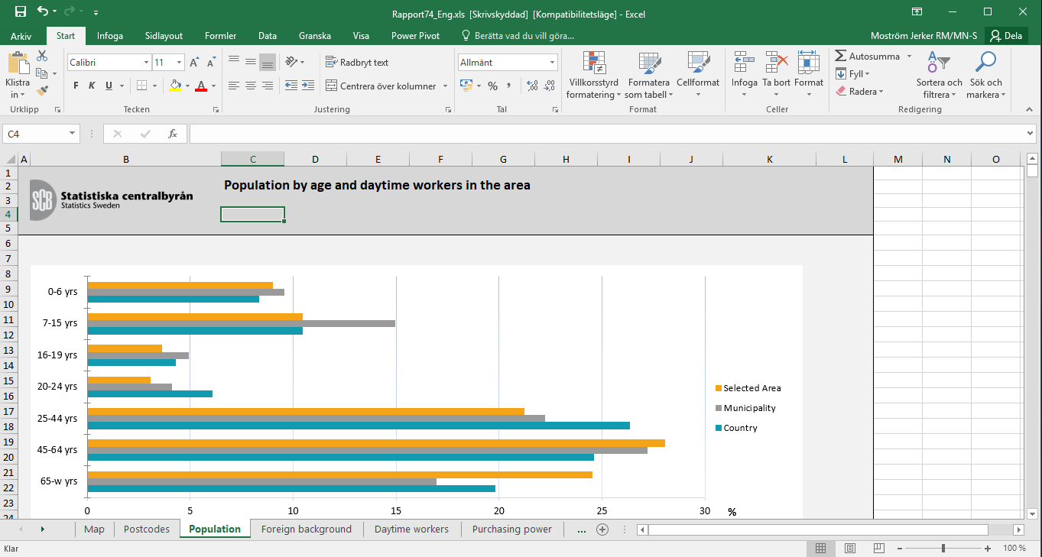

Slide 5
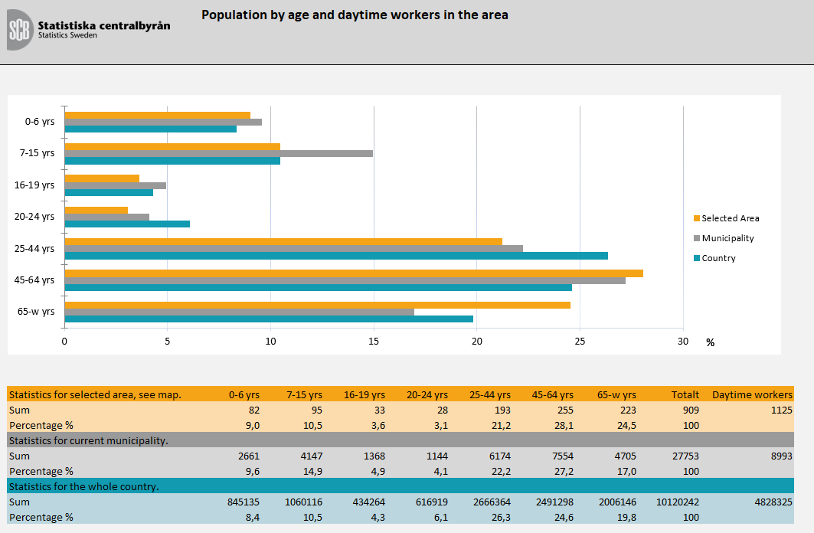
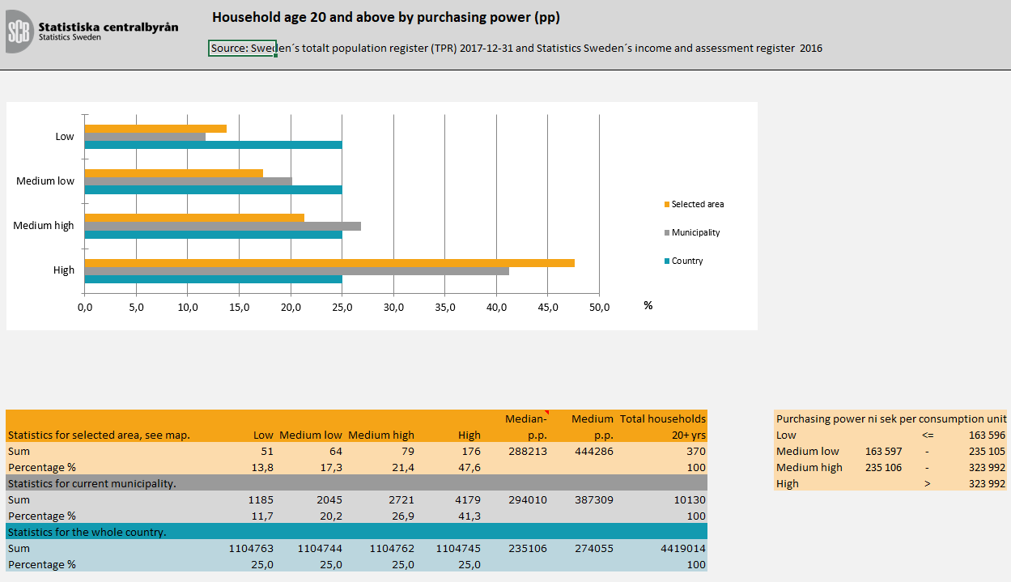
Example on statistical content

Slide 6
”Data on map” > open public service?
What are the most relevant data themes?
How can we ensure a decent level of service performance, response times etc (for a potentially large number of requests)?
How can we provide a tool easy enough to use?
The BIG issue: How can we ensure privacy of information and design disclosure controls (when we don’t know the user and their intended use)?

Slide 7
The approach
Use of personas to (”The tourist”, ”The problem-solver” and ”The Analyst”) to define the appropriate service level
Use of ”user-stories” to define relevant data themes and tool design (establishment of new shops etc)
A working group for disclosure controls
A working group for tool design

Slide 8
Some proposed solutions for privacy protection
All micro data nedd to be aggregated to grid cells before query (to avoid problems with geographical differencing)
Grid cells invisible for users
Thresholds and supersession of small values + noice
Use of intervals and median values (for sensitive variables)
Fixed radius for point-of-interest

Slide 9
Content to be avaliable
Population
  by age
  by sex
  by Swedish/foreign background
Income
  Median income from employment and business for population aged 20+
  Median purchasing power for population aged 20+
Education
  Population aged 25-64, by educational level
Vehicles
  Number of vehicles owned by a natural person
Households
  by type of household
  by the number of children aged 0-17
Properties and dwellings
  Most common form of tenure
  Population by type of real estate
Labour market
  Gainfully employed daytime population aged 16+
  Population aged 20-64, by employment

Slide 10
Conclusions
Work in progress! – a concept this year
A new situation with a lot of unknowns
Opening up data entails lack of control of usage (usually we have a relation with the user and his/hers intended use of data)
Interesting lessons including collaboration between different parts of the organisation (IT, methods, legal experts, geospatial experts)

Slide 11
Thank you!
Jerker Moström
Statistics Sweden
jerker.mostrom@scb.se

