Slide 1










Workshop on Data Integration:
Realising the Potential of Statistical and Geospatial Data
21-23 May 2019, Belgrade
UNECE Guidance on data integration
for measuring migration
Paolo Valente, UNECE
STATISTICS

Slide 2



Background and process
STATISTICS
2014 UNECE-Eurostat Work session on migration statistics
  Discussion on data integration for migration
  Need to promote methodological work
2015 UNECE Task force created by CES Bureau
  Members: Spain (chair Antonio Argueso, INE), Austria, Canada,
  Italy, New Zealand, Switzerland, UK, USA, UNECE, Eurostat
2016-2018 Task force developed the document
  September 2016: Survey on national practices
  October 2017: Draft version presented at Work session
  April 2018: Electronic consultation with CES members
  June 2018: Endorsement by CES
February 2019: Publication on UNECE website: https://www.unece.org/index.php?id=51143

Slide 3
Purpose and content of the publication
STATISTICS
Purpose: To provide a general overview of data integration for measuring migration, and of the approaches adopted in various countries
Content:
  Definition of “data integration” in the context of migration
  Review of country experiences on the basis of a survey covering over 50 countries
  Detailed case studies for 13 countries
  Metadata
  Recommendations

Slide 4
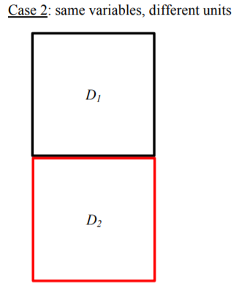
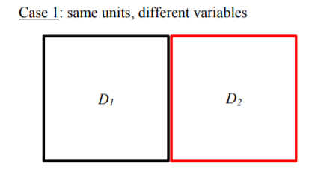
Working definition of “data integration”
STATISTICS
“A statistical activity on two or more datasets resulting in a single enlarged and/or higher quality dataset”

Slide 5
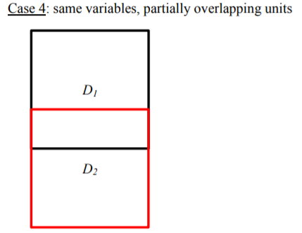
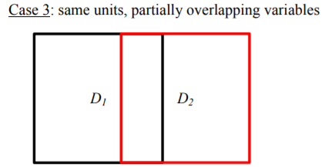
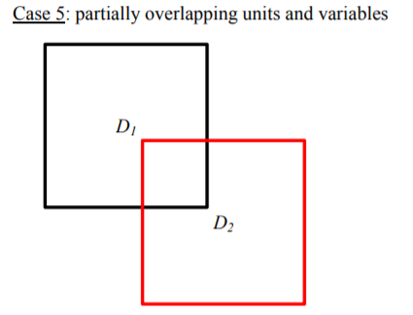
Other cases: calibration to external sources,
mirror statistics
D2
(Pop. Register, external source…)
D1
(Survey)
5

Slide 6
Survey on data integration practices
STATISTICS
1/11

Slide 7
Case studies – main outcomes (1/3)
STATISTICS
In countries with a population register, this is often (but not always) the main source of migration data
  data integration is carried out to:
    improve data quality
    adjust for missing de-registrations of emigrants
    identify deceased persons
    provide additional information on variables not included in primary sources
  practices based on ‘presence signals’ (or ‘signs of life’) of individuals

Slide 8
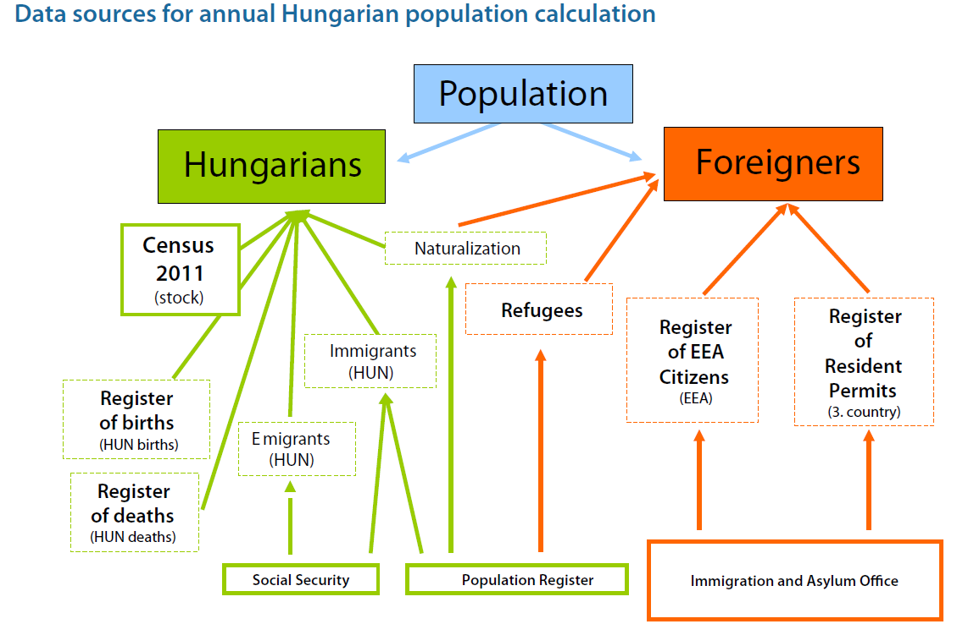
Case studies – main outcomes (2/3)
STATISTICS
In some countries, the population register is one of several sources, but not the most important

Slide 9
Case studies – main outcomes (3/3)
STATISTICS
In countries without a population register
  sources of migration data include:
    data on passports, visas and stay permits
    passenger cards filled at borders
  data integration is carried out to:
    improve data quality
    adjust for missing de-registrations of emigrants
    identify deceased persons
    provide additional information on variables not included in primary sources
    → improve information on actual place and date of settlement of immigrants

Slide 10
Metadata
STATISTICS
Comprehensive metadata are necessary to assess the comparability of migration data produced by different countries
Three main types of metadata:
  Metadata specific to each data source, describing main features and how data are transformed before integration
  Metadata for each step of data integration (i.e., for each pair of data sets being integrated)
  Quantitative measures of data quality, to assess the effects of data integration

Slide 11
Recommendations
STATISTICS
Improve access to administrative data for national statistical offices
Use administrative data for migration statistics
Combine data from different sources using ‘presence signals’
Pay attention to the quality of integrated data
Be transparent about data integration methods used and develop standards
Promote international comparison and exchange of migration data

Slide 12
STATISTICS
Thank you!

