Slide 1
Open-source licenses
Carlo Vaccari - June 2024

Slide 2

(pre)history
from the letter of T. Jefferson to Isaac McPherson (1813)
He who receives an idea from me, receives instruction himself without lessening mine; as he who lights his taper at mine, receives light without darkening me. That ideas should freely spread from one to another over the globe, for the moral and mutual instruction of man, and improvement of his condition, seems to have been peculiarly and benevolently designed by nature, when she made them, like fire, expansible over all space ... and like the air ... incapable of confinement or exclusive appropriation.

Slide 3
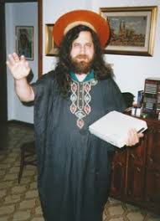
Stallman
once upon a time all software was “open” and “free”
rms at MIT in the first '80s collides with the first closed systems (PDP and Xerox)
1983: out from MIT, launches GNU (Gnu's Not Unix) – developments starts with developing tools like Emacs e gcc
1985: rms founds the Free Software Foundation
1989: GPL General Public License → copyleft
Note: free software, free as in freedom, not free as a beer!

Slide 4

linux
In 1991, Linus Torvalds, a Finnish student launches an application on a newsgroup for the development of an open operating system
Linus started one of the largest collective process of development with thousands of programmers around the world
GNU tools are used to develop Linux (GNU / Linux)
Today linux kernel is still maintained by Linus, with many distributions (Android, RedHat, Ubuntu,…), different "packaging" of the kernel

Slide 5
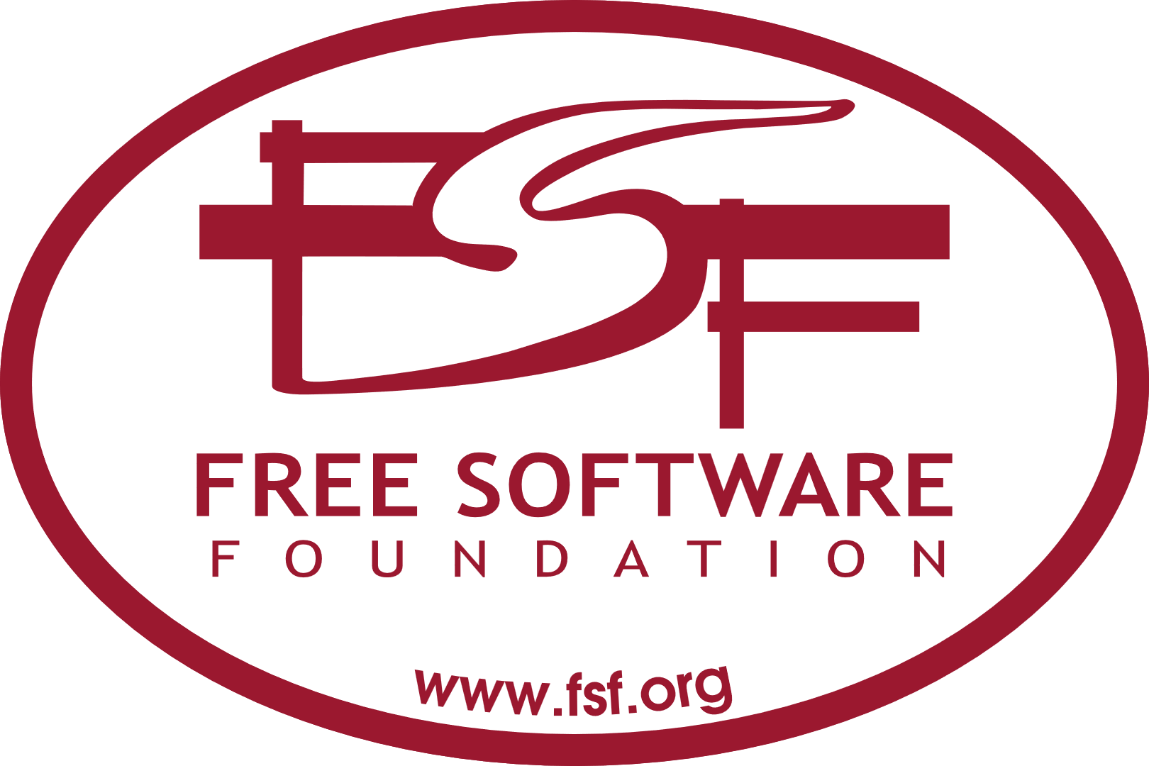
free software according to the fsf
Freedom 0: The freedom to run the program, for any purpose
Freedom 1: The freedom to study how the program works, and change it so it does your computing as you wish. Access to the source code is a precondition for this
Freedom 2: The freedom to redistribute copies so you can help your neighbor.
Freedom 3: The freedom to distribute copies of your modified versions to others. By doing this you can give the whole community a chance to benefit from your changes. Access to the source code is a precondition for this.
from fsf

Slide 6

Copyright and licenses
In the U.S. and many countries, copyright is automatically granted for any creative work you produce. Copyright is defined “a type of intellectual property that protects original works of authorship”. Copyrighting your work does not require a formal process to ensure these rights are given.
Copyright grants the owner various rights, such as reproducing and distributing copies of the work. If an owner wants control over how their work can be used by others, then they must implement a license that outlines the rules by which those users must abide. If the copyright owner states the work is “All Rights Reserved”, this means that their work cannot be used or modified by anyone at all.

Slide 7

Proprietary software
Proprietary software is any software with a license that restricts how it can be used, modified, or shared. Video games are a common example of proprietary software. If you purchase a video game, you aren’t allowed to make a copy of that game to share or sell. Likely you aren’t permitted to modify the code to run it on a different platform.
If you’ve purchased proprietary software, it will likely come with a end-user license agreement (EULA) that specifies you do not own the software. Instead, you own a software license that permits you to use that software. EULAs also define how you can use the license itself, and they typically limit you from sharing it with others without the permission of the software owner.

Slide 8

Free and Open-source
Two distinct movements: the free software and open-source software movements. Both argue that software users should be allowed to access a program’s source code, modify it and share it.
Free software is generally considered to be open source, but open-source software is not always considered to be free. But for example CSPro is free but is not open (source code not available) and RedHat Linux is open but not free (as a beer).
We use the terms “open-source software”; if you are interested in detailed distinction, read The Difference Between Free and Open-Source Software.

Slide 9

Open-source
1988: Open Source Initiative (OSI - Raymond) defines “open source”:
Free redistribution (for free or not)
Freedom to consult the source code
Derived works approved
Integrity of the author's source code
No discrimination against persons or groups
No discrimination against fields of application
The license must be distributed (no additional license)
The license may not be specific to a product
The license must not restrict other software
The license must be technology neutral

Slide 10
Open-source licenses
OSI maintains a list of Approved Open-source licenses, licenses that comply with the Open Source Definition
In brief, they allow software to be freely used, modified, and shared. To be approved by the Open Source Initiative (also known as the OSI) a license must go through the Open Source Initiative’s license review process.

Slide 11

Permissive and copyleft
A permissive license grants users permission to use, modify, and share the source code, but users also have the option to change some of the terms for redistribution, including derivative work. In the context of software, a derivative work is a piece of software that is based on an existing program. If the original was released under a permissive license, a creator can choose to share their derivative work with a different license.
A copyleft license, also grants users permission to use, modify, and share the source code, but offers protection against relicensing through specific restrictions. This means that software users creating derivative work are required to release under the same copyleft license of the original work. With copyleft users will have the same rights and permissions when using works derived from the original software.

Slide 12


Permissive licenses
Permissive licenses grant software users permission to use, modify, and share the source code. Additionally, creators of software derived from permissively licensed software can change the licensing conditions for redistribution.
Apache License, written by the Apache Software Foundation (ASF). With this license, users do not have to share their modified version of the source code under the same license and can choose to use a different one, this is known as sub-licensing.
Many important tools for Web and Big Data (Hadoop)
MIT License, from the Massachusetts Institute of Technology (MIT) and is one of the shortest to read with few restrictions. Similar to the Apache license, it also gives users the option to sublicense the software.
Others like BSD (FreeBSD), Boost

Slide 13

Copyleft licenses
Copyleft licenses grant software users permission to use, modify, and share the source code, but also protect against relicensing through specific restrictions and terms and conditions. Called “viral” licenses.
Copy-left:
Right – Left
Past / past participle of “leave” – allowed,
GNU Licenses
Different versions of the GNU General Public License (GPL) released by the Free Software Foundation.
GPL v1 (1989): GPLv1 focused on protecting user freedoms and safeguarding against potential threats posed by proprietary software. Its core principle emphasizes that users should retain the ability to run, modify, examine, and redistribute the program's source code.

Slide 14
Copyleft licenses
GPL v2 (1991) GPLv2 expanded upon the ideas presented in GPLv1 while resolving ambiguities and incorporating essential concepts necessary for broader adoption. This license a strong copyleft license: it requires that any modifications to the source code get released using the same license. GPLv2 includes a clause that prevents distributors from adding their own restriction to the software
The GPL v3 (2007) requires users to state any modifications to the original code and to provide original code when distributing any binaries. This version also made it easier to work with other licenses such as Apache. In addition protect from Tivoization (hardware “locked” that prevents modified software to run).

Slide 15
Copyleft licenses
LGPL - There is also the GNU Lesser General Public License. This license is meant to serve as a middle-ground between strong and weak copyleft licenses. The main difference with this license is that software users can combine a software component of the LGPL with their own and are not required to share the source code of their own components. Users can also distribute a hybrid library, which is a combination of functions in the LGPL library and functions from a non-LGPL, but there must be a copy of that non-LGPL library and information on where it’s located.
Mozilla Public License (MPL), from the Mozilla Foundation, is considered a weak copyleft license. This license is file-based copyleft, which means code can be combined with open-source or proprietary code.

Slide 16
Copyleft licenses
EUPL (European Union Public License) is designed to promote the use and distribution of open-source software within the legal framework of the European Union. Its key characteristics:
Compatibility with other licenses like GPLv2, facilitates integration with other open-source projects.
Copyleft Nature: Ensures derivative works remain open-source.
Jurisdictional Flexibility: Valid across EU member states with translations in all official EU languages
Patent Clauses: protects users/developers from patent litigation.
Source Code Availability: Ensures access to the source code.
The EUPL's adaptability and compatibility with other licenses make it a robust choice for European open-source projects, fostering legal certainty and collaboration within the open-source community

Slide 17

Compatibility among licenses
Compatibility between open-source licenses determines whether code released under one license can be combined with code governed by a second license within the same project or product.
GPL and LGPL: Both the GNU General Public License (GPL) and Lesser General Public License (LGPL) belong to the same license family, and thus offer high compatibility. Code released under GPL can incorporate LGPL-licensed elements, given that the resulting combination complies with GPL obligations
MIT and Apache License 2.0: Permissive licenses like MIT and Apache License 2.0 generally exhibit broad compatibility due to their minimalistic nature.
BSD-derived licenses: Similar to MIT and Apache License 2.0, BSD-family licenses tend to display excellent compatibility with other permissive licenses. Merging code covered by BSD-style licenses with MIT, Apache License 2.0, or other similarly unrestrictive licenses rarely raises compatibility concerns.

Slide 18
Compatibility among licenses
GPL vs. permissive licenses: Generally speaking, combining code governed by GPL and permissive licenses (MIT, Apache License 2.0, etc.) introduces complications concerning the overall license governing the final merged work. Permissively licensed code can easily integrate with GPL-licensed code, but the reverse isn't true without potentially compromising the permissiveness of the originally licensed code.
Understanding the nuances of open-source license compatibility enables developers and teams to combine existing solutions effectively and build successful, legally sound projects. Before merging code with different licenses, thoroughly review the relevant guidelines to ensure compatibility and prevent possible infringement disputes.

