Slide 1
Maturity Models for
Official Statistics
Steven Vale, UNECE

Slide 2
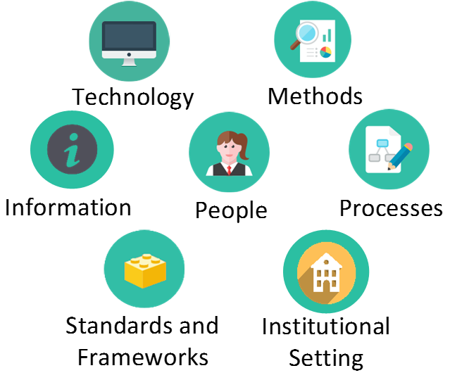

Starting Point: Capabilities
= The ability to
do something

Slide 3
Example
Seasonal adjustment requires:
  People, methods, processes, technology, standards and information (i.e. data!)
  In the context of the organisational setting (legislation, policy, etc.)
If we only address one of these dimensions, e.g. training people, or providing software, this will not ensure that an organisation has the capability to do seasonal adjustment!

Slide 4
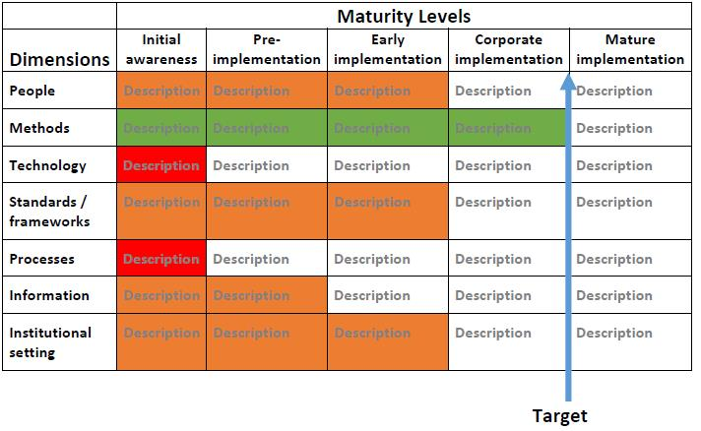
Maturity Models
For each capability, assess where you are now, and where you want to be

Slide 5



Maturity Models
Focus capacity development where it is most needed

Slide 6
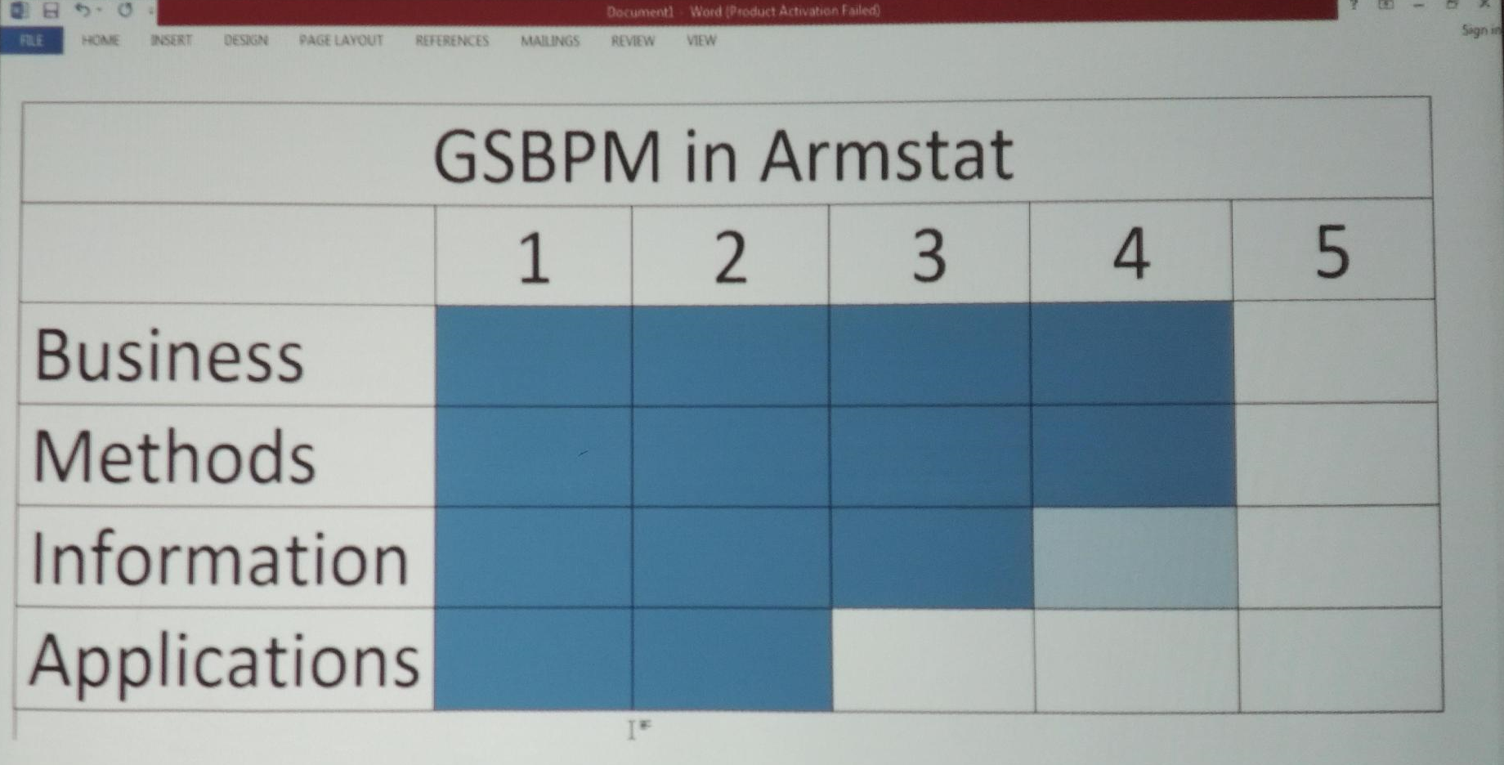
Maturity Models in Practice

Slide 7
More Information
UNECE Statistical Capacity Development Strategy
  https://unece.org/sites/default/files/2020-11/Statistical%20capacity%20development%20strategy%20final.pdf
Modernisation Maturity Models (GSBPM, GAMSO, etc.)
  https://statswiki.unece.org/pages/viewpage.action?pageId=129172266
Risk Management Maturity Model
  https://statswiki.unece.org/display/GORM/Chapter+8%3A+Risk+management+maturity+model
Data Stewardship Maturity Model
  In preparation

