Slide 1


Input Privacy-Preservation Techniques Project
Presented at 2022 Workshop on the Modernisation of Official Statistics
Dennis Ramondt - UNECE Project Manager

Slide 2
The work of the following people:
in collaboration with members of the UN-petlab
Fabio Ricciato | Eurostat | Ralph Schreijen | Statistics Netherlands
Konstantinos Giannakouris | Eurostat | Eric Deeben | ONS, UK
Luis Clemente | INEGI, Mexico | Dang Trung Nam | GSO, Vietnam
Fabrizio De Fausti | Istat, Italy | Benjamin Santos | Statistics Canada
Massimo De Cubellis | Istat, Italy | Taeke Gjaltema | UNECE
Mauro Bruno | Istat, Italy | Wai Kit | UNECE
Monica Scannapieco | Istat, Italy | Priscila Marentes | INEGI, Mexico
Abel Dasylva | Statistics Canada | Daniel Owen | ONS, UK
Robert McLellan | Statistics Canada | Mat Weldon | ONS, UK
Philippe Gagné | Statistics Canada | Julian Templeton | Statistics Canada
Saeid Molladavoudi | Statistics Canada | Dennis Ramondt | UNECE
Matjaz Jug | Statistics Netherlands
Notes:
Modern statistical organizations are more and more investing on becoming part of a data ecosystem where they acquire and integrate data from multiple sources and provide richer statistical products. Such sources can be rather consolidated like administrative sources or more recent like Big Data sources.
In this scenario, the issue of privacy preservation is particularly relevant: the more sources are acquired and integrated, the higher are the risks of disclosing information violating individual privacy rights. Hence, from a legislative perspective there are indications to take privacy into account throughout the whole data treatment process, through the privacy by design’ concept.
National Statistical Organizations (NSOs) are used to apply techniques for enforcing privacy by design on the output side, i.e. when publishing aggregated statistical data for dissemination purposes and when sharing microdata for research purposes. Statistical disclosure control (SDC) techniques as well as centers for remote microdata access are capabilities that are present in most NSOs.
See e.g. GDPR (General Data Protection Regulation), EU regulation 2016/679, where Article 25 is about “Data protection by design and by default”

Slide 3
Outline
Input privacy
Recap results 2021
Track 1, Private set intersection
Track 2, Private machine learning
Track 3, organize public consultation
Closing words
Notes:
Modern statistical organizations are more and more investing on becoming part of a data ecosystem where they acquire and integrate data from multiple sources and provide richer statistical products. Such sources can be rather consolidated like administrative sources or more recent like Big Data sources.
In this scenario, the issue of privacy preservation is particularly relevant: the more sources are acquired and integrated, the higher are the risks of disclosing information violating individual privacy rights. Hence, from a legislative perspective there are indications to take privacy into account throughout the whole data treatment process, through the privacy by design’ concept.
National Statistical Organizations (NSOs) are used to apply techniques for enforcing privacy by design on the output side, i.e. when publishing aggregated statistical data for dissemination purposes and when sharing microdata for research purposes. Statistical disclosure control (SDC) techniques as well as centers for remote microdata access are capabilities that are present in most NSOs.
See e.g. GDPR (General Data Protection Regulation), EU regulation 2016/679, where Article 25 is about “Data protection by design and by default”

Slide 4
The Balancing Act
We continually play the game of balancing data usability and security:
PPTs do not solve the balancing act of security, privacy and data use in and of themselves, but offer risk mitigation that may be the difference between a project no-go and go.
Security & Privacy
Value Creation from Statistical Inference

Slide 5
Input & Output Privacy
A function takes in some input (from one or more parties) and produces some outputs (given to one or
more parties).
f

Slide 6
Input Privacy Approaches
Input privacy focuses on how to ensure privacy of inputs of one or more parties entering a joint function.
101010100101010101001010101011100101010010
Trusted Third Party
Secure Enclave
Encryption

Slide 7
Output Privacy Approaches
Output privacy typically relies on:
Aggregation & sensitivity analysis
(classic data disclosure controls)
Perturbation
(for example differential privacy)
Both endeavour to prevent reverse engineerability of the original data.
f

Slide 8
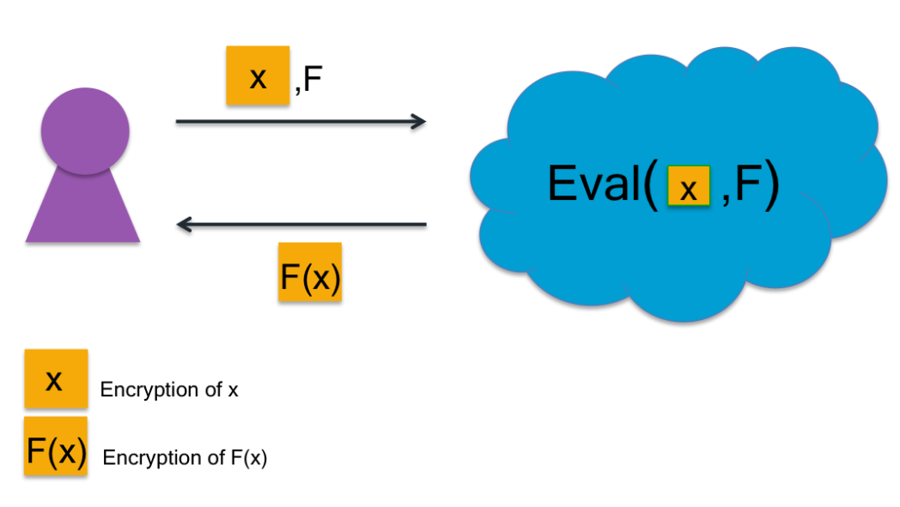
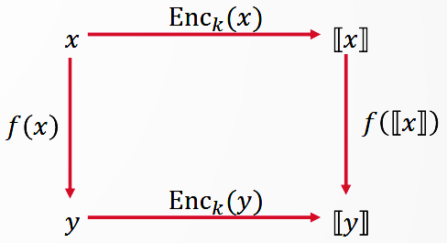
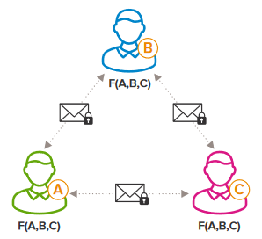
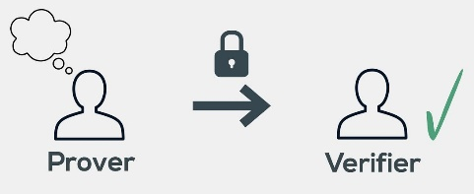
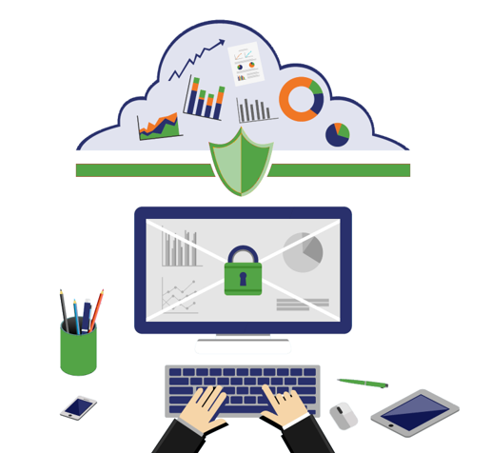
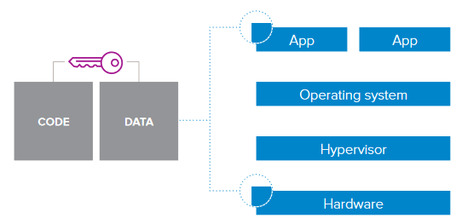
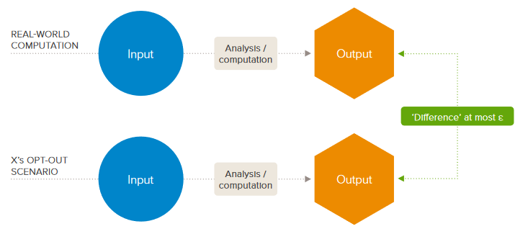
Privacy-Preserving Technologies
Homomorphic Encryption
Secure Multiparty Computation
Differential Privacy
Trusted Execution Environment
Zero-knowledge Proofs
Pictures: Privacy Preserving Technologies Report, Royal Society, 2019.

Slide 9
Highlights 2021
Framework for describing use cases for Input privacy-preservation
Documented 5 use cases
Described 2 generic scenario's
Notes:
Modern statistical organizations are more and more investing on becoming part of a data ecosystem where they acquire and integrate data from multiple sources and provide richer statistical products. Such sources can be rather consolidated like administrative sources or more recent like Big Data sources.
In this scenario, the issue of privacy preservation is particularly relevant: the more sources are acquired and integrated, the higher are the risks of disclosing information violating individual privacy rights. Hence, from a legislative perspective there are indications to take privacy into account throughout the whole data treatment process, through the privacy by design’ concept.
National Statistical Organizations (NSOs) are used to apply techniques for enforcing privacy by design on the output side, i.e. when publishing aggregated statistical data for dissemination purposes and when sharing microdata for research purposes. Statistical disclosure control (SDC) techniques as well as centers for remote microdata access are capabilities that are present in most NSOs.
See e.g. GDPR (General Data Protection Regulation), EU regulation 2016/679, where Article 25 is about “Data protection by design and by default”

Slide 10
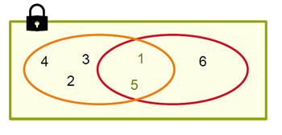


Private set intersection
Encrypted environment
Micro-data import transactions
Micro-data export transactions
X
Y
Import data
Export data

Slide 11
International trade use case (PSI)
A PSI use case between two NSIs
Match international trade micro-data at the transaction level without a unique identifier
  Export data from a 1st NSI,
  More detailed import data, from a 2nd NSI.
A total or a mean is computed based on the matching result.

Slide 12
International trade use case (cont’d)
Benefits
  Study the use of trade agreements, e.g. Canada-EU Trade Agreement (CETA).
  Resolve bilateral trade-asymmetries, e.g. imports into A from B reported by A differing from exports from B to A reported by B.

Slide 13
Private machine learning
Experiment with more complex models and other distributed data related to members of HLG-MOS
Incorporate Secure Multi-party Computation for secure aggregation of weights during training, as well as inference
Integrate Differential Privacy as part of the protocol to protect output privacy
analyze the impact of PETs when used to protect the machine learning model
Pilot:
NSO offer PET based remote analytics service

Slide 14
Organize public consultation
  Open technical consultation on:
  Towards a trustworthy Multi-Party Secure Private Computing-as-a-service infrastructure for official statistics
The consultation is mainly targeted at:
Privacy and security experts from both the technical and legal sides.
Potential users of the envisioned MPSPC infrastructure, including but not limited to statistical authorities, public bodies and private companies.
Digital activists and representative of civil society (e.g., citizen associations).
Researchers and developers in relevant fields.
Notes:
Key challenge: how to build trust into the infrastructure? • This is the main challenge. • Complex answer, as intermingles technological and nontechnological aspects. • Idea: ask the question to experts from various domains, via a public consultation (informal, technical) • Public consultation as a way to pull expert knowledge • to identify possible strategies to cope with known challenges • to identify additional challenges and critical points • Side benefit: probe general interest for SPC-as-a-service model

Slide 15
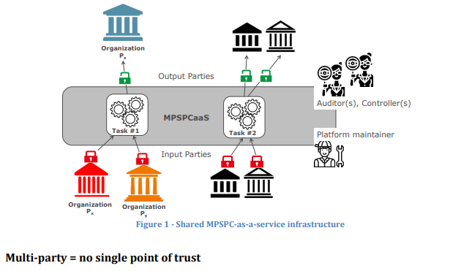
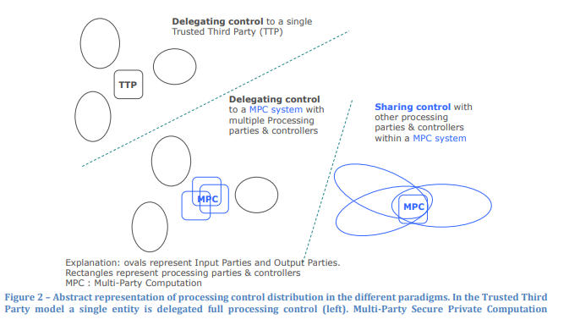
Organize public consultation

Slide 16
Possible application areas for NSOs
Advanced Data Collection: access to (private) data sources with privacy-related barriers
Datahubs: providing data analytics environment for data with privacy-related barriers (NSO provides service and data)
Data ecosystems: enabling data collaboration in privacy-preserving data networks and alliances (NSO provides data but not service)

Slide 17
Next steps (in and after the project)
Final report with reports of the different tracks
Public wiki with the reports
Community of practitioners, continued through the UN petlab
Results of the technical consultation

Slide 18
Workshop Input privacy-preservation project
24 November 2022
Time
14:00-14:15 | Introduction to the project
14:15-15:00 | Private Set Intersection
15:00-15:45 | Private machine learning
15:45-16:30 | Multi party private computing-as-a-service
16:30-17:00 | Project conclusions
17:00 | Closing Seminar

Slide 19
Q & A

