Slide 1

Supporting Standards Group
on behalf of our Modernisation Group:
Zoltán Vereczkei (chair)
Workshop on the Modernisation of Official Statistics
22-24 November 2022, Geneva

Slide 2
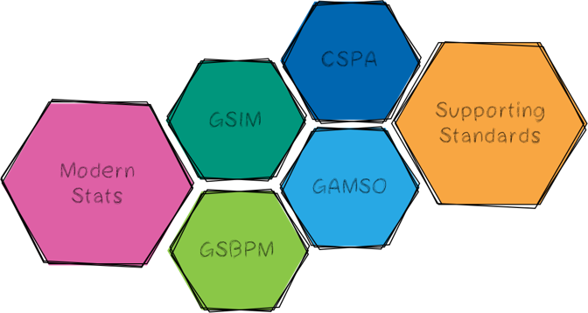
Supporting Standards Group: our mission
Find ways how to
  develop,
  enhance,
  integrate,
  promote,
  support and
  facilitate the implementation of
  a range of standards needed for statistical modernisation.
Operational responsibility for the maintenance and development of the ModernStats standards.

Slide 3
Where to find us?
Information on the Supporting Standards Group on the HLG-MOS Modernisation Group page
Information on the ModernStats models:
  Generic Statistical Business Process Model (GSBPM)
  Generic Statistical Information Model (GSIM)
  Generic Activity Model for Statistical Organizations (GAMSO)
  Core Ontology for Official Statistics (COOS)
  Common Statistical Production Architecture (CSPA)
  Common Statistical Data Architecture (CSDA)
Information on our ModernStats World Workshops, including interesting country examples. Latest (2022) material here.

Slide 4
Members
Dedicated experts from NSOs and international statistical organisations.
Member | Country/ Organisation
Andrea Petres | Hungary
Anna Długosz | Poland
Carlo Vaccari | Italy
Cory Chobanik | Canada
Daniel Blanc | Uruguay
Daniel Gillman | USA
David Barraclough | OECD
Edgardo Greising | ILO
Essi Kaukonen | Finland
Member | Country/ Organisation
Federico Segui | Uruguay
Flavio Rizzolo | Canada/DDI
Florian Vucko | France
Franck Cotton | France
Helda Mitre | Albania
InKyung Choi | UNECE
José Lujan | Mexico
Janusz Dygaszewicz | Poland
Juan Muñoz | Mexico
Member | Country/ Organisation
Juan Rioja | Mexico
Kevin McCormack | Ireland
Manuel Cuéllar-Río | Mexico
Mauro Bruno | Italy
Martina Hahn | Eurostat
Matjaz Jug | Netherlands
Omurbek Ibraev | Kyrgyzstan
Waleed Mohamed | Egypt
Zoltán Vereczkei | Hungary

Slide 5

Network of experts
Our Task Teams in 2022:
GSIM Review Task Team: 9 organisations 16 people
Core Ontology for Official Statistics phase 2: 10 organisations 16 people
GSBPM Tasks Task Team: 11 organisations 18 people
GSBPM / SDMX / DDI Task Team: 11 organisations 15 people
GSBPM overarching processes
CSPA capacity building
Our workshop in 2022:
ModernStats World Workshop 2022: 54 people

Slide 6
Overview of 2022 activities/results
GSIM Review
To be completed in 2023.
Take a look at what we are doing at our Github.
Core Ontology for Official Statistics phase 2
Important milestone by the end of the year.
Material available here (under public review)
Task Teams
GSBPM Tasks
Completed, available here.
GSBPM / SDMX / DDI
To be completed in 2023.
Group
ModernStats World Workshop 2022
Completed, available here.
GSBPM overarching processes
Incorporated into our 2023 programme
TBD
CSPA capacity building
Different approach in 2023

Slide 7
GSIM Review Task Team
Context
The Generic Statistical Information Model (GSIM) provides a catalog of standardised information classes to describe statistical data and metadata.
GSIM is a conceptual model that serves multiple purposes:
  Facilitate business discussions by providing a “lingua franca” for describing statistical information
  Provide high-level, abstract information entities that can be realised in practice with implementation standards, e.g. SDMX, DDI, etc.
  Provide a common vocabulary to describe inputs and outputs of process, activity, service and capability statistical models, i.e. GSBPM, GAMSO, CSPA, CSDA, respectively.
Over the past three years a large body of issues has been compiled on several fronts:
  Output of the Metadata Glossary activity
  Synergy with the Core Ontology for Official Statistics (COOS) and the Linking GSBPM and GSIM activities
  Ongoing GSIM revision/review activity and consultation

Slide 8
GSIM Review Task Team
Progress
Main progress areas
  Process Design: remodeling of input specification with the addition of input-type classes
  Exchange Channel: better separation between specification, implementation and information being exchanged
  Referential Metadata: use case-driven refactoring and testing of the model (e.g. quality indicators)
  Registers: decoupling from Exchange Channels and removed distinction between statistical and administrative from the model
Coverage and terminology
  Created Reference Document class to capture unstructured, supporting documentation (e.g. methodology handbooks, guidelines, policies)
  Renamed controversial “Information Object” term to “Information Class”
  Updated definitions and explanatory texts across the board (in progress)
  Reviewed associations and their cardinalities (in progress)
  Check our results on Github: https://github.com/UNECE/GSIMRevision/

Slide 9
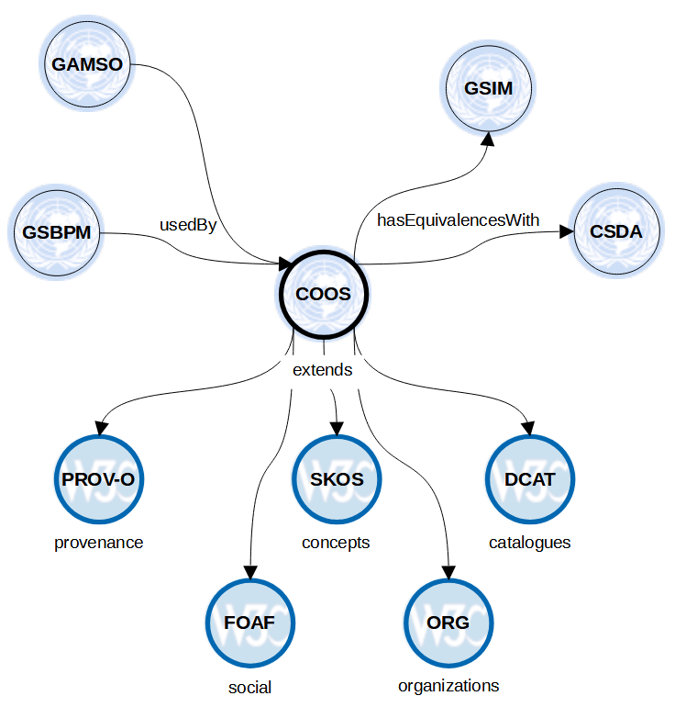
Core Ontology for Official Statistics
Context
COOS as an integration model for the core set of ModernStats standards backed by elements of well-known standard vocabularies.
COOS defines a conceptual integration framework to provide semantic coherence across these models based on a common vocabulary of terms, definitions and a well-defined set of inter- and intra-model relationships formalized in RDF/OWL, using standards vocabularies, e.g. SKOS, PROV, DCAT, DC, ORG, etc.

Slide 10
Core Ontology for Official Statistics
Results
Integration of feedback from expert review
Extension of perimeter with links to CSDA and GSIM
Consolidation of logical structure with ontology expert
Identification of use cases (e.g. statistical compendium)
COOS v1 published and is currently under public review
Check our results on Github: https://linked-statistics.github.io/COOS/coos.html

Slide 11
GSBPM Tasks Task Team
Context
Initiated by the community: prepare a proposal for a finer-level (3rd) coding of the statistical activities described in the GSBPM
Reviewed examples of lists of «lower level» GSBPM tasks from 8 countries: Australia, Azerbaijan, Costa Rica, Norway, Romania, Saudi Arabia, Serbia, Spain
Developed a proposal for the task level for all GSBPM phases and sub-processes under a set of principles (e.g., coding, granularity, minimality, description format)

Slide 12
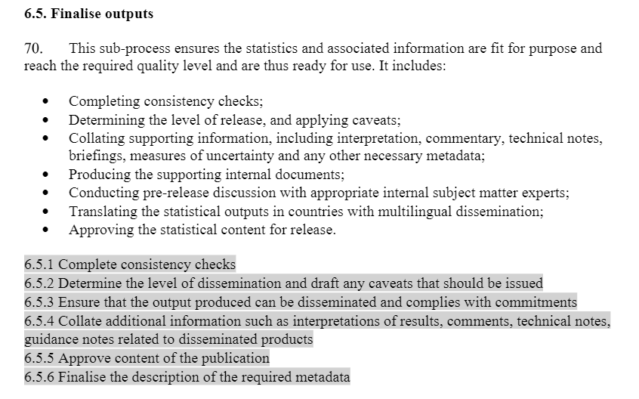
GSBPM Tasks Task Team
Results
GSBPM main document with 3rd level tasks for each sub-process
Excel sheet presenting the proposals of the 8 nations side by side
Word document with examples and trace of the discussions that took place in the group
Input to be taken on board for future work within the Supporting Standards Group: GSBPM revision and also for the clarification of the GSBPM overarching processes
Activity completed in August 2022
Example for GSBPM sub-process 6.5
Check our results on the wiki: https://statswiki.unece.org/display/GSBPM/GSBPM+Tasks

Slide 13




GSBPM / SDMX / DDI Task Team
Context
Statistical Data and Metadata eXchange
Benefits
International / global standards
Free / open
Helps reuse tools and concepts
Increases interoperability
Improves quality
Difficulties
Which standard to use for which use case?
Which artefact to use for which stage of production process?
Technical, people get lost
Data Documentation Initiative
Notes:
SDMX : international standard (ISO 17369:2013) for describing and exchanging data and metadata between organisations
DDI : international standard for describing the data produced by surveys and other observational methods in the social, behavioral, economic, and health sciences

Slide 14
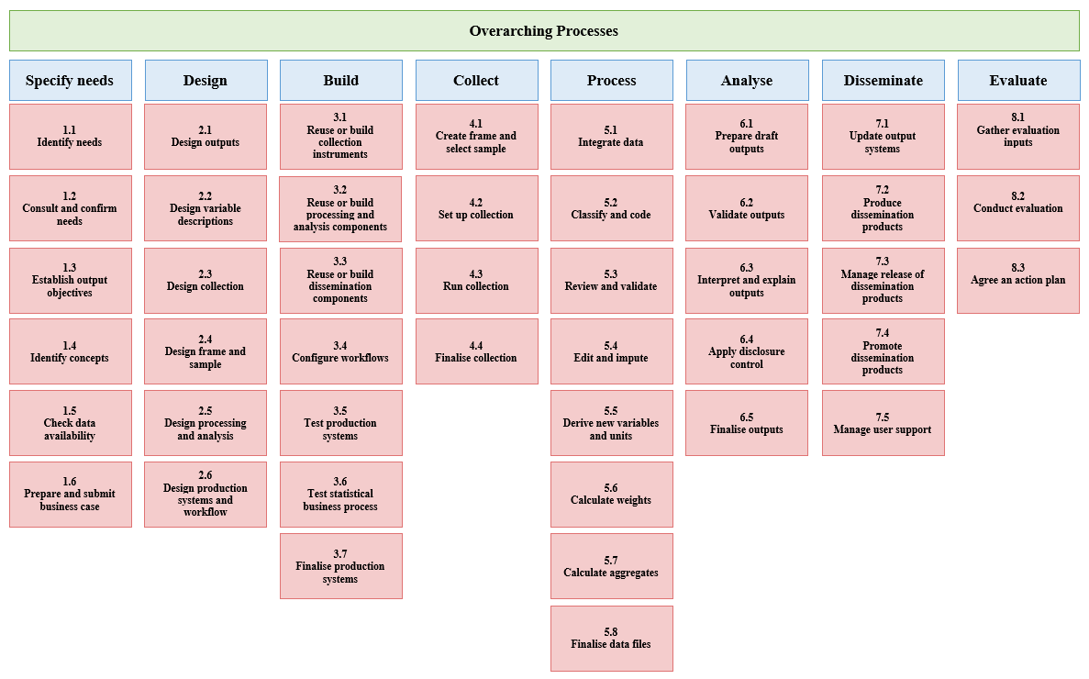

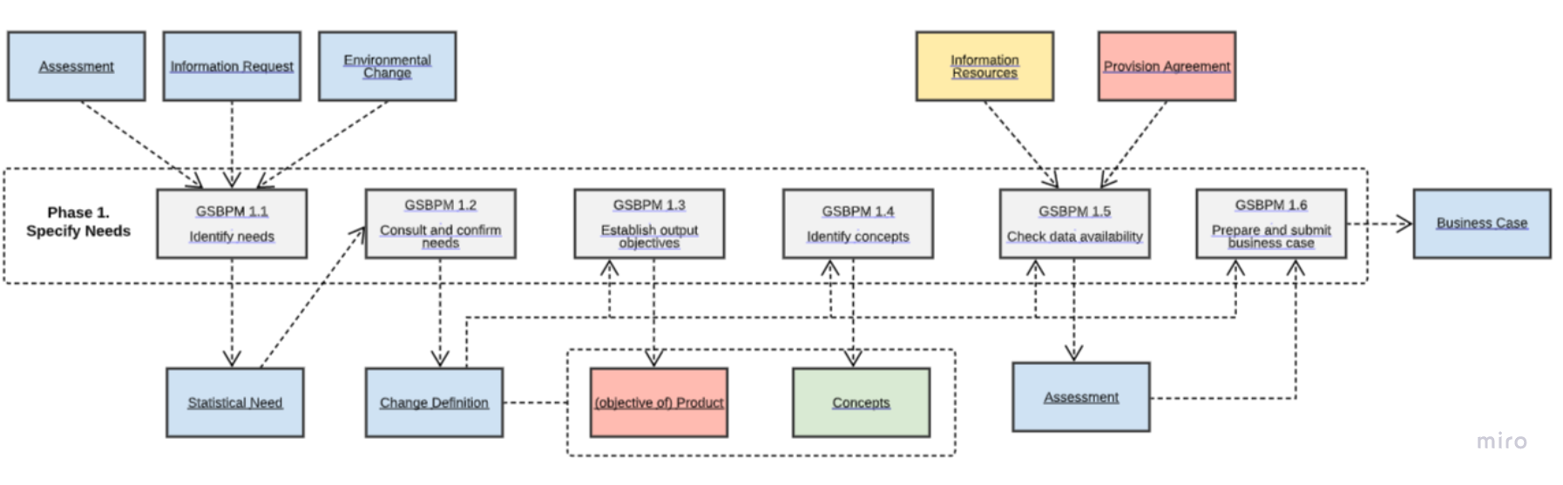
GSBPM / SDMX / DDI Task Team
Context
GSBPM
Provides statistical context
Statistical Data and Metadata eXchange
Provides inputs / outputs that can be mapped to SDMX / DDI artefacts
Linking GSBPM - GSIM
Data Documentation Initiative

Slide 15
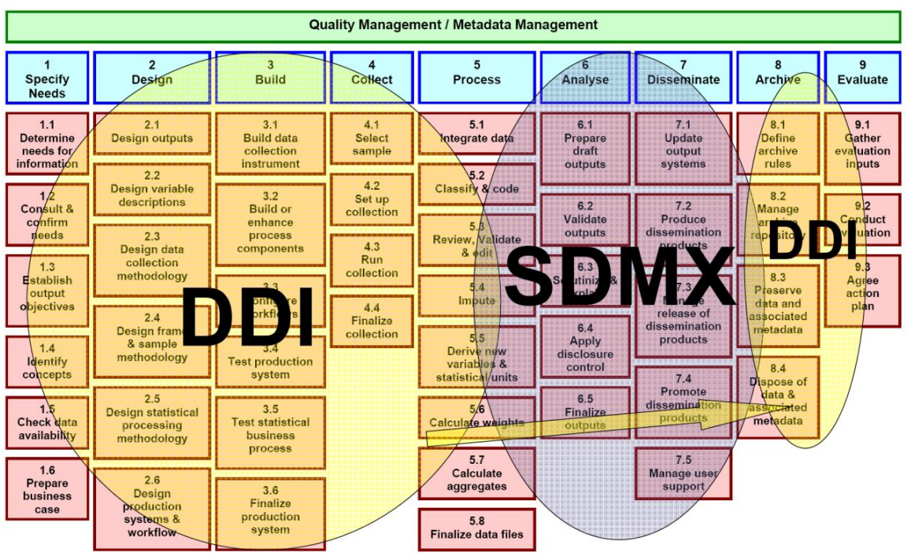
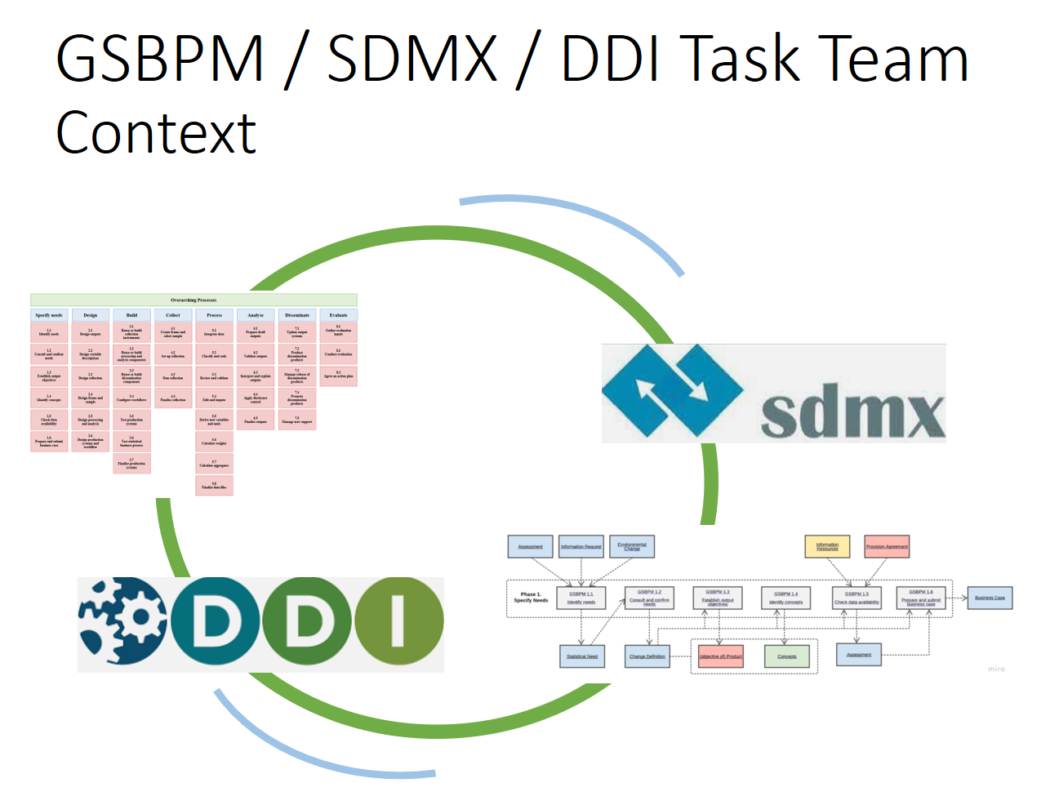
GSBPM / SDMX / DDI Task Team
Evolution
Source: Steven Vale: Exploring the relationship between DDI, SDMX and the
Generic Statistical Business Process Model

Slide 16
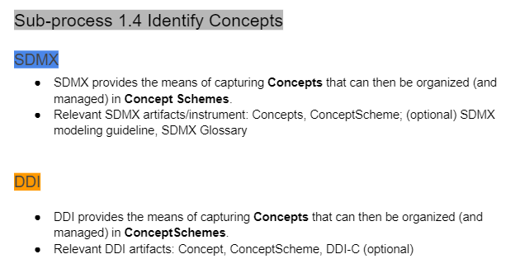
GSBPM / SDMX / DDI Task Team
Progress
Objectives
Provide short description why/how SDMX/DDI helps as an entry point
List relevant SDMX/DDI artefacts under each sub-process
Map relevant SDMX/DDI artefacts under each sub-process to GSIM class
Results and (some preliminary) findings
By using GSBPM as common linkage points, identifies where SDMX and DDI work together, their strengths
With mapping between SDMX and DDI made easier, more chances for interoperability between the two standards
Example for GSBPM sub-process 1.4

Slide 17
ModernStats World Workshop 2022 workshop objectives
To bring together users and the community, focus on the use of the standards, common challenges and the needs of the community.
To provide a platform for the users to exchange experience and lessons learned.
To progress work on development and maintenance of the ModernStats models.
Three focus areas:
  ModernStats implementation
  ModernStats evolution
  ModernStats integration

Slide 18
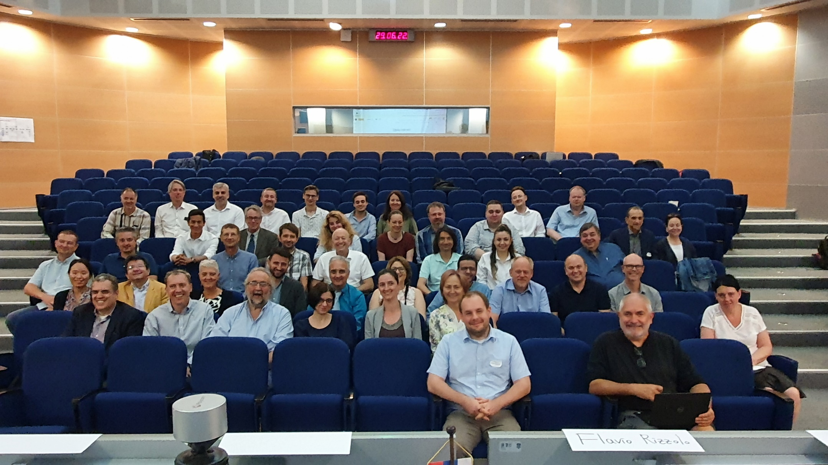
ModernStats World Workshop 2022
Results
Some key lessons learned:
Countries doing similar developments, facing similar issues. ModernStats models can help a lot!
Need to come together to sit down and discuss.
Specific messages to take back to the group and align our 2023 programme accordingly.
Hosted by Statistical Office of the Republic of Serbia in Belgrade from 27 to 29 June 2022.
Meeting material here!

Slide 19
Future directions
Integration of ModernStats standards on a higher level:
  Between our models
  But also the way we work
  Between official statistics and the outside world
Evolution of ModernStats standards: be relevant and stay relevant
ModernStats Community of Practice
Discuss key issues inside our community first & define what is needed!
  Shared services in general and CSPA; but also CSDA
  Common challenges: process modelling, similar developments in countries

Slide 20
Overview of our planned 2023 activities
GSBPM & GAMSO revision
GSIM revision (continuation)
Task Teams
GSBPM / SDMX / DDI (continuation)
Core Ontology for Official Statistics v2
Defining the direction for model development:
Integrated use of the models, issue-driven approach
Group
Involving users, experts (next to workshops):
ModernStats Community of Practice
Improving visibility of ModernStats standards (e.g. ISI 2023)

Slide 21
GSBPM & GAMSO revision
GSBPM and GAMSO will be revised together within the same team.
Excellent opportunity to better integrate the models!
Many key challenges already identified.
User consultation: Q1 2023
Integrate planned GSBPM overarching processes work.
Planned last milestone: CES consultation and adoption: Q2 2024

Slide 22
GSIM revision
Ongoing prioritisation of issues to be addressed in GSIM version “2023” (GSIM v2.0?).
Creation of backlog for future releases/updates (determined in conjunction with COOS work).
Development work to finish end of Q1 2023.
Public review and release Q2-Q3 2023.

Slide 23
GSBPM / SDMX / DDI
Cover all phases of the GSBPM, building on the work already started.
If you know colleagues who are interested in making SDMX/DDI easier via GSBPM (or learning more about SDMX or DDI through lenses of GSBPM!), please pass the information about the Task Team!
Task team: Hungary, Mexico, USA, Canada, France, Netherland, ILO, OECD and UNECE
Activity to finish in 2023.

Slide 24
Core Ontology for Official Statistics v2
COOS as landing and triaging point for more integrated feedback-based evolution process.
Topics not included in first version, for example:
  consistency of product/dataset relationship
  inclusion of support program
  modelling of links between GSIM and GSBPM
More use cases and concrete examples.
Application profile for practical use with other standards.
Timing of the activity (start-finish) still to be decided.

Slide 25
ModernStats Community of Practice
Bring together experts and users.
Discuss topics that the SSG should explore and further develop.
Discuss topics of interest parallel to the revision of the models.
Increase the understanding and the use of ModernStats models within different user groups.
Stay tuned! More information about this later: idea currently being discussed within the Supporting Standards Group.

Slide 26
We need you!
Please consider joining our Task Teams and help us to realise our ambitious work programme!
We need good experts, especially for the GSBPM & GAMSO revision and the GSBPM / SDMX / DDI Task Teams!
Excellent opportunity to add your expertise and take part in the modernisation programme!
Contact us!
  InKyung Choi: choii@un.org
  Zoltán Vereczkei: zoltan.vereczkei@ksh.hu

Slide 27
Acknowledgements
Experts committed to the work of the Supporting Standards Group and the Task Teams.
Chairs of the task teams.
UNECE with very special thanks to InKyung Choi for her invaluable support!
You

Slide 28
Thank you!
https://statswiki.unece.org/display/hlgbas/Modernisation+Groups

