Slide 1



The Modernisation Group on
Capabilities and Communication
Workshop on High-Level Group for the Mondernisation of Official Statistics
22 – 24 November 2022, Geneva, Switzerland

Slide 2
The Modernisation Group on Capabilities and Communication is part of the High-Level Group for the Modernisation of Official Statistics (HLG-MOS) or ModernStats. It continues the work of the Modernisation Group on Developing Organisational Capability. The main focus is on the following activities: Change Management Organisational Frameworks for Collaboration Legal and Licensing Building Competencies Guidelines for Managers including best practice Evaluation including Costs and Benefits Communicating Modernisation For more information about the group and how it works please consult the following document: CapComm Group description.

Slide 3
Anna Borowska co-Chair (Poland)
Maria Hurley - co-Chair (Ireland)
Aeidin Sheppard, Deirdre Harte, Pamela Lafferty (Ireland)
Antonio Ottaiano, Fabrizio Rotundi, Angela Leonetti, Daniela Bonardo, Giulia Peci and Michela Troia (Italy)
Olga Świerkot – Strużewska, Emilia Andrzejczak (Poland)
Margarida Rosa (Portugal)
Tine Pestaj (Slovenia)
Janice Keenan, Janine Warner, Eric Rancourt, Guillaume Maranda, Martin-J Beaulieu and Susie Fortier (Canada)
Jeremy Visschers, Martha Kevers, Niels Blezer, Nardie Crijns and Anna Troost-Peursum (Netherlands)
Andrea Ordaz-Németh (Hungary)
Elsa Dhuli and Vjollca Simoni (Albania)
Rodrigo Nunez (Mexico)
Eran Ropalidis (Israel)
Cathy Bates (Australia)
Lukasz Augustyniak and Colin Stewart (Eurostat)
Ellen Dougherty (USDA)
Tetyana Kolomiyets, Taeke Gjaltema (UNECE Secretariat)

Slide 4


Ethical leadership Task Team
  Business and Data Ethics
  Ethics Surveys
  GAMSO-GSBPM Ethics framework
  Coordination/members CES bureau In-depth review Data Ethics

Slide 5

TASK TEAM ON ETHICAL LEADERSHIP: PEOPLE & BEGINNINGS
The Task Team on Ethical Leadership
started its activity in 2021 as a follow up of the Risk Management Framework and related Guidelines, released in 2017 by the Modernisation Committee on Organisational Framework and Evaluation, under the coordination of the UNECE HLG-MOS;
has been focusing both on ethics management as a key strategy to all processes and activities within an organization, namely “business ethics” (or corporate ethics) and on data ethics;
acknowledges the excellent work carried out by the Task Team, coordinated by CSO Ireland, on mapping and describing a list of “core values to the Fundamental Principles of Official Statistics” that was proposed to the CES Bureau as follow-up of the discussion on “How national statistical systems adhere to the core values of official statistics” at the Plenary Session of the Conference of European Statisticians (CES) held in June 2021.
TASK TEAM MEMBERS
Co-chairs: Fabrizio Rotundi, Italy and Eric Rancourt, Canada
Angela Leonetti, Italy
Elsa Dhuli, Helda Mitre, Alma Kondi, Albania
Martin-J Beaulieu, Susie Fortier, Canada
Simon Whitworth, Alice Toms, UK
Niels Ploug, Denmark
Tine Pestaj, Slovenia
Andrea Ordaz-Németh, Hungary
Samuel Schuetz, Switzerland
Taeke Gjaltema, Tetyana Kolomiyets, UNECE
Among the others, the Task teams goals, approved by the HLG-MOS are:
To identify possible common practices in ethics management;
To define a common vocabulary and give concrete suggestions to support NSOs’ leadership in real-work-type
To provide a reference handbook to figure out how to deal with potential behavioural dilemmas

Slide 6

TASK TEAM ON ETHICAL LEADERSHIP: THE PRELIMINARY POLL
Feb ‘21
Sep ‘21
Jun ‘22
1° survey:
60% resp.
2° survey:
78% resp.
3° survey:
72% resp.
Early in 2021 the task team delivered a short preliminary poll to know how many NSOs had been implementing policies, procedures and programmes on ethics management and how many are interested to be informed about successful ethics management practices
Based on the encouraging results, the Task Team submitted a second survey in September 2021, to collect as much information as possible about the existence of NSO’s practices on Ethics management and Ethical Leadership which may reflect on organisational process (business ethics) and on both statistical production and research (data-ethics).
Then, an additional survey was delivered in 2022 to delve into the suggestions come from the response analysis of the 2021 survey, especially investigating “business ethics”, that is, ethics as a cross-cutting element throughout the organisation and representing a key for a qualitative performance improvement.

Slide 7

TASK TEAM ON ETHICAL LEADERSHIP – 2023 PROPOSALS
The Task Team really considers the expectations expressed by the NSOs in the surveys realized, in order to better define the outputs for 2022 and beyond; the proposals have been included in the Business Case presented to the HLG-MOS.
The main Task Team outputs proposed for 2023 are:
common vocabulary as regard with Ethics management, data ethics, leadership, performances, etc.;
organizational framework grounded on ethics principles;
concrete suggestions (a sort of Reference Handbook, including case studies) to support NSOs’ in real-work-type situations;
collaborative platform and meeting where sharing information, experience and Ethics management practices;
possible specific statements on Ethics in the GAMSO and GSBPM models, to align them with the ethics framework.

Slide 8
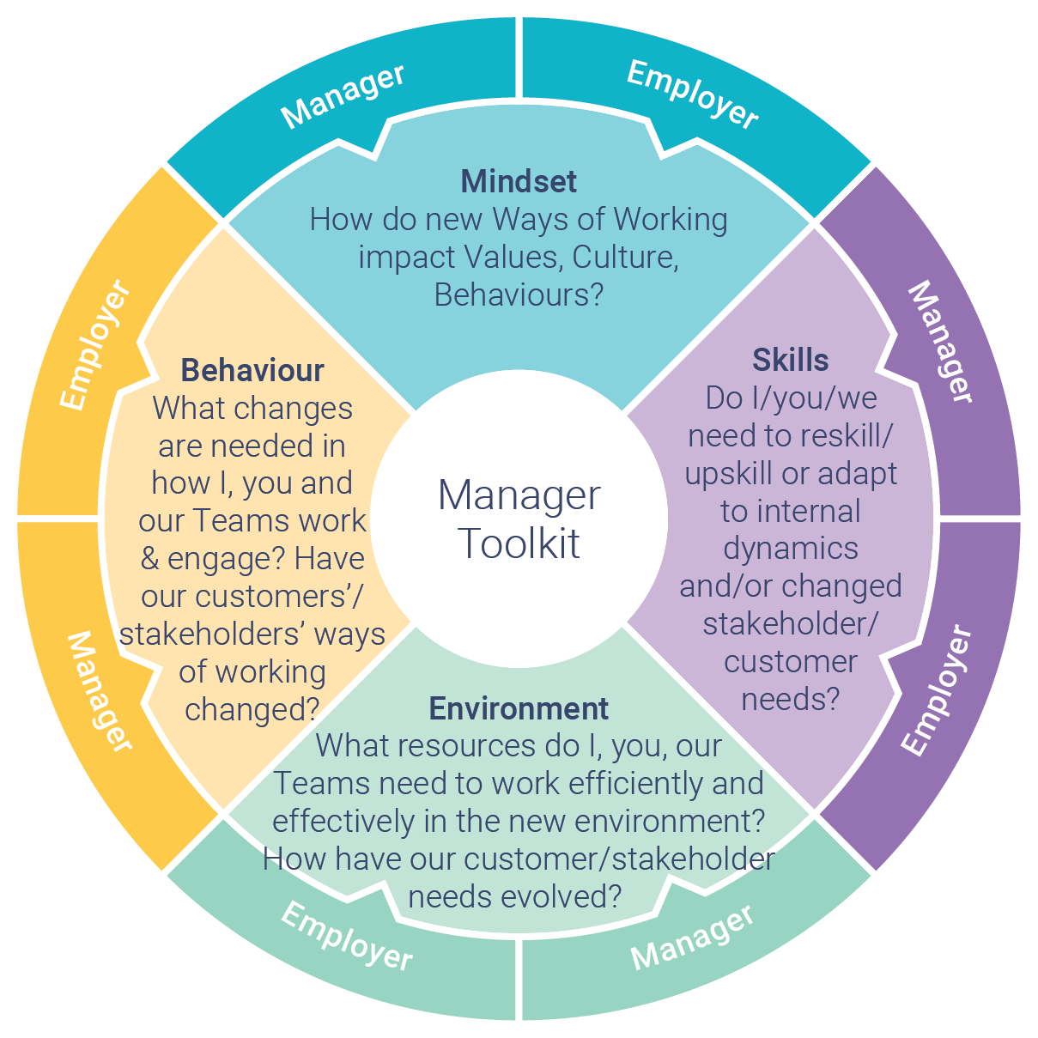
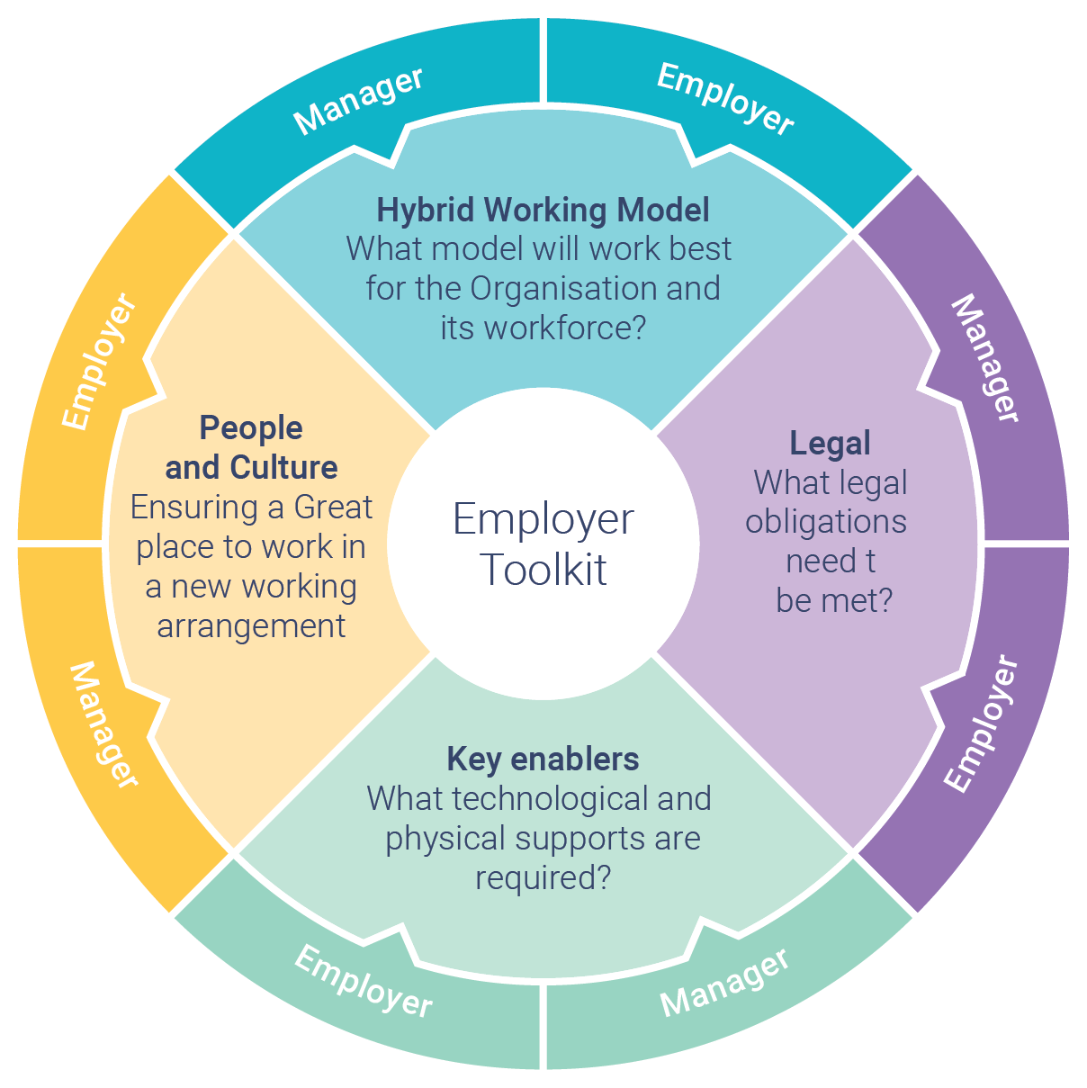
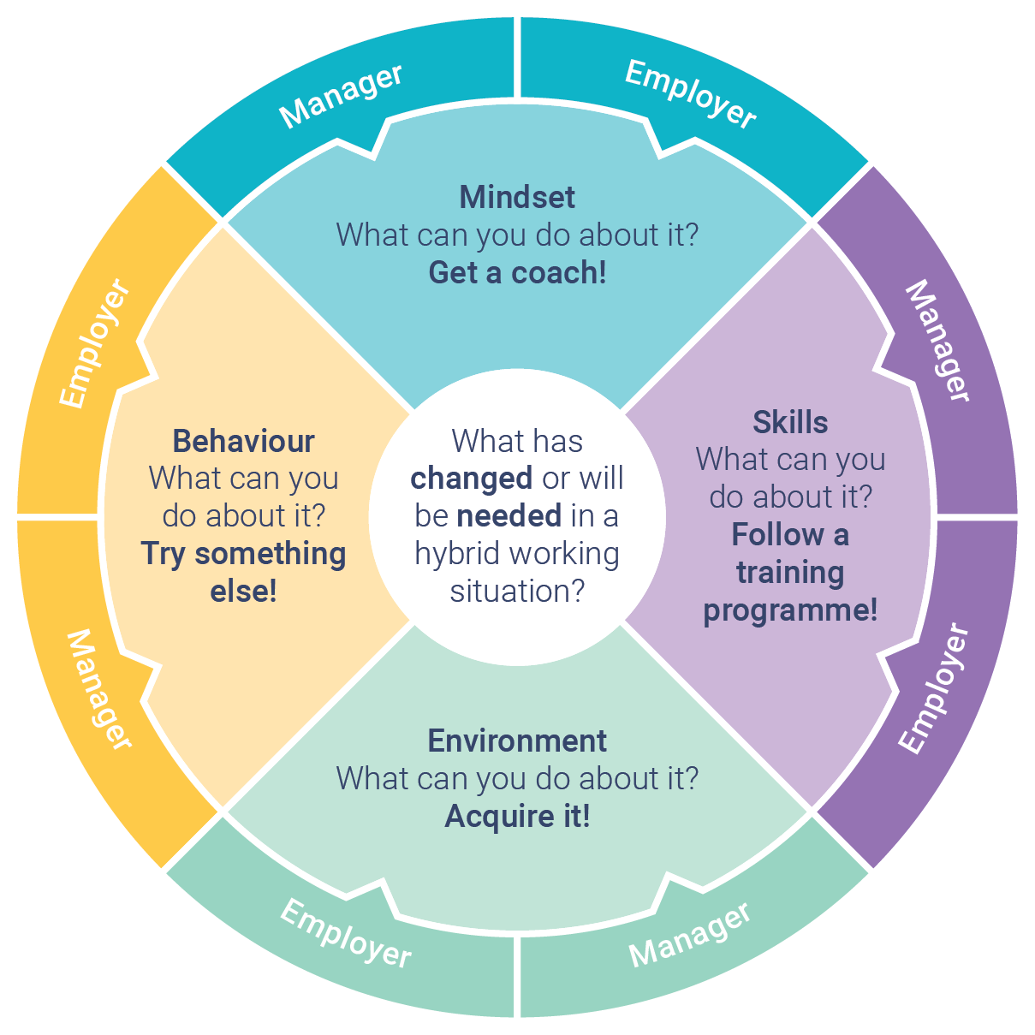
Future of Work Task Team
Future of Work Toolkits
Job of the Future
Reaching Youth:
  Future employees
  Users of official statistics
  Data source for official statistics
Joint Questionnaire
Results you can find on:
https://statswiki.unece.org/pages/viewpage.action?pageId=218890322
and also on the page of the Workshop on Modernisation: https://statswiki.unece.org/display/hlgbas/Timetable+and+Documents+HLG2022

Slide 9
Future of work toolkits
The questionnaire was focused on:
How Blended working is defined and implemented in the different participating countries, and policies around it
Allocation of space or reconfiguration of employer premises to accommodate Blended Working
Wellbeing in Blended Working Environment
Virtual Working Supports and changes to core equipment
How has Learning and Development evolved
What steps have been taken to explored changes needed in Key Work Dimensions due to new model of working
Tremendous diversity in replies (41), but almost all respondent countries either:
  have a policy in place or in development
  comply with a national framework for civil/public service attendance, or
  are actively considering future work arrangements

Slide 10
Future of work toolkits
Diagnosis is the Easy Part!
There are clear areas of challenge emerging for all employers – NSIs aren’t exempt!
Are the FoW Sub-Groups focused on the right challenges?
Where should we prioritise our 2023 efforts?

Slide 11
Job of the Future
Current reflections on the base of the questionnaire:
Generation Z is coming
Different requirements of the workplace
Competitive market for skills
Data science and analytics in every industry
Pace of change
‘The pace of change has never been this fast and yet it will never be this slow again’
Justin Trudeau World Economic Forum 2018
The majority of respondents (26 countries) have arrangements or a policy in place, 6 have no policy/arrangement while 6 countries did not reply; NSI’s took a range of approaches to this, some more mature than others.
19 countries have flexible work practices; project work, cross functional work, agile, autonomous teams
Flexible Working Practices

Slide 12
Job of the Future – where to next?
So where to next? How can NSI’s anticipate and prepare for the job of the future? If the NSI focus is attracting Gen Z, our research would suggest the initial focus should be on implementing D&I policies, work life balance and corporate responsibility. If it is on retention of existing staff our research suggests focussing on stay interviews and flexible working arrangement/practices.
Some countries, like the UK, are beginning to the feel the impact of Generation Z while many have yet to experience it. A list of potential areas of further work for the UN-HLG are outlined below:
Recruitment
Guidance onrecruitment strategies which could be engaged to attract different generations of workers.
Induction
Provide guidelines on how to engage all generations during the induction programme.
Interviews
Offer examples of stay and exit interview questions and guidance on how to use both effectively
Equality, Diversity & Inclusion
Offer guidance on the development of policies/initiatives
Flexibile Work
Develop a maturity model on flexible work practices/arrangements to assist NSI's to develop

Slide 13
Reaching the youths
Why Reaching Youth?
• Duty of NSIs in stimulating data usage and boosting statistical literacy
• Relation between existing communication strategies and non-traditional media sources
• Diversity, shift in need and digital world
• The youth cohort has a low response rate compared to other groups.
Generally generation Y (and beyond) use non-traditional sources, have their own language and are comparatively critical, aware and idealistic. This creates a mismatch with mainstream communication strategies of NSIs
Ergo: youth need to be targeted separately

Slide 14



Objectives Reaching Youth
Future of Work & How do we target youth?
Communication strategy
Target youth as a separate cohort
Custom strategy for youth
Youth as a data user
How do NSIs boost statistical literacy?
What research have NSIs done?
Measurements for effectiveness
Youth as a data source
How do NSIs reach youth?
What approaches or experiments did NSIs explore?
Validation criteria

Slide 15
Market Research, Digital Marketing & Communication strategies Task Team
  Brand and reputation management
  How to Measure success and the impact of our communication
  Strategies to tackle and anticipate disinformation
  Various other topics being considered:
    Establishing strategic objectives and outcomes for communications initiatives
    Understanding the appropriate tools, channels and content for communication campaigns
    Level of resources required to deliver effective communication across multiple platforms
    Developing relevant and effective metrics on impact of communications campaigns
    Value of Official Statistics
    Responsibility to be a trusted voice
    Demands created by the pandemic
    Increasing complexity of communications work
    A resource to share experiences and advice

Slide 16
Market Research, Digital Marketing & Communication strategies Task Team
Outputs
The role of brand management, marketing and crisis communication for Statistical Organizations
Brand development
Marketing Activities
Managing a crisis
Statswiki Resource Page

Slide 17
HRMT Workshop
11 – 13 October 2022, Brussels, Belgium
During the workshop we created common story of our future of work and working for the future addressing the challenge of recruiting, developing and retaining NSO talent in the post-COVID employment market.
Our main focus was on:
WHY we need to reframe NSI Work, People and Workplaces
WHAT we have tried; What we have learned from recent Crisis Response Initiatives
HOW we build NSIs for the future:
  Organisation, Culture & Ethics
  People
  Training & Skills
  WHERE (should we be going) to from here?
We had also a special session for the EFTA partner countries in the afternoon of 13 October
Armenia, Azerbaijan, Georgia, Kazakhstan, Kyrgyzstan, Republic Moldova, Tajikistan, Turkmenistan, Ukraine, Uzbekistan
More information on: Workshop on Human Resource Management and Training - Future of work, Working for the future (11-13 October 2022, Brussels)

Slide 18
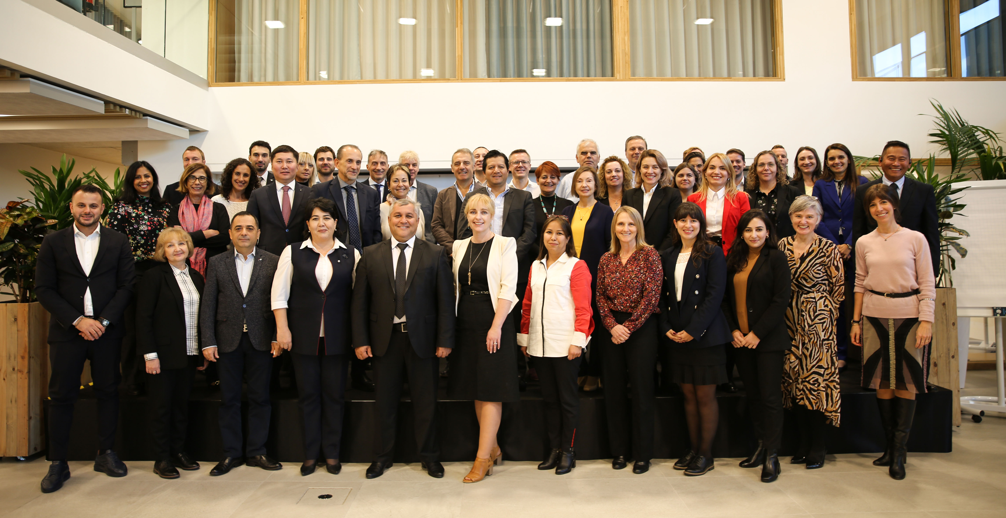
Key items identified for future work include (see Annex 1 for more details):
  Organisational ethics reference manual (Framework, process, training)
  Future of Work – Maturity model and development, resource repository.
  Meta-Academy and associated skills support development
  Statistical Manager and Leader competency profile development (personas, training supports)
  NSIs performance Management and Productivity.
  Internal Communications Framework Development:
    Alienation in a distributed working environment
    Communication Up-and-down
    Staff as internal advocates and external ambassadors (stewardship)
  Analytics and metrics for professional HR management in the NSIs (workshop, framework)
  A transitional NSI Employer Brand
HRMT Workshop

Slide 19
Business Case for The job of the future
We would like to propose to continue the work on activities working on one or more of the following ideas.
As we won’t be able to work on all proposals, based on available time and resources, expertise of team members we will select one or more topics to work on.
Recruitment and onboarding (induction):
Guidelines on recruitment of younger staff
Guidelines on engaging all generations to the onboarding/induction program
Guidelines on stay interviews
Maturity/development model for corporate branding

Slide 20
Business Case for The job of the future
Work and job of the future:
Guidance and policies on what is defined as (and how to obtain them) equality, diversity and inclusion.
Maturity/development model on flexible work practices and the matching management and leadership style to manage performance and productivity
Framework for internal communication in a flexible working environment
Reaching youth:
Communication strategy to reach youth
Measuring and stimulating data usage and statistical literacy
Creating universal guidelines for new protocols on how to target youth as data source
Creating universal guidelines on how to deal with legislation and other barriers like parental consent

Slide 21
Business Case for exploring new and disruptive content and strategies to meet the communication challenges facing official statistics organisations
At the DissComm conference in October 2022 key challenges and opportunities for future work were discussed.
The topics that were identified as priorities included building trust in official statistics, the challenge and threat posed by disinformation, and building awareness and engagement amongst specific sectors of society (e.g. young people).
The ecosystem in which many of these challenges will be addressed is a digital one: digital platforms and web portals (including social media) where the majority of our audiences, access information, build connections and communities, and search for the tools and services required to meet their needs.
The purpose of this activity proposal is to build understanding of this ecosystem, and ensure that our organisations are maximizing its potential as a tool to address the challenges mentioned here.

Slide 22
Business Case for exploring new and disruptive content and strategies to meet the communication challenges facing official statistics organisations
Identify experiences and approaches of NSI’s using digital products and web portals (including social media), specifically in the areas of:
Disinformation and misinformation challenges
Trust building
Reaching and promoting engagement with young people and other target audiences (e.g. data providers, potential employees)
Identify successes and failures in relation to content strategy and use of platforms.
Explore the potential advantages and pitfalls of engaging with influencers or ambassadors to promote and raise the official statistics as a brand, generally or on specific campaigns.
Defining what constitutes success in relation to social media activities and how to measure it.
The objective of this activity is to provide information on, and pathways to:
Maximising the potential of digital products and web portals to support the communication objectives of Official Statistics
Building on the experience of others in relation to the developing of content, identifying platforms, and measuring the impact of these activities
Understanding the capability and capacity requirements within communication teams to operate effectively in the digital ecosystem.

Slide 23
Business Case for Data Analytics Proposal
Use a reporting tool such as Power BI to collate data from a range of sources such as attrition data, absence, recruitment time to hire, % of diversity declarations. Using this report as part of the performance cycle then allows for individuals/teams to analyse areas of focus in their organisation/section; for example, it might be that the data shows a performance pay gap between disabled and non-disabled colleagues. The report will also enable more proactive, strategic advice to be provided through a fulsome overview of the data to help support strategies and give real-time indicators on the progress of various initiatives, such as the number of hires of a diversified workforce, retention, and many others.
Manual manipulation of data may lead to human error and unnecessary effort and less timely or relevant data. In addition, without the ability to measure and assess our interventions we may not be undertaking the appropriate lever to drive the desired behaviour or outcome.

Slide 24
Human resources and more...
Guidelines for Managers (2015 EN/RU)
Guidelines on Risk Management Practices in Statistical Organisations (2016 EN/RU)
Capabilities:
  Placemat - Key Capabilities for Modernising Statistical Organisations
Developing Organisational Resilience:
  Paper on Visions, Missions and Target Operating Models
  Green paper: Developing Organisational Resilience in Statistical Organisations
Statistical Training:
  Statistical and End User IT Training Framework - based on GSBPM Model (2017)
  Statistical Training Framework aligned to the GSBPM - paper (2018)
Organisational barriers to international collaboration (2016):
  Paper on organisational barriers to international cooperation
Competencies profiles (2015):
  Big Data Team
  Big Data Team Leader

Slide 25
Human resources and more...
Strategic Communication Framework Publication - English (2021)
Brand and reputation management - English (2022)
Ethics management, leadership and performance (work in progress 2022)
Report on the Survey results on Ethics Management (2021)

Slide 26
Links & further information:
Human resources and more...
Future of Work (coming soon)
Guidelines on Risk Management
Guidelines for Managers
Strategic Communication Framework
Brand and reputation management
Dissemination and Communication (Expert Meetings)
HLG-MOS & outputs and activities
taeke.gjaltema@un.org (info on HLG-MOS etc.)
tetyana.kolomiyets@un.org (Capability and Communication group)

Slide 27


Join the Capabilities and Communication Group
Anybody can join
Jointly developing useful products
Collaboration of the willing and able
Focus on Innovation and latest needs
Workshop to share work and to get input and new ideas for future work
Work programme of the UNECE High-Level Group for the Modernisation of Official Statistics
Part of the Unite Nations (Economic Commission for Europe and North America, including Caucasus and Central Asia) governed by Conference of European Statisticians (UNECE+ Argentina, Australia, Brazil, Chile, Colombia, Japan, Mexico, New Zealand, South Africa, South Korea and more)
Work supported by HLG-MOS and CES ➔ All Chief Statisticians UNECE region and (far) beyond
Contact: Tetyana Kolomiyets (Tetyana.Kolomiyets@un.org), Taeke Gjaltema (taeke.Gjaltema@un.org)

Slide 28
Thank you for your attention!

