Slide 1
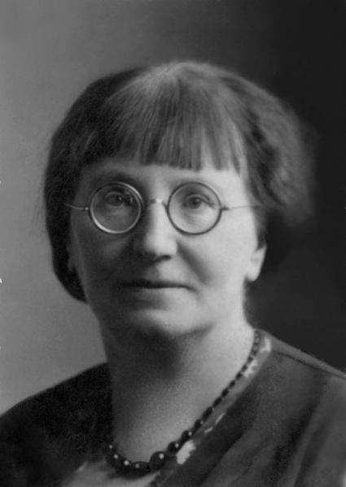
ML-Ops
….if it would be illustrated by the Swiss avant-garde painter Alice Bailly

Slide 2
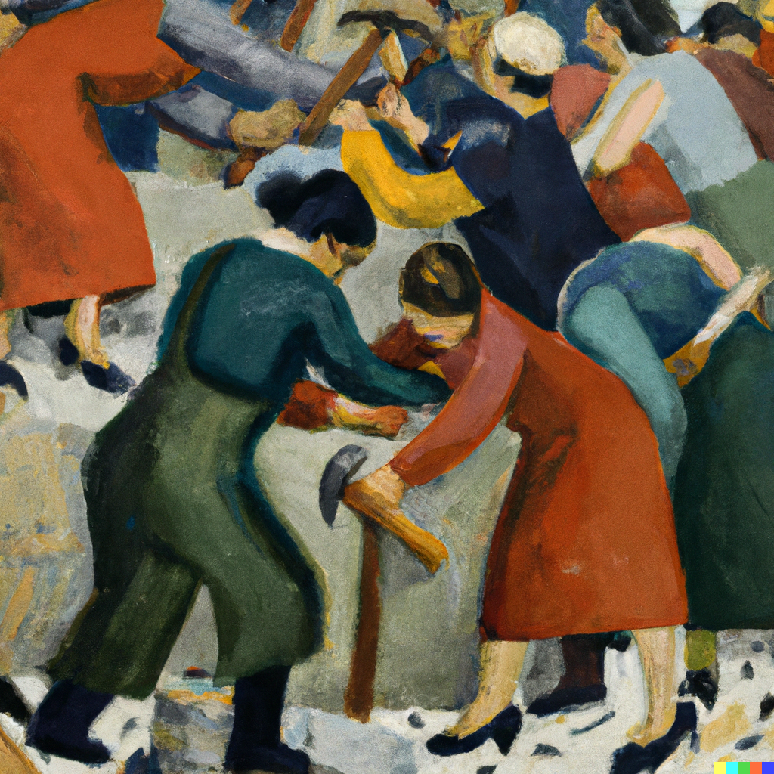
Statistical production still contains lots of manual work

Slide 3
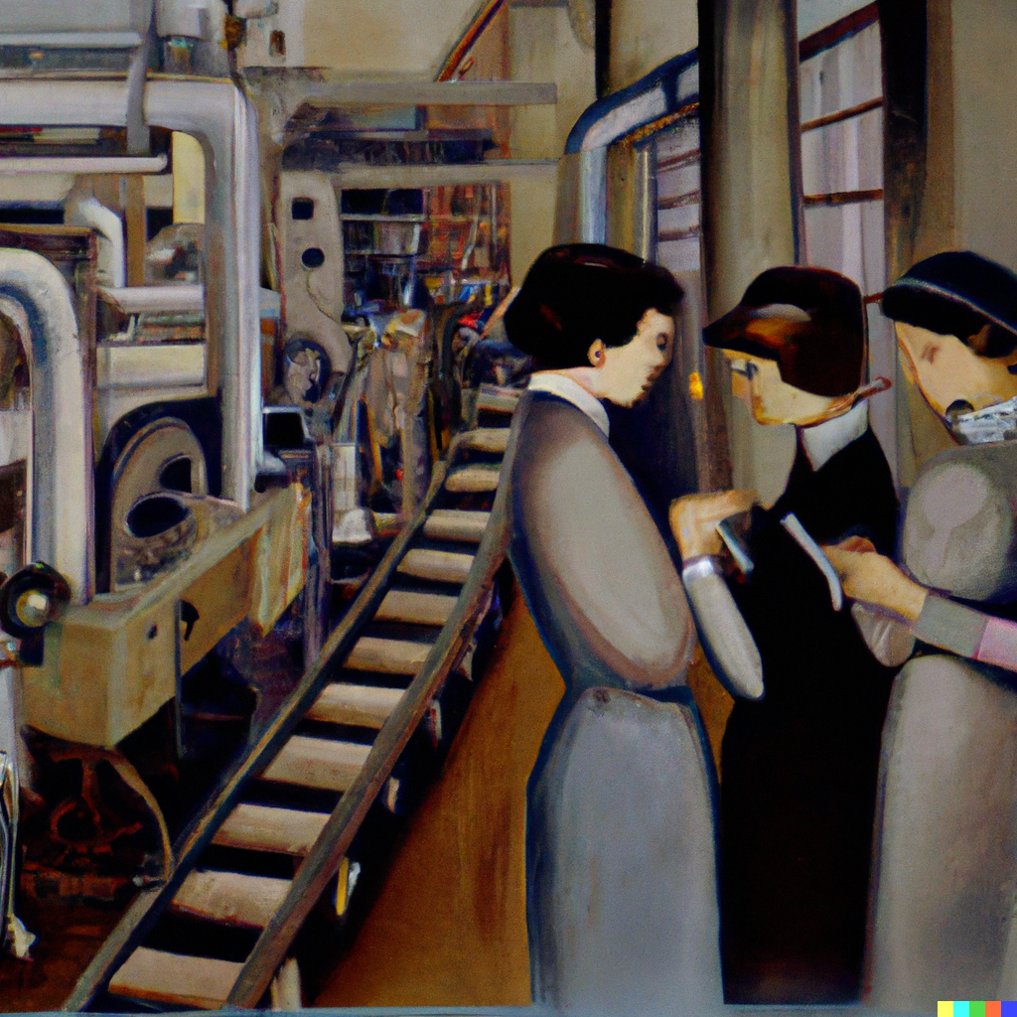
The HLG-community have invested in industrialising production

Slide 4

New data science and machine learning is now entering official statistics

Slide 5
ML-Ops is a set of practices to industrialise Machine learning
New methods and machine learning
Manual
Automated
Traditional methods

Slide 6
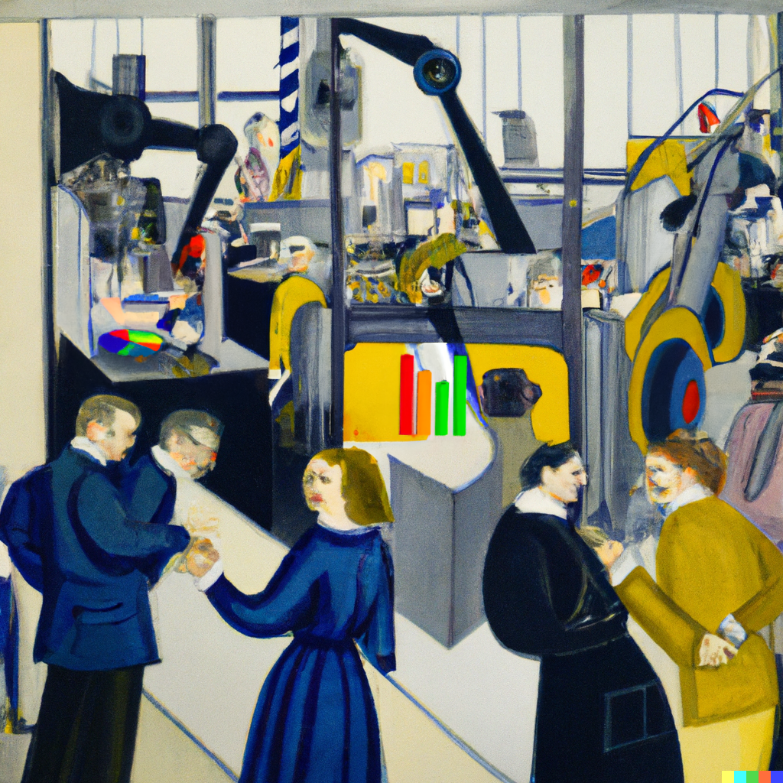
Adopting ML-Ops will help us:
- move proof of concepts to production
- automate data flows and management
- help to industrialise traditional statistical production - Stat-Ops?

