Slide 1



Meta Academy Project Review
2022 Workshop on the Modernisation of Official Statistics
November 22, 2022
Kate Burnett-Isaacs, Statistics Canada
and Eric Anvar, OECD

Slide 2

NSOs share similar challenges
Offering learning and development opportunities: a pillar for the Future of Work
Need to constantly adapt skills to evolving technologies and data market
…And yet: mechanisms to share, reuse or co-create learning experiences at scale do not exist – between NSOs, or even within NSOs or NSSs

Slide 3
The goal of Meta Academy 2022
Initiate a framework and forum to facilitate co-creation and reuse of training across NSOs
Unleash the creation and use, at scale, of open digital assets to boost employee upskilling

Slide 4
Project recap
Round table of NSO training experiences
Initial brainstorming & presentations of existing initiatives
Work Package 1.2 – 6 months*
Identify common barriers and propose solutions to fill those gaps
Work Package 1.1 – 3 months
Experimentation of content co-creation and reuse (Git training)
Outcome from 2022
Work Package 2 – 6 months

Slide 5
Main barriers identified in work package 1
Absence or limited…
  …common understanding of the training needs
  ..shared methodology to create learning content
  ..forum or community for trainers and academy managers to exchange practices, share on priorities
  …decision to co-invest in training efforts.
Removing those barriers defines the notion of ‘Meta-Academy’

Slide 6
Key takeaways from the Meta Academy project
On the pedagogy: some initiatives focus more on self-learning approach; others on synchronous learning experience with a coach (onsite or online).
On the content: some initiatives take a broad approach at covering all regular official statistics activities; others are very much focused on data science or data intensive scientific activities
On the audience: some initiatives target a national audience while others aim to grow an international network
On the platform: all initiatives crystallise around a digital platform through which training content and services are created and traded

Slide 7
Outcomes of Work Package 2:
Experiment with Git and Version Control
What did WP 2 learn from WP 1?
What did we learn from WP2
Importance and use of personas
Targeting training to adult learners
Lessons learned from other NSOs Git training experiences:
  Importance of clear concepts and terminology when it comes to Git, GitLab and Github
  Importance of highlighting ‘what’s in it for’ employees and managers
  What NSOs need to know about Gitlab and version control
How general industry content can be adapted to apply to the NSO context
Without a shareable and accessible platform or method to host training, content and delivery cannot go anywhere

Slide 8

Where do we go next?
The most promising avenue to explore is to develop a ModernStats Carpentry under a partnership between the HLG-MOS and the Carpentries organization

Slide 9
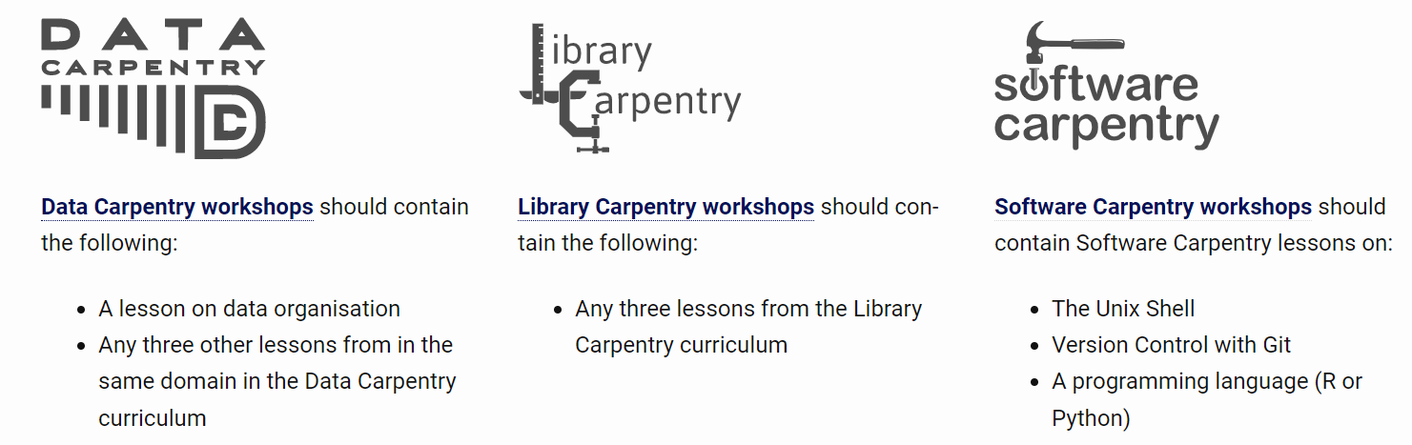

Who are the Carpentries?
Existing Carpentries projects
A new Carpentry?
ModernStats Carpentry
+
‘Our vision is to be the leading inclusive community teaching data and coding skills to produce relevant, timely and granular official statistics.’
A community of 4000 certified trainers; 90000 learners participated in 3500 workshops from #100 members (universities and libraries mostly).

Slide 10
Why is Carpentries the best option?
Barriers
Shared methodology to create learning content
Forum or community for trainers and academy managers to exchange practices, share on priorities
forum and method to ensure training content and delivery evolve with the industry
A shareable platform or repository to host material
How Carpentries meets our needs
The Carpentries have a standard Lesson Program Incubation, testing and peer review process for the creation of training
Through the community of trainers and maintainers that includes academia and industry partners, as well as the Carpentries requirement and methods to keep training up,
‘Train the trainers’ programme, mentoring groups, and existing network of 4000 trainers from all over the world.
Existing platform to organise and coordinate training sessions

Slide 11
What is their ‘Business Model’?
The Carpentries are a non-profit, registered in the US, funded by membership and workshop fees, and grants from donors.
01
In order to engage with the Carpentries, the HLG-MOS and/or member organizations will need to a pay a membership fee.
02
However, in the context of a ModernStats Carpentry, participating organisations could organise as many trainings as they wish
03
All Carpentries content are open and free under CC license; training substance and materials are stored in Github
04

Slide 12
Conclusion
ModernStats Carpentry project proposal

Slide 13
Thank you
Questions?

