Slide 1
Statistical Data Governance Framework to Achieve Data Interoperability (DAFI)
Report of Advances
Workshop on the Modernisation of Official Statistics
22-23 November 2022
Prepared by: the DAFI Team
INEGI/BSTN/SSG

Slide 2
Contents
Problem Statement for Interoperability
Data Governance
Expected Outputs from the Project
Advances
Time for feedback and comments

Slide 3

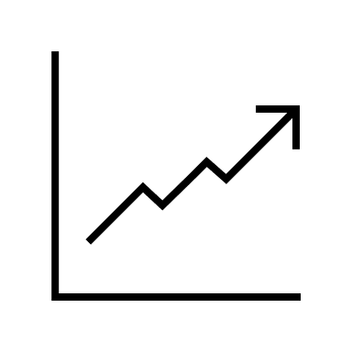









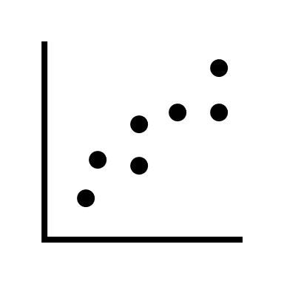
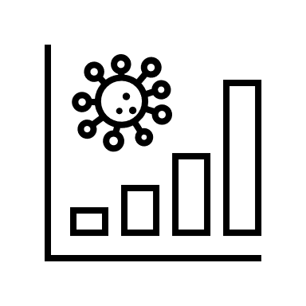





Interoperability
The ability of systems or services to exchange and make use of the information without prior communication.
Institutions whose core business is the production and dissemination of official statistical information must deal with data and metadata coming from different sources and domains.

Slide 4
Types of Interoperability
Semantic
(data context)
Technical
Organisational
Structural
(data architecture)
Syntactic
(data language)
Systems
(data presentation)
Legal
Notes:
Semantic: Contexts and vocabularies
Structural: Models, structures, and schemas
Syntactic: Formats for encoding, decoding, and representing
Systems: Networks, computers, applications, and web services

Slide 5
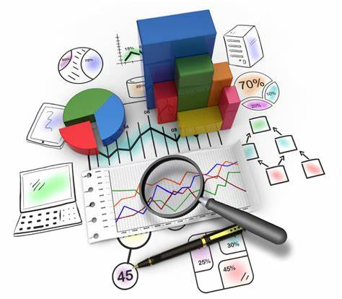
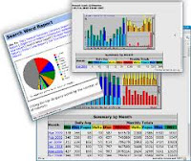
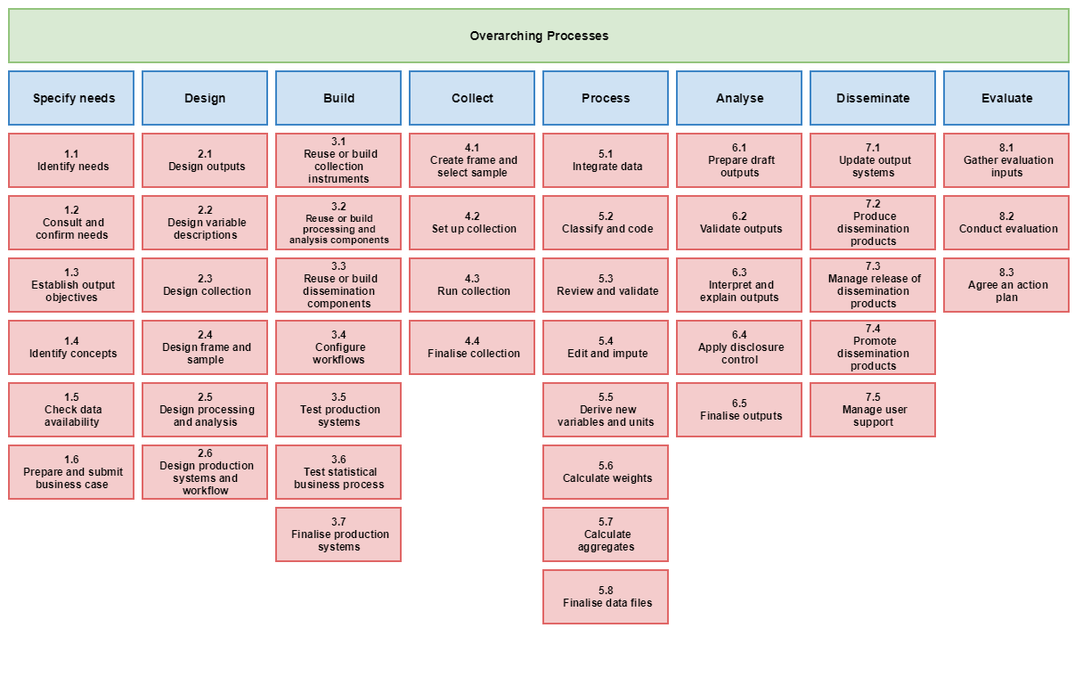


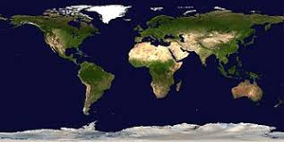
Levels of Statistical Interoperability
Global
International Organisations
Internal to the Information Production Process
Between programs in the Same Domain
Between Statistical Domains
International, Regional
International and Regional Statistical Systems
National
National Statistical Offices
(Inside Statistical Departments)
Conceptual, Temporary, and Geographical
National Statistical Systems

Slide 6
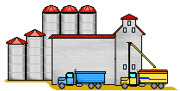
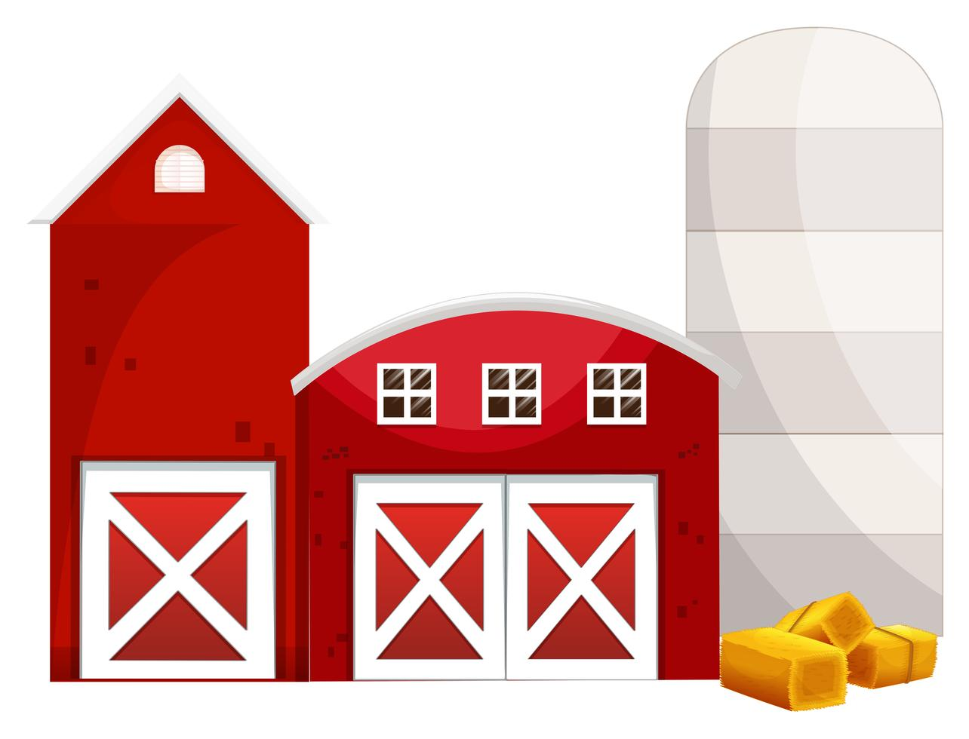





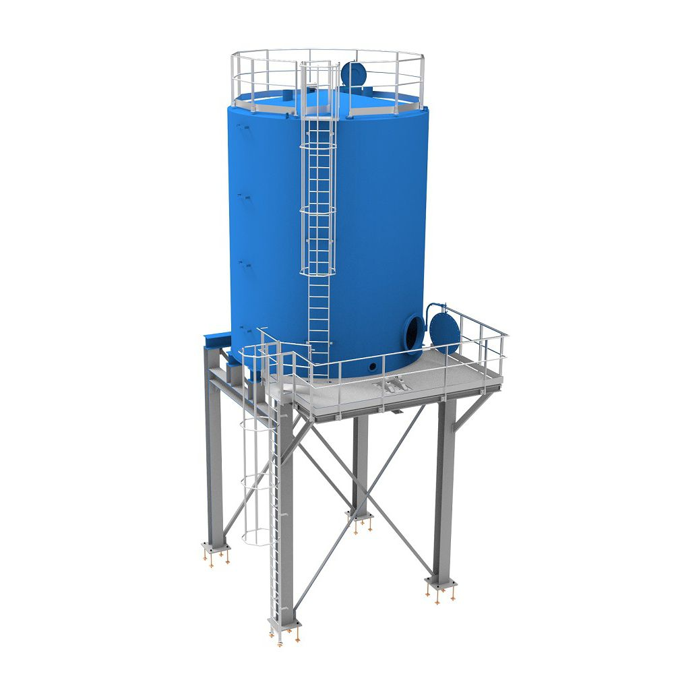
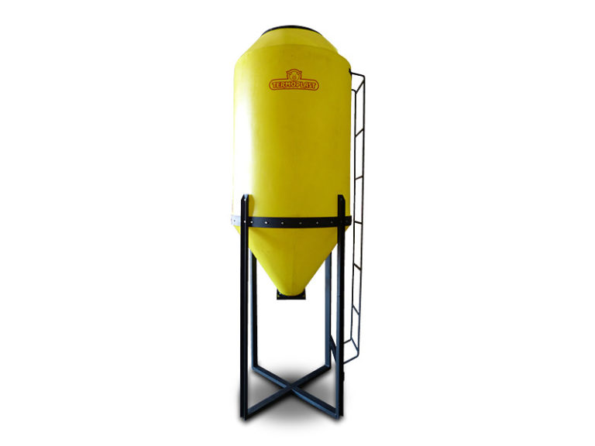
The Root of the Interoperability Problem
Labour statistics
Human settlements
and housing statistics
Sustainable development
Differences in definitions of concepts between programs /domains (sometimes, even between program cycles)
Unstandardized classifications
Heterogeneous formats
Regional and small area
statistics
Macroeconomic statistics

Slide 7
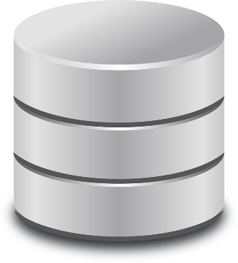
Production Systems
Dissemination Systems
Production Systems
Aggregated Information (indicators)
Data Warehouse
Metadata Repositories
Production Systems
Transformation Tools
Transformation Tools
Transformation Tools
Transformation Tools
Transformation tools for: Big Data, ETL, ELT, Data Virtualisation, Data Lakes, etc.

Slide 8
INTEROPERABLE STATISTICAL DATA AND METADATA PLATFORM
Identified, Classified, and Shared Concepts and Classifications
Linked Data and Metadata
Common Methodologies, Constraints, and Rules
STATISTICAL DOMAINS
Program A
Common Structures and Models
Common Time and Space Dimensions
Connected Database Schemas and Repositories
Program B
Program C
Common and Individual Views
Traditional and New Advanced Information Services
Reusable Systems and Tools

Slide 9
Data Governance
Organisation
Standards and Models
Principles and Policies
The organization and implementation of policies, procedures, structure, roles, and responsibilities which outline and enforce rules of engagement, decision rights, and accountabilities for the effective management of information assets
Activities and Procedures
Metrics
Technologies and Tools

Slide 10
Benefits of the Data Governance focused on Interoperability
Streamlines the information production process
Improves quality and transparency of information
Increases the value of the statistical outputs
Enables the creation of new services to solve emergent and complex requirements
Eases data and metadata management
Improves the potential in the reuse of tools

Slide 11
Data Governance Framework for Interoperability (DAFI)
A framework is a system of rules, ideas, or beliefs that are used to plan or decide something. It simplifies things to make them easier to understand
A Data Governance Framework is an instrument that is useful to have a holistic view of the data governance elements required to be in control of the information assets of the organisation.
DAFI will help to align efforts, unify concepts and organize the core elements that are needed to establish and manage an interoperable platform of data, metadata and systems

Slide 12
Outputs of the Project
Understanding of basic terms related to data governance and statistical interoperability
A document describing a reference framework containing the main elements to achieve data interoperability.
Identification of the core elements needed to achieve statistical interoperability
Recommendations and guidelines on how to apply existent models and tools to establish an interoperable data environment

Slide 13
Summary…
Web-scraping
Increasingly, statistical organisations work with diverse data
Great opportunity to meet the complex information needs through data integration
However, data managed in silos making them non-interoperable (e.g., semantics, syntactic) creating a big challenge for data integration
Data should be governed with interoperability in mind
Survey
Satellite
Statistical organisations
Private sector
Administrative
Crowd-sourcing
Notes:
Diverse data -> great opportunities to respond to complex policy questions (disaster reduction, climate change, etc.)
Also important as NSOs are increasingly taking role of national data steward…??
Methodologies and technical standards are (more or less) there??

Slide 14
DAFI Team
The Project raised interest from many institutions.
The team is conformed by experts from: Canada, Egypt, France, Hungary, Israel, Italy, Kyrgyzstan, Mexico, Saudi Arabia, USA, ILO, OECD, and UNECE
Very rich set of backgrounds, knowledge and experience
It was a challenge to unify our visions for the project

Slide 15
What we have been advancing so far…
We started by reviewing use cases and relevant efforts made by different organizations
Then, most of the initial work was about getting agreements on:
  The scope of the Project to get an alignment of the efforts
  The relevant concepts about the main topic of the Project, and their definitions to get a common language
  The contents that would fit in the document
  The initial structure for the document
What we are working on now:
  Generation of contents for the project
  Improving the structure to make it more meaningful for the reader, answering questions like: Why we do this? What do we want to achieve? How can we make it?

Slide 16
The Document Structure So Far
The document structure follows the logic of:
  Why do we need a Framework for Interoperability (Introduction)?
    Background
    Problem Statement
    Scope and Purpose
    Core Terms
  What do we want to achieve (Statistical Interoperability)?
    Review of Statistical Interoperability
    Benefits
    Types of Interoperability
  How we will achieve our goals (DAFI Framework)?
    DAFI Structure and Components
    Related Standards and Models
    Guidelines on How to Build an Interoperable Statistical Platform
    Recommendations on How to Achieve Interoperability

Slide 17
Thank You
Comments, Questions, Any Feedback
Juan.Munoz@inegi.org.mx

