Slide 1
Statistical Data Governance Framework to Achieve Data Interoperability (DAFI)
Extension of the Project for 2023
Workshop on the Modernisation of Official Statistics
22-23 November 2022
Prepared by: Juan Muñoz
INEGI/BSTN/SSG

Slide 2
Reasons to continue with the project…
The convenience of making use of the invested effort to incept the project, design the structure of the document and refine the scope of the project
The interest of many statistical organisations, national and international, in the outputs of the project
Huge compromise of the team members to finish the project
There is momentum in the creation of contents

Slide 3
What we are going to do in 2023?
By the first quarter of 2023, we aim to finish the structure and description of the components of the framework
During the second and third quarters of 2023, we will be working on developing recommendations and guidelines on how to achieve interoperability
For the last part of 2023, we plan to finish editing the document

Slide 4
Project Outputs
Data Governance Framework for Interoperability (DAFI)
Common Vocabulary with core concepts related to Data Governance and Interoperability
A structured set of elements to take decisions for the transformation of the statistical silos into a interoperable statistical data and metadata platform
Recommendations and Guidelines to Achieve Interoperability

Slide 5
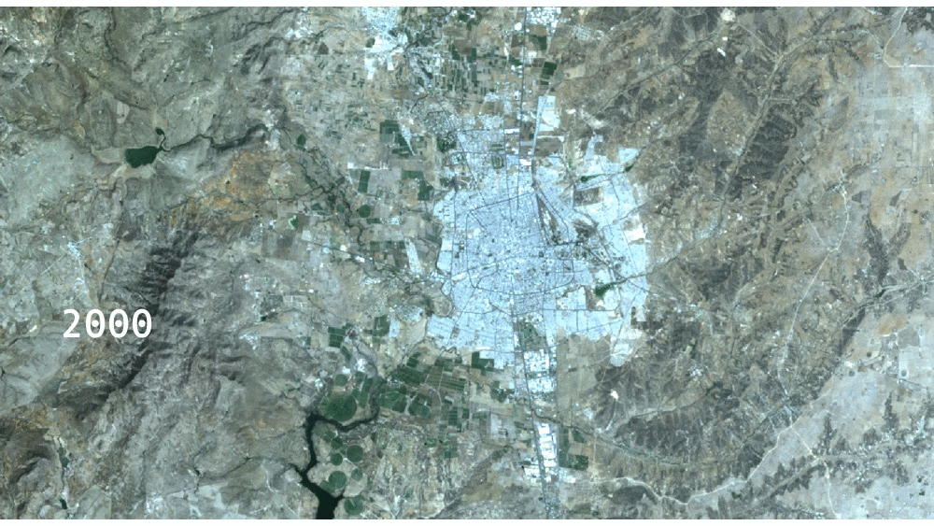
Relations with emergent projects…
PUT YOUR STATISTICS HERE
The output of the Project provides a valuable basis for:
  The transformation of statistical information silos into an interoperable and manageable platform
  The integration of traditional and emergent data sources
  The implementation of solid and useful statistical data lakes
  The building of geo-referenced time series with statistics from different domains
  The creation of a new generation of statistical services supporting advanced analysis for complex questions and new ways to visualise the facts
And is a step forward towards a practical use case integrating the standards and models that already exist in the official statistics community

Slide 6
Thank You
Comments, Questions, Any Feedback
Juan.Munoz@inegi.org.mx

