Slide 1




High-Level Group for the Mondernisation of Official Statistics
Workshop on Human Resource Management and Training
"Future of work, Working for the future"
11-13 October 2022, Brussels, Belgium
Notes:
UNECE region: Europe, Caucasus, Central Asia and North America
CES members: UNECE & Argentina, Brazil, Colombia, Mexico, Australia, New Zealand, Japan, South Korea, South Africa etc.

Slide 2















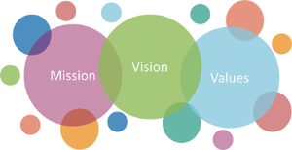
High-Level Group for the Modernisation of Official Statistics HLG‐MOS
A Collaboration of the Willing
Activities are voluntary and demand driven
Strategic Vision and oversight by HLG-MOS
Actively steered by an Executive Board
Four main principles:
    Openness
    Flexibility
    Participation
    Pragmatism
Everybody can join and participation at all levels
Notes:
HLG-MOS was setup by the CES: activities are demand driven and guided by the strategic vision and being overseen by the Chief Statisticians of the HLG-MOS → recognition at the highest level about the importance of the activities selected.
There is an overall realisation of CS about the importance of Communication of statistics and the importance of statistical literacy for NSOs and the changing role of Statistical Organisations in modern times.

Slide 3
ModernStats World 2022
CES
HLG-MOS
HLG-MOS Seminars & Sprints
Data Science
Blue Skies Thinking Network
Meta Academy
(ONS/HLG-MOS)
Machine Learning Community
Sprints
Workshop?
Pitches
Sprints
WP1
Work Stream
Work Stream
Task Team
Task Team
Core team
Task Team
Executive Board
WP2
WP3
Task Team
Task Team
Pitch Talks
Task Team
Work Stream
Webinar
Webinar
Capability and Communication
Supporting Standards
Data Governance for Interoperability Framework
Input Privacy-preserving techniques
HRMT
Workshop
Sprints
Sprints
ModernStats World WS
Sprints
WP1
Sprints
WP1
Task Team
Task Team
Task Team
Task Team
WP3
WP2
WP3
WP2
Task Team
Task Team
Task Team
Task Team
Modernisation Workshop
Webinar
Webinar
GSDEMs
Dissemination Communication Expert meeting
Data Editing Expert meeting
Data Collection Expert meeting
Confidentiality
Expert meeting
Notes:
Structure HLG-MOS 2022

Slide 4
ModernStats World 2022
CES
HLG-MOS
HLG-MOS Seminars & Sprints
Data Science
Blue Skies Thinking Network
Meta Academy
(ONS/HLG-MOS)
Machine Learning Community
Sprints
Workshop?
Pitches
Sprints
WP1
Work Stream
Work Stream
Task Team
Task Team
Core team
Task Team
Executive Board
WP2
WP3
Task Team
Task Team
Pitch Talks
Task Team
Work Stream
Webinar
Webinar
Capability and Communication
Supporting Standards
Data Governance for Interoperability Framework
Input Privacy-preserving techniques
HRMT
Workshop
Sprints
Sprints
ModernStats World WS
Sprints
WP1
Sprints
WP1
Task Team
Task Team
Task Team
Task Team
WP3
WP2
WP3
WP2
Task Team
Task Team
Task Team
Task Team
Modernisation Workshop
Webinar
Webinar
GSDEMs
Dissemination Communication Expert meeting
Data Editing Expert meeting
Data Collection Expert meeting
Confidentiality
Expert meeting

Slide 5
HLG-MOS Innovation Pipeline 2022
Official Statistics Community
Data Science and Modern Methods Group
HLG-MOS Executive Board
CES
Bureau
2022 Work
Programme
Data Editing Expert Meeting
Blue Skies Thinking Network
Data Collection Expert Meeting
HLG-MOS
Confidentiality Expert Meeting
HLG-MOS Modernisation Workshop
Dissemination Communication Expert Meeting
Capability and Communication Group
HRMT Workshop
ModernStats World WS
Supporting Standards Group
Notes:
This diagram shows the innovation pipeline and the process of identifying new activity and project topics to further advance our modernization.

Slide 6
HLG-MOS Innovation Pipeline 2022
Official Statistics Community
Data Science and Modern Methods Group
HLG-MOS Executive Board
CES
Bureau
2022 Work
Programme
Data Editing Expert Meeting
Blue Skies Thinking Network
Data Collection Expert Meeting
HLG-MOS
Confidentiality Expert Meeting
HLG-MOS Modernisation Workshop
Dissemination Communication Expert Meeting
Capability and Communication Group
HRMT Workshop
ModernStats World WS
Supporting Standards Group
Notes:
This diagram shows the innovation pipeline and the process of identifying new activity and project topics to further advance our modernization.

Slide 7

Capability and Communication group (CapCom)
Market Research, Digital Marketing & Communication strategies
  Brand and reputation management
  How to Measure success and the impact of our communication
  Strategies to tackle and anticipate disinformation
  Various other topics being considered:
    Establishing strategic objectives and outcomes for communications initiatives
    Understanding the appropriate tools, channels and content for communication campaigns
    Level of resources required to deliver effective communication across multiple platforms
    Developing relevant and effective metrics on impact of communications campaigns
Ethical leadership Task Team:
  Business and Data Ethics
  Ethics Surveys
  GAMSO-GSBPM Ethics framework
  Coordination/members CES bureau In-depth review Data Ethics

Slide 8
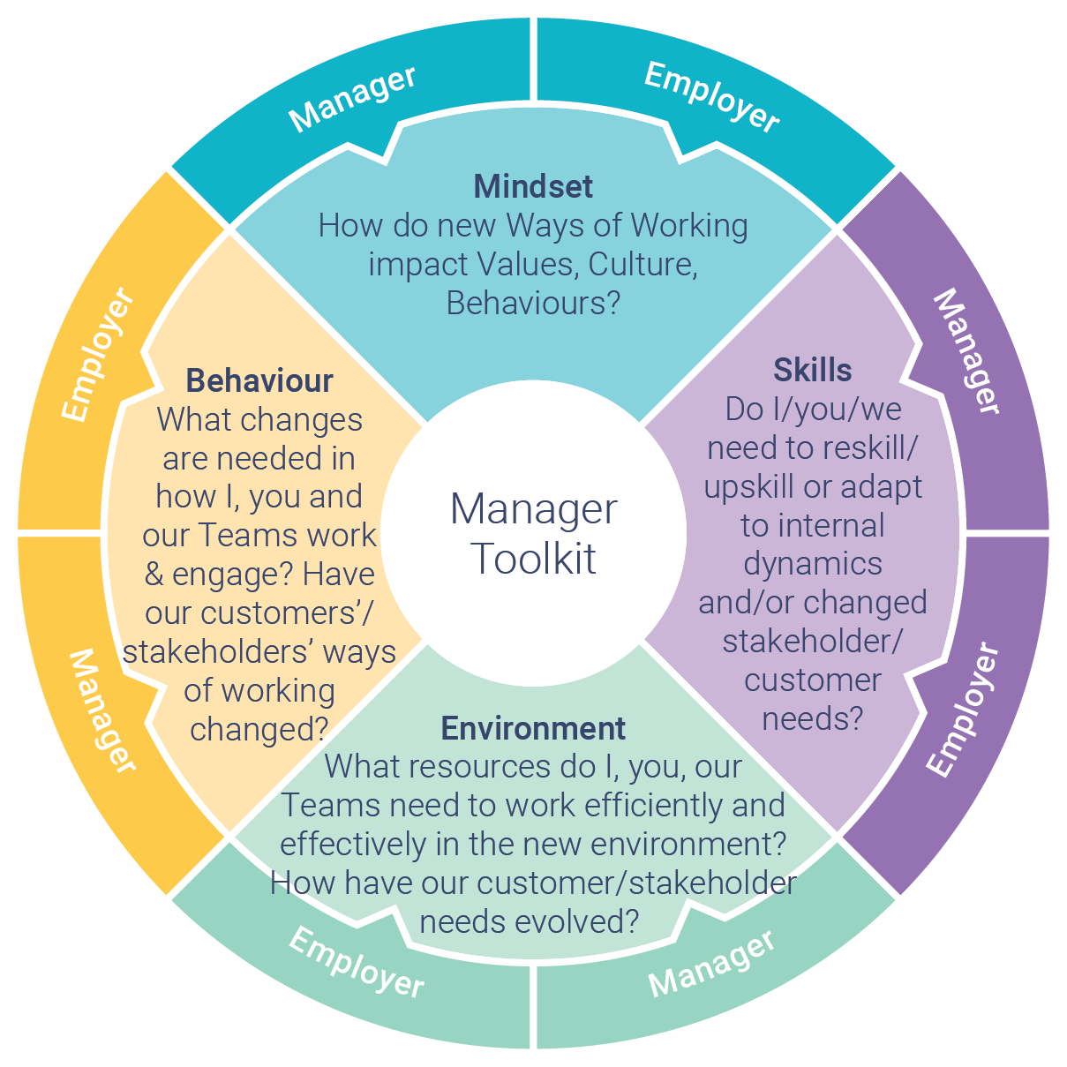
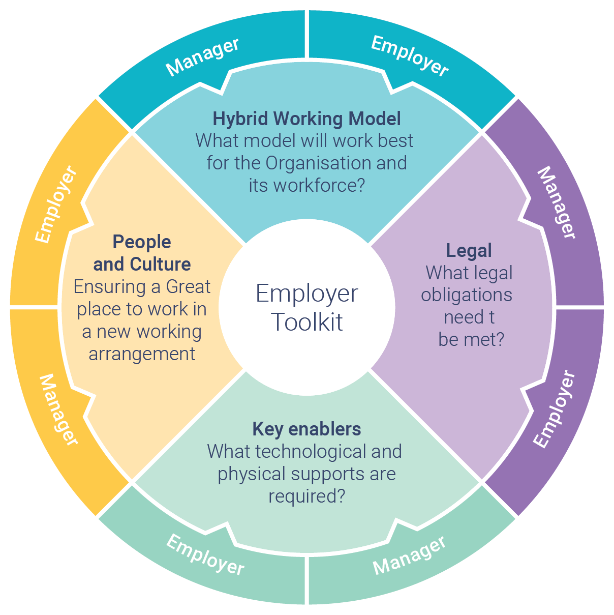
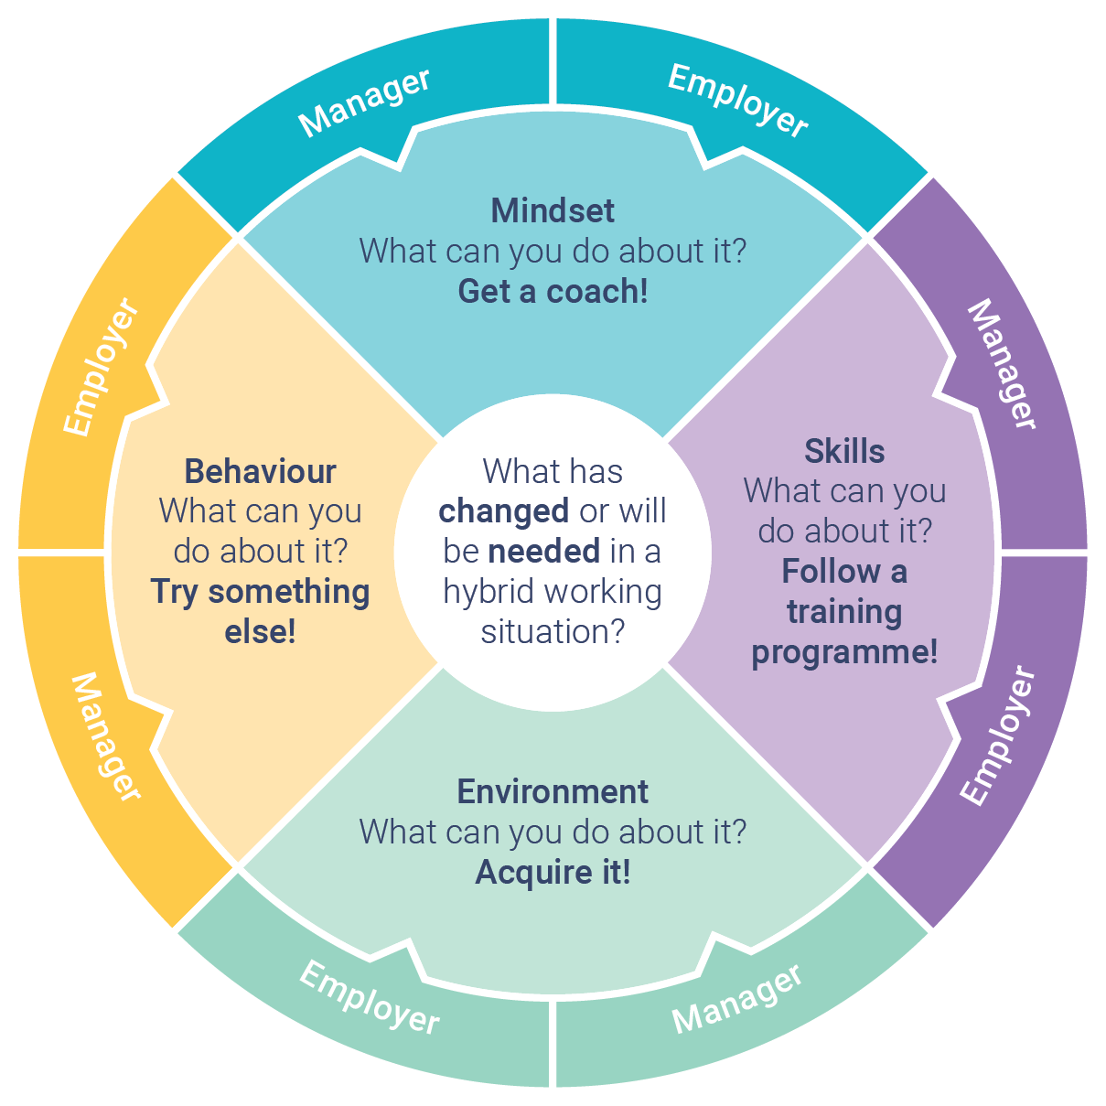
CapCom: Future or Work Task Team
Future of Work Toolkits
Job of the Future
Reaching Youth:
  Future employees
  Users of official statistics
  Data source for official statistics
Joint Questionnaire
Will all be presented in the next three days

Slide 9
Human resources and more...
Guidelines for Managers (2015 EN/RU)
Guidelines on Risk Management Practices in Statistical Organisations (2016 EN/RU)
Capabilities:
  Placemat - Key Capabilities for Modernising Statistical Organisations
Developing Organisational Resilience:
  Paper on Visions, Missions and Target Operating Models
  Green paper: Developing Organisational Resilience in Statistical Organisations
Statistical Training:
  Statistical and End User IT Training Framework - based on GSBPM Model (2017)
  Statistical Training Framework aligned to the GSBPM - paper (2018)
Organisational barriers to international collaboration (2016):
  Paper on organisational barriers to international cooperation
Competencies profiles (2015):
  Big Data Team
  Big Data Team Leader

Slide 10
Links & further information:
Human resources and more...
Future of Work (coming soon)
Guidelines on Risk Management
Guidelines for Managers
Strategic Communication Framework
Brand and reputation management
Dissemination and Communication (Expert Meetings)
HLG-MOS & outputs and activities
taeke.gjaltema@un.org (info on HLG-MOS etc.)
tetyana.kolomiyets@un.org (Capability and Communication group)

Slide 11


Join the Capability and Communication Group
Anybody can join
Jointly developing useful products
Collaboration of the willing and able
Focus on Innovation and latest needs
Workshop to share work and to get input and new ideas for future work
Work programme of the UNECE High-Level Group for the Modernisation of Official Statistics
Part of the Unite Nations (Economic Commission for Europe and North America, including Caucasus and Central Asia) governed by Conference of European Statisticians (UNECE+ Argentina, Australia, Brazil, Chile, Colombia, Japan, Mexico, New Zealand, South Africa, South Korea and more)
Work supported by HLG-MOS and CES ➔ All Chief Statisticians UNECE region and (far) beyond
Contact: Tetyana Kolomiyets (Tetyana.Kolomiyets@un.org), Taeke Gjaltema (taeke.Gjaltema@un.org)

