Slide 1


Synthetic Data for National Statistical Organisations: A Starter Guide
Methods and Recommendations
HLG-MOS Synthetic Data Webinar
November 17, 2021
Kenza Sallier- Statistics Canada

Slide 2
Outline
Context
Methods, tools and recommendations
Methods decision tree and lessons learned

Slide 3
Context
Data synthesis is not new (Rubin, 1993), in theory but in practice it is (less then 10 years)
The data revolution had (notably) two impacts that explains National Statistical Organizations (NSOs) interest around synthetic data:
  NSOs want to take the lead in providing data about their country: open data initiative and being more user-centric
  Advancement in technology and computer capacity made it possible to implement methods and develop tools
Chapter 3 of the Synthetic Data for National Statistical Organisations: A Starter Guide
Collaborative work since January 2020
Project had 50 participants from 15 NSOs, one academia institute and 3 private sector participants

Slide 4
Context
Many methods exist: Focus is made on methods that can be implemented within the infrastructure of a NSO
Selection was based on reference, if the method was truly implemented either in a academic or NSO context.
The goal is to highlight the applicability of each of these methods in the practice of statistical organizations -> provide an overview of the method, pros and cons, tools and references
Also provide recommendations on the use cases based on the methods selected: indications on how to select the right method for a given project

Slide 5
Things to consider when picking a method
It is important to start by identifying the type of synthetic data required and in what context they will be used:
  Desired analytical value to be preserved
  Release strategy
Complexity of the dataset, volume, software knowledge and computational capacity
3 main categories of methods
  Sequential modelling
  Simulated data
  Deep learning

Slide 6
Sequential modeling
Sequential modeling: or conditional modeling -> we condition on specific variables to generate others.
2 methods:
  The fully conditional specification (FCS)
  Information Preserving Statistical Obfuscation (IPSO)

Slide 7
Sequential Modeling
Fully conditional Specification
Stems from imputation (Van Buuren et al. 2006)
The goal, in theory, is to preserve all relationships between variables
Assumption that the analytical value is contained in the joint distribution of all variables
Aims at approximating the joint distribution and generate new data points from the estimated joint distribution
The FCS uses Bayes’ Theorem to express the joint distribution of the variables as
$$f_{X_{1}, X_{2},…, X_{p}}=f_{X_{1}}×f_{X_{2}|X_{1}}×…× f_{X_{p}|X_{1}, X_{2},…, { X}_{p−1} }$$
Now, the statistical problem is solved by approximating each of the univariate distributions

Slide 8
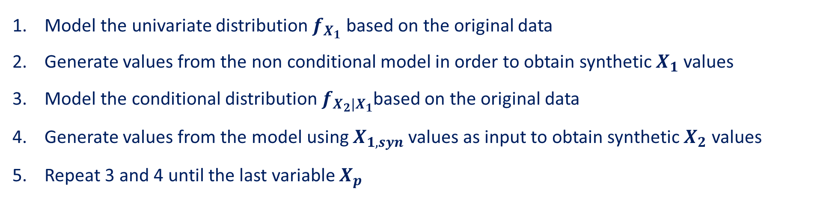
Sequential Modeling
Fully conditional Specification
$$f_{X_{1}, X_{2},…, X_{p}}=f_{X_{1}}×f_{X_{2}|X_{1}}×…× f_{X_{p}|X_{1}, X_{2},…, { X}_{p−1} }$$
Model the univariate distribution $f_{X_{1}}$ based on the original data
Generate values from the non conditional model in order to obtain synthetic $X_{1}$ values
Model the conditional distribution${ f}_{X_{2}|X_{1}}$based on the original data
Generate values from the model using $X_{1,syn}$ values as input to obtain synthetic $X_{2}$ values
Repeat 3 and 4 until the last variable $X_{p}$

Slide 9
Sequential Modeling
Fully conditional Specification
Tools for FCS:
The R package Synthpop is a tool for generating synthetic datasets.
The main method available to produce synthetic datasets is the FCS (Nowok et al., 2015).
For more information visit www.synthpop.org.uk.

Slide 10
Sequential Modeling
Fully conditional Specification
Pros | Cons
This method is easy to understand and easy to explain. Because the target is the joint distribution of the dataset, this method aims at preserving (in theory) all relationships between all variables. Relationships of interest are not required to be known prior to the creation process. Furthermore, because it stems from imputation, this approach naturally bears a strong resemblance operationally speaking with its well-established data-editing sibling. | For skewed data (such as business or economic data), the presence of outliers remains a challenge in terms of disclosure or perceived disclosure control. With many variables the process can become time-consuming.

Slide 11
Sequential Modeling
Fully conditional Specification
Recommandations
Releasing synthetic microdata to the public & Testing analyses | Education | Testing Technology
Recommended | Can be used. If analyses conducted and statistical conclusions are pre-determined it might be too time-consuming in comparison to other methods. | Can be used but might be too advanced in comparison to the real analytical need

Slide 12



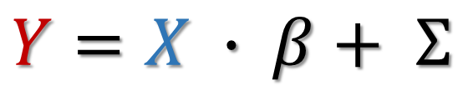
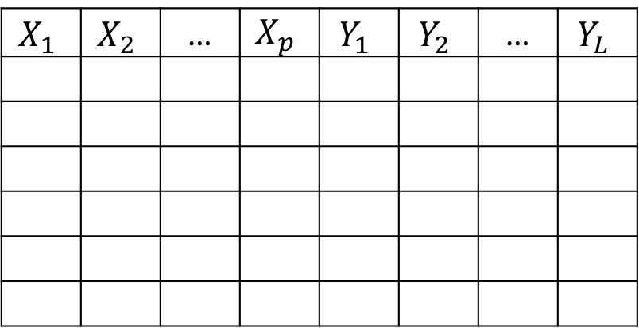

Sequential Modeling
Information Preserving Statistical Obfuscation (IPSO)
The goal is to preserve specific statistics and statistical conclusions related to linear regression
$$X$$
$$Y$$
Assume multivariate normality distributions
Assume a linear regression model
$$X_{1}$$ | $$X_{2}$$ | … | $$X_{p}$$ | $$Y_{1}$$ | $$Y_{2}$$ | … | $$Y_{L}$$
$$Y=X ∙ β+ Σ$$
$${\hat{β}}_{original}={\hat{β}}_{synthetic}$$
$${\hat{Σ}}_{original}={\hat{Σ}}_{synthetic}$$
Non-confidential
Confidential
Independent
Dependent

Slide 13
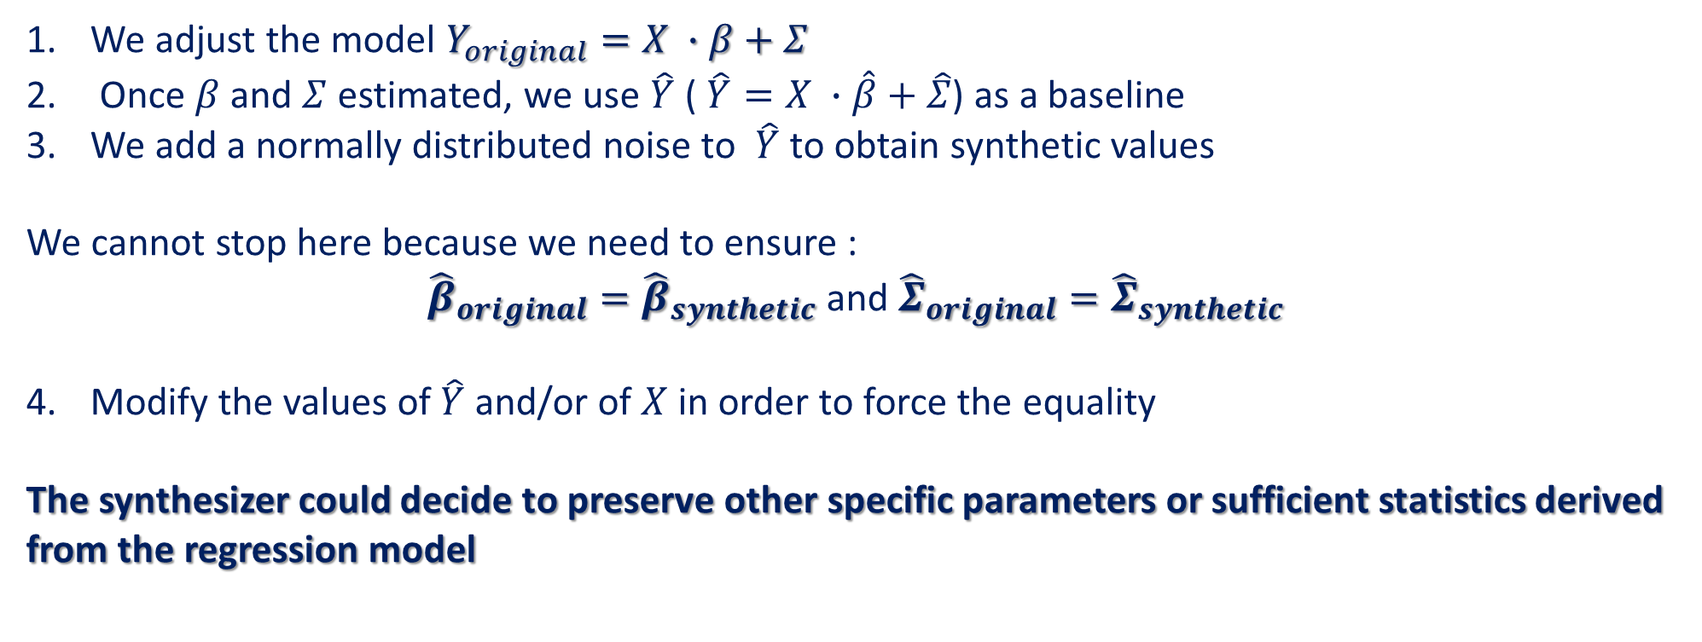
Sequential Modeling
IPSO
We adjust the model $Y_{original}=X ∙β+Σ$
Once $β$ and $Σ$ estimated, we use $\hat{Y}$ ( $\hat{Y}=X ∙\hat{β}+\hat{Σ}$) as a baseline
We add a normally distributed noise to $\hat{Y}$ to obtain synthetic values
We cannot stop here because we need to ensure :
${\hat{β}}_{original}={\hat{β}}_{synthetic}$ and ${\hat{Σ}}_{original}={\hat{Σ}}_{synthetic}$
Modify the values of $\hat{Y}$ and/or of $X$ in order to force the equality
The synthesizer could decide to preserve other specific parameters or sufficient statistics derived from the regression model

Slide 14
Sequential Modeling
IPSO
Tools for IPSO:
Mu-Argus, Implementation of Domingo-Ferrer and Gonzalez-Nicolas (2010), https://github.com/sdcTools/muargus
R package sdcMicro, An implementation of Ting et al. (2008) is included as a noise addition method, https://cran.r-project.org/package=sdcMicro
R package RegSDC, Implementation of all methods described in Langsrud (2019), https://CRAN.R-project.org/package=RegSDC

Slide 15
Sequential Modeling
IPSO
Pros | Cons
Like the FCS, the method is easy to understand and to explain. With this method, it is possible to preserve exactly some pre-identified parameters and sufficient statistics. Thus, any analysis relying on (multivariate) normality will produce the exact same results in the original and synthetic data. IPSO can be implemented as part of another method or process, to generate synthetic datasets. These hybrid methods may be used alleviate the normal distributions assumptions | Normal distribution for all variables is a strong assumption that is seldom true.

Slide 16
Sequential Modeling
IPSO
Recommandations
Releasing synthetic microdata to the public & Testing analyses | Education | Testing Technology
Recommended if the analyses are all related to linear regressions, otherwise not recommended. | Recommended if the analyses are all related to linear regressions otherwise not recommended | Can be used but might be too advanced in comparison to the real analytical need

Slide 17
Simulated Data
Simulations are often used in statistics to generate artificial data in order to conduct empirical analyses
Thus, a new perspective on simulations is that simulation processes can be used to create artificial data as synthetic data.
2 methods:
  From dummy files to more analytically advanced synthetic files
  Pseudo likelihood

Slide 18
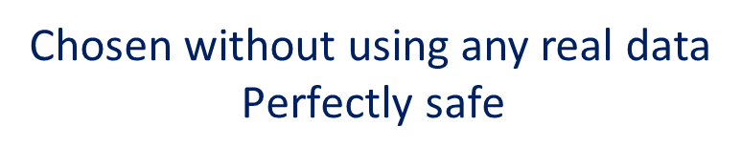
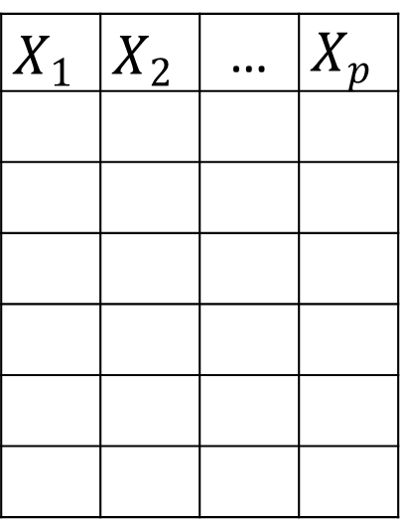
Simulated Data
From dummy files to more analytically advanced synthetic files
$$X_{1}$$ | $$X_{2}$$ | … | $$X_{p}$$
$$\vec{X_{i}}\sim N\left(μ,σ\right), i.i.d., ∀ i=1,…p$$
Chosen without using any real data
$$\text{Perfectly} \text{safe}$$
No analytical value and considered a dummy file
Not useful

Slide 19
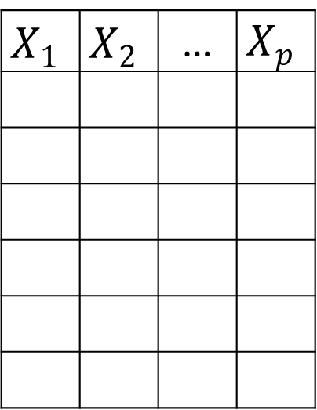

Simulated Data
From dummy files to more analytically advanced synthetic files
The synthesizer could also decide to use information from the original data, in the generation process, to ensure that some of the analytical value is preserved.
$$X_{1}$$ | $$X_{2}$$ | … | $$X_{p}$$
$$\vec{X_{1}}\sim N\left(\hat{μ_{1}},\hat{σ_{1}} \right)$$
$$\vec{X_{2}}\sim N\left(\hat{μ_{2}},\hat{σ_{2}}\right)$$
$$⋮$$
$$\vec{X_{p}}\sim N\left(\hat{μ_{p}},\hat{σ_{p}}\right)$$
Estimates based on the original data

Slide 20
Simulated Data
From dummy files to more analytically advanced synthetic files
The simulation process can be refined by using more information from the original microdata to preserve more statistical properties
The Fleshman-Vale-Maurelli method (Fleishman, 1978 and Maurelli, 1983) can generate multivariate non-normal distributions with the following features preserved:
  means
  variances
  Skews
  Intercorrelation between variables
It is possible to preserve pre-identified statistics

Slide 21
Simulated Data
From dummy files to more analytically advanced synthetic files
Tools:
In general, simulation processes can be programmed easily enough using any software.
For a more complex type of simulation, the R package semTools (https://CRAN.R-project.org/package=semTools) simulates microdata using the co-variance matrix, skewness and kurtosis from the original sample data (Jorgensen et al. 2019).

Slide 22
Simulated Data
From dummy files to more analytically advanced synthetic files
Pros | Cons
Simulation processes are easy to understand and can create completely safe data when no information pertaining to the original data is used. Can generate fully synthetic files. For more advanced types of simulations, some analytical value can be preserved. | Usually, does not allow to meet complex analytical needs.

Slide 23
Simulated Data
Dummy Files
Recommandations
Releasing synthetic microdata to the public & Testing analyses | Education | Testing Technology
Not recommended | Can be used if training does not require analytical value in the data | Recommended

Slide 24
Simulated Data
Analytically Advanced Simulated Data
Recommandations
Releasing synthetic microdata to the public & Testing analyses | Education | Testing Technology
Recommended if analyses conducted are related to the pre-identified results that needed to be preserved in the synthesis process. Otherwise, not recommended. | Recommended if analyses conducted are related to the pre-identified results that needed to be preserved in the synthesis process. Otherwise, not recommended. | Can be used but might be too advanced in comparison to the real analytical need

Slide 25
Simulated Data
Pseudo likelihood
Most of the research related to data synthesis has been focused on census datasets and administrative data
Other methods presented work under the assumption that the original data covers the entire population of interest
Therefore, statistical conclusions obtained via the synthetic file can only be comparable to the ones obtained in the original sample and not necessarily the original population.
Issue when the sampling process follows an informative design (Lavallée and Beaumont, 2015)
With NSOs collecting data via many projects relying on probabilistic surveys, a natural question which arises is: how do we include survey design features in the data synthesis process?

Slide 26

Simulated Data
Pseudo likelihood
More detailed discussion on synthetizing weights in the guide
Goal: incorporate information of the sampling process in the data synthesis in order to obtain a synthetic dataset from which we can estimate characteristics of the original population
An option : providing synthetic weights with the synthetic sample
Another option: use weighted models to approximate distributions from the original population, and generate values from them
The pseudo likelihood method was suggested in this case.
Example of an advanced simulation process that generates data of high analytical value.
The idea is to preserve as much all links between variables and univariates statistics as they exist in the original population

Slide 27
Simulated Data
Pseudo likelihood
The pseudo likelihood method generates synthetic populations by incorporating survey weights into the models based on the pseudo likelihood approach (Kim et al, 2020).
The idea is to build to estimate the distributions of the finite population.
Once that the finite population density is estimated, the synthesizer can generate fully synthetic populations by drawing values repeatedly from it.
No explicit distributions so we cannot rely on more regular models
Requires to derive the full conditional distributions of the Markov Chain Monte Carlo (MCMC) algorithm for posterior inference by using the pseudo likelihood function.

Slide 28
Simulated Data
Pseudo likelihood
Tools:
There is no known tool per se to apply the method. However, section 2.1 and 2.2 of Kim et al (2020) provides detailed information on the method and how to implement it.

Slide 29
Simulated Data
Pseudo likelihood
Pros | Cons
Addresses informative sampling. When generating synthetic populations, the sampling process is already accounted for; thus, the uncertainty introduced by sampling process is also accounted for. Users can estimate parameters from the original population. Providing synthetic populations can be better than providing synthetic samples convenience -> no need to estimate sampling variance nor to provide synthetic weights | There are potential challenges with the choice of prior distributions in the MCMC algorithm

Slide 30
Simulated Data
Pseudo likelihood
Recommandations
Releasing synthetic microdata to the public & Testing analyses | Education | Testing Technology
Strongly recommended if users want to estimate statistics from the original finite population. | Can be used. If analyses conducted and statistical are pre-determined it might be too time-consuming in comparison to other methods. | Can be used but might be too advanced in comparison to the real analytical need

Slide 31
Deep Learning
GAN
With improvements in technology and computational capacity, implementation of machine learning processes have become easier and more accessible.
Machine learning approaches have been more and more employed to generate synthetic datasets.
More specifically, the use of deep learning models has become appealing because of their capacity to extract from big datasets very powerful predicting model.
The generative adversarial network (GAN) (Goodfellow, et al., 2014) is a prominent generative model used for synthetic data generation.

Slide 32
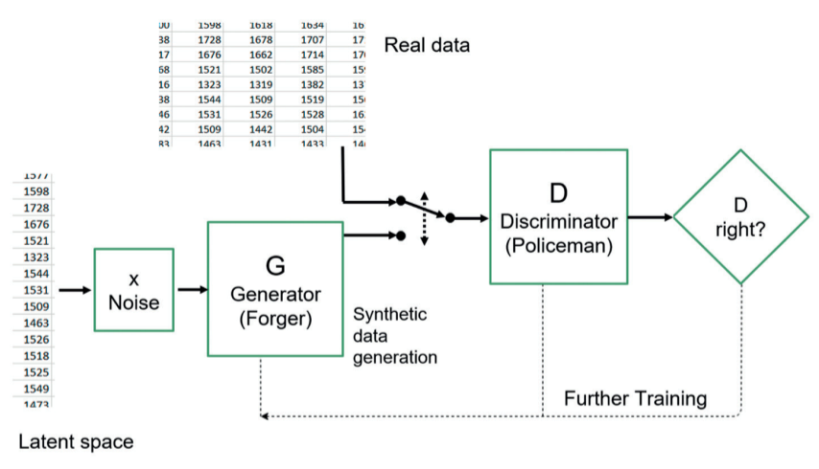
Deep Learning
GAN
Theory and implementation processes can be technically challenging, we will mainly explain the overall concepts, as more information can be found in the references.
Source: https://doi.org/10.1111/1740-9713.01466

Slide 33
Deep Learning
GAN
Tools:
There is no known tool per se to apply the method. However, Kaloskampis et al (2020) provides detailed information on the method and how to implement it.

Slide 34
Deep Learning
GAN
Pros | Cons
GAN can be used to generate continuous, discrete but also text datasets, while ensuring that the underlying distribution and patterns of the original data are preserved. Can generate fully synthetic datasets. Aims at preserving all relationships between variables. Can handle unstructured data. | GAN can be seen as complex to understand, explain or implement when there is only a minimal knowledge of neural networks. There is often a criticism associated to neural networks as lacking of transparency or being a black box. The method is time consuming and has a high demand for computational resources.

Slide 35
Deep Learning
GAN
Recommandations
Releasing synthetic microdata to the public & Testing analyses | Education | Testing Technology
Recommended especially in presence of text or unstructured data | Can be used. If analyses conducted and statistical conclusions are pre-determined it might be too time-consuming in comparison to other methods. | Can be used but might be too advanced in comparison to the real analytical need

Slide 36
Methods Decision Tree
Do you need to preserve all links and statistics?
Yes
No
Is the user interested in estimating statistics from the original finite population or original data only?
Pseudo Likelihood
Do you need to preserve some pre-identified statistics?
Yes
Analytically Advanced Simulated Data or IPSO
Is your data structured or can it be structured?
GAN
Fully Conditional Specification
No
Dummy Files
No
Yes
Original data only
Original population

Slide 37
Some lessons learned
Many methods exist
More complex methods are not always the best option (ex: testing technology)
It’s really important to understand how the synthetic datasets will be used

Slide 38
References
Cano, Isaac and Torra, Vicenç. (2009), Generation of Synthetic Data by means of fuzzy c-Regression. 1145-1150. 10.1109/FUZZY.2009.5277074.
Domingo-Ferrer, J., Gonzalez-Nicolas, U. (2010), Hybrid microdata using microaggregation, Information Sciences, 180(15), 2834-2844.
Drechsler J. (2011), Synthetic Datasets for Statistical Disclosure Control. New York: Springer-Verlag.
Drechsler, J. and J.P. Reiter. (2011), An empirical evaluation of easily implemented, nonparametric methods for generating synthetic datasets. Computational Statistics and Data Analysis, 55, 3232-3243.
Efron, B. (1979), Bootstrap Methods: Another Look at the Jackknife." Ann. Statist. 7 (1) 1 – 26, January.
Fleishman, Allen I. (1978), A Method for Simulating Non-Normal Distributions.
Goodfellow, I. Pouget-Abadie, J. Mirza, M. Xu, B. Warde-Farley, D. & Ozair, S. Courville, A. and Bengio, Y. (2014), Generative Adversarial Networks. Advances in Neural Information Processing Systems. 3. 10.1145/3422622.
Jorgensen, T. D., Pornprasertmanit, S. Schoemann, A. M. and Rosseel, Y. (2019), semTools : Useful Tools for Structural Equation Modeling.

Slide 39
References
Kim, H. J. Drechsler, J. and Thompson, K. J. (2021), Synthetic microdata for establishment surveys under informative sampling, Journal of the Royal Statistical Society Series A, Royal Statistical Society, vol. 184(1), pages 255-281, January.
Kaloskampis, I., Joshi, C., Cheung, C., Pugh, D. and Nolan, L. (2020), Synthetic data in the civil service. Significance, 17: 18-23. https://doi.org/10.1111/1740-9713.01466
Langsrud, Ø. (2019), Information Preserving Regression-based Tools for Statistical Disclosure Control, Statistics and Computing, 29, 965–976.
Lavallée, P. and Beaumont, J.-F. (2015), Why We Should Put Some Weight on Weights. Survey Insights: Methods from the Field, Weighting: Practical Issues and ‘How to’ Approach, Invited article, Retrieved from https://surveyinsights.org/?p=6255
L'Ecuyer, P. and Puchhammer, F. (2021), Density Estimation by Monte Carlo and Quasi-Monte Carlo, Monte Carlo and Quasi-Monte Carlo Methods.
Muralidhar, K., Sarathy, R. (2008), Generating Sufficiency-based Non-synthetic Perturbed Data, Transactions on Data Privacy, 1(1), 17-33
Nowok, B., Raab, G.M. and Dibben, C. (2015), synthpop: Bespoke creation of synthetic data in R.

Slide 40
References
Rubin, B., (1993),Discussion: Statistical disclosure limitation. Journal of Official Statistics 9(2), pp 462-468.
Sallier, K. (2020), Toward More User-centric Data Access Solutions: Producing Synthetic Data of High Analytical Value by Data Synthesis’. Statistical Journal of the IAOS, vol. 36, no. 4, pp. 1059-1066, 2020
Ting, D., Fienberg, S.E., Trottini, M. (2008), Random orthogonal matrix masking methodology for microdata release, International Journal of Information and Computer Security, 2(1), 86-105.
Van Buuren, S., Brand, J. P. L. Groothuis-Oudshoorn, C. G. M. and Rubin, D. B. (2006), Fully Conditional Specification in Multivariate Imputation. Journal of Statistical Computation and Simulation 76 (12): 1049–64.
Vale, C. D., and Maurellim V. A. (1983), Simulating Multivariate Nonnormal Distributions. Psychometrika 48 (3): 465–71.

Slide 41
Thank you!
Questions?
Kenza.sallier@statcan.gc.ca

