Slide 1

Supporting Standards Group
Zoltán Vereczkei (Chair)
16 November 2021
HLG-MOS Modernisation Workshop 2021 (Virtual)

Slide 2
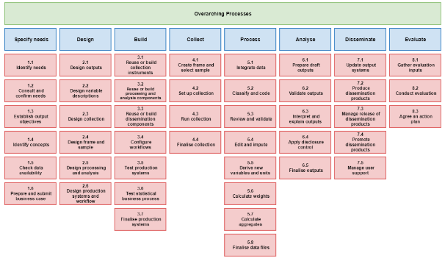

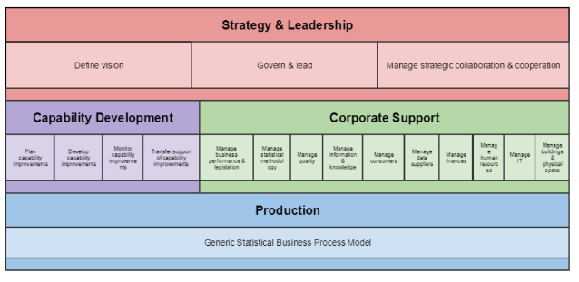

Supporting Standards Group
The goal of the group is to find ways how to develop, enhance, integrate, promote, support and facilitate implementation of the range of standards needed for statistical modernisation.
Operational responsibility for the maintenance and development of the ModernStats models:
GAMSO
Generic Activity Model for Statistical Organisation
GSBPM
Generic Statistical Business Process Model
GSIM
Generic Statistical Information Model
CSPA
Common Statistical Production Architecture

Slide 3
Members
20 experts from 12 NSOs and 4 international statistical organizations
Members | Organizations
Zoltán Vereczkei - Chair | Hungary
Anna Dlugosz | Poland
Carlo Vaccari | Italy
Cory Chobanik | Canada
Csaba Ábry | Hungary
Dan Gillman | United States
David Barraclough | OECD
Edgardo Greising | ILO
Emanuele Baldacci | Eurostat
Essi Kaukonen | Finland
Members | Organizations
Flavio Rizzolo | Canada / DDI
Florian Vucko | France
Franck Cotton | France
Juan Muñoz | Mexico
Kevin McCormack | Ireland
Martina Hahn | Eurostat
Matjaz Jug | Netherlands
Mauro Bruno | Italy
Omurbek Ibraev | Kyrgyzstan
Waleed Mohamed | Egypt

Slide 4



Network of experts
5 task teams in 2021
Linking GSBPM and GSIM task team – 18 members
Geospatial task team – 20 members
GSIM task team – 21 members
Core Ontology for Official Statistics task team – 17 members
GSBPM “task” task team – 9 members
57 unique members from (17 national and 3 international organizations)
35 virtual meetings in 2021

Slide 5
Overview of 2021 activities
Geospatial
Completed, available here
Task teams
Linking GSBPM-GSIM
To be completed by end of 2021
Core Ontology (COOS)
To be completed by end of 2021
GSIM
Started as „soft update”…
GSBPM “task”
On-going (started in Fall 2021)
Group
ModernStats Governance
Completed, available here
ModernStats Usage Survey
Completed, available here

Slide 6
Linking GSBPM and GSIM task team
Sub-process 5.3 Review and validate
Process Input Specification | Process Design | Process Output Specification
Core Input type Data Sets (Unit Data Sets) to be reviewed and validated Data Structures associated with Data Sets to understand Data Sets Represented Variables to be reviewed and validated Process Methods that specifies methodology for review and validation (e.g. calculating plausibility or validity) which can be represented as Rules, as designed in Phase 2 Parameter Input type Parameter values to be used for review and validation methodologies as specified in Process Method such as: Limit value for edit Rule (interval for valid values) Threshold for checking outlier Process Support Input type Auxiliary Data Sets or any Information Resource to be used for review and validation, e.g. historic comparison, macro-level comparison Technical / methodological handbooks, policies or guidelines to be followed regarding data validation as well as quality management | Process Method Review Data Sets and Process Methods Apply Process Methods and Rules to review Data Sets Apply Process Methods and Rules to validate Data Sets Calculate quality measures specified by Process Methods Update Data Sets and associated element in Data Structure with results from review and validation | Core Output type Data Sets (Unit Data Sets): updated Data Set Data Structure associated with Data Set Referential metadata: descriptions of the Process Methods used, quality information summarising Process Metrics or any other relevant information to be passed along with Data Sets Process Metric type Quality measures related to review and validation such as: Number of validations conducted Number of outliers detected Quality measures of Process Step such as: Time spent to complete the Process Step (derived from Process Execution Log) Cost spent to complete the Process Step Process Execution Log type Execution log such as Time that Process Step started Time that Process Step ended Any message or event log generated from software used for review and validation
Process Control Design Have all Represented Variables needs to be reviewed? If YES, go to next Process Step in Business Process If NO, go to the beginning of current Process Step

Slide 7
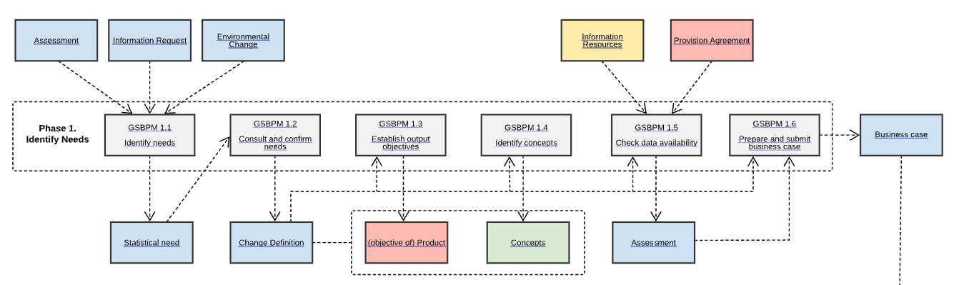
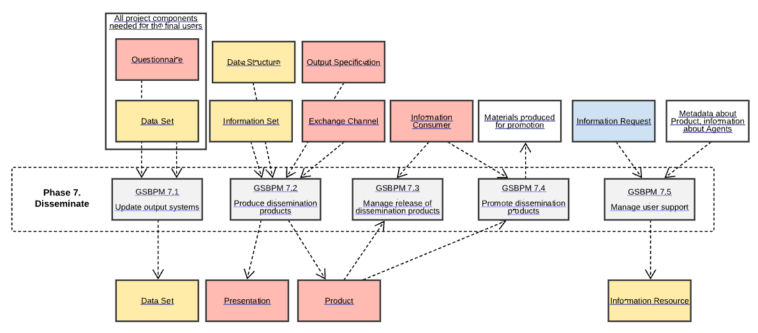
Linking GSBPM and GSIM task team
(Examples of “clickable” version of information flow: phase 1 and phase 7)

Slide 8
Linking GSBPM and GSIM task team
Integrated view for GSBPM and GSIM.
Help us (you) to better understand the relationship between the GSBPM and GSIM.
Valuable to help you to move forward with implementation of ModernStats models (especially GSIM after GSBPM or the two models together).
Easier interpretation of GSIM objects and definitions
Available for GSBPM sub-processes.

Slide 9
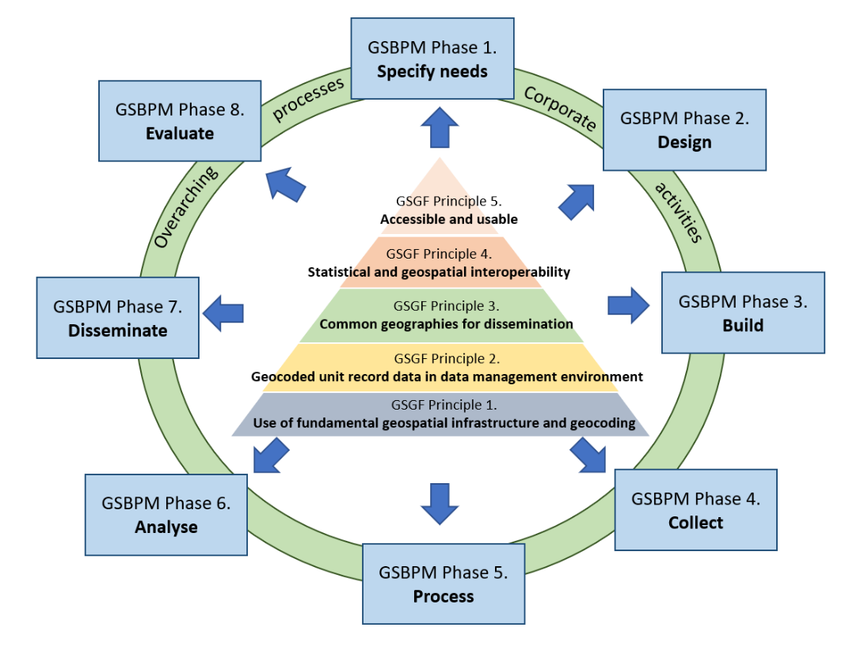
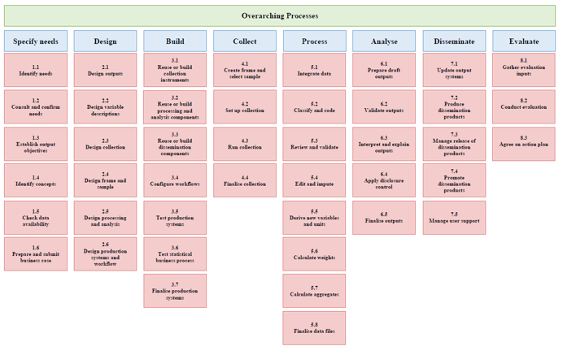
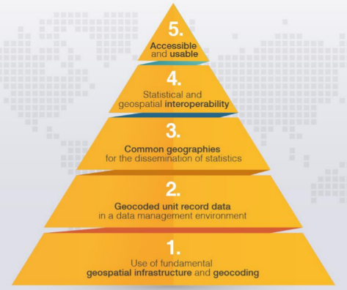
Geospatial task team: GeoGSBPM
Global Statistical Geospatial Framework (GSGF) provides principles that supports the production of harmonized and standardized geospatially enabled statistical data.
GeoGSBPM operationalizes the GSGF principles throughout the production process.
GSBPM
GSGF

Slide 10
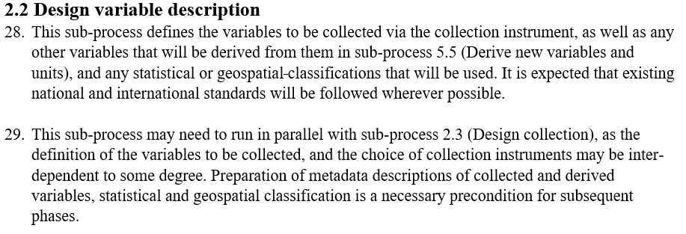
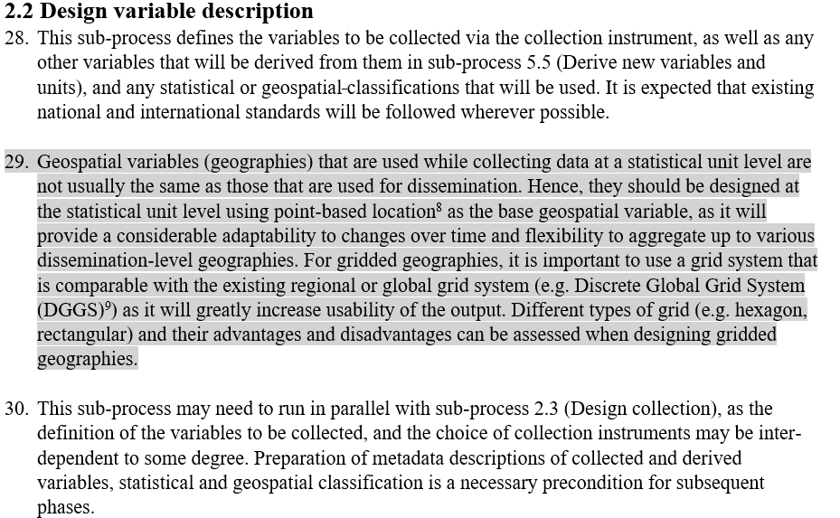
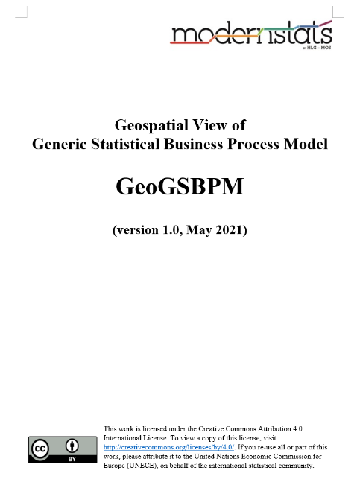
Geospatial task team: GeoGSBPM
GeoGSBPM describes geospatial-related activities and considerations using the framework of the GSBPM
(Example of GSBPM sub-process 2.2 Design variable description)
GSBPM original text
Geospatial-related consideration and activities
Available on GeoGSBPM wiki

Slide 11
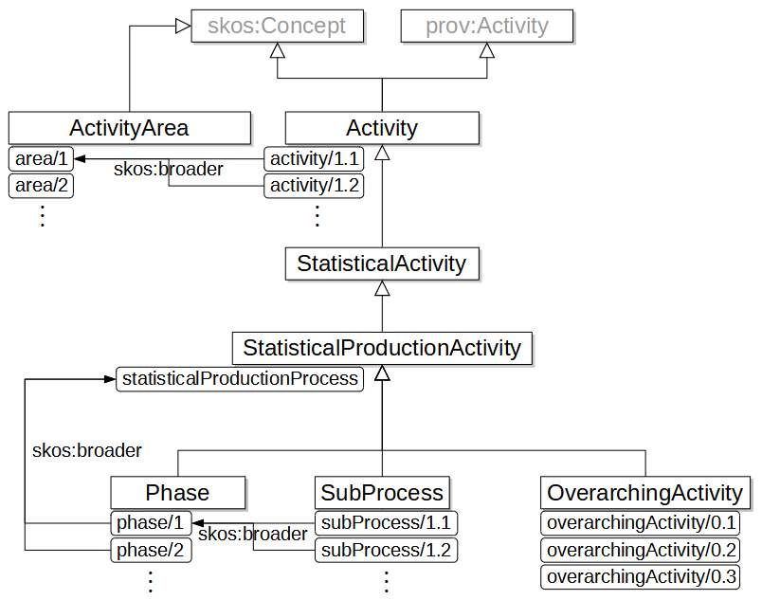
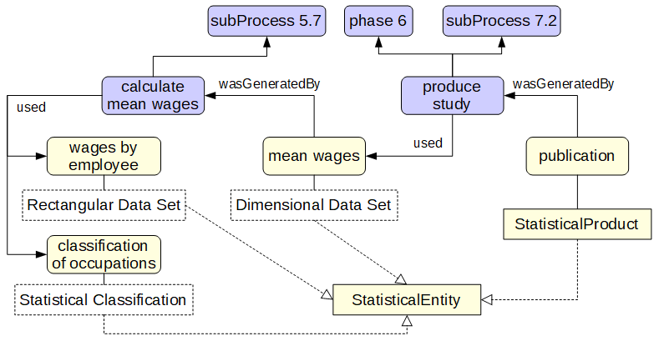
Core Ontology task team
Example: COOS and external vocabularies it links to can allow to represent and share concrete statistical processes
COOS integrating ModernStats models (GSBPM, GAMSO)

Slide 12
Core Ontology task team
Trends:
  Collaboration in order to define business models aiming at building common representations of processes and information in the domain of official statistics: ModernStats models: GSBPM, GSIM, GAMSO, CSDA.
  More and more statistical offices turn to semantic standards in order to formalize their data and metadata.
  Core ontology suggests formal representations for the core concepts used in our domain.
What is available? Ontology specification, a governance document, a URI policy and OWL ontology (under expert review).
Details on Github: https://linked-statistics.github.io/COOS/coos.html

Slide 13
GSIM task team
Produced GSIM Communication Paper in 2020.
We started as a „soft update” but ended up to overcame challenges with a lot of added value for the future GSIM version. These are fundamental for the model (re-assessment of several key GSIM objects and modify them) → full revision.
2021: lot of focus on interoperability: Linking GSBPM and GSIM and Core Ontology task teams provided valuable inputs and renewed perspectives on how GSIM could be used in conjunction with GSBPM and GAMSO.

Slide 14
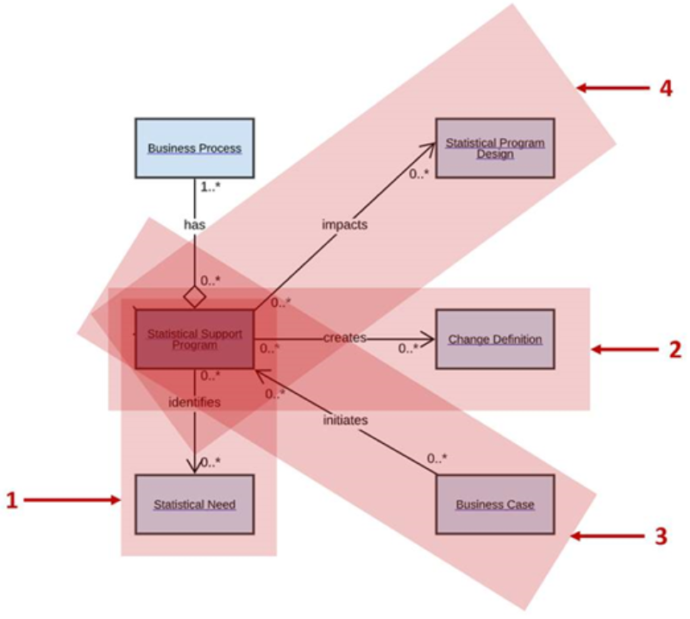
GSIM task team
Two GSIM objects „Statistical Program” and „Statistical Support Program” were heavily discussed, with various scenarios (e.g., GSBPM Phase 1, Phase 8, GAMSO corporate support) and organizational set-up.
As the level of process standardization increases in the statistical organization, the role of these two objects, and their relationships to GSBPM, become more important.

Slide 15
GSBPM „Tasks” task team
Many countries try to indentify lower level to the GSBPM model and requested compiling a common list for the community.
Country examples available – thank you!
The work started during the fall of 2021 and will continue but already started compiling first proposals (based on common principles for phases and sub-processes).
Mixture of country examples, GSBPM expertise and GSBPM model issues (potential lessons for a future GSBPM revision).
Expect to conclude around June 2022.

Slide 16
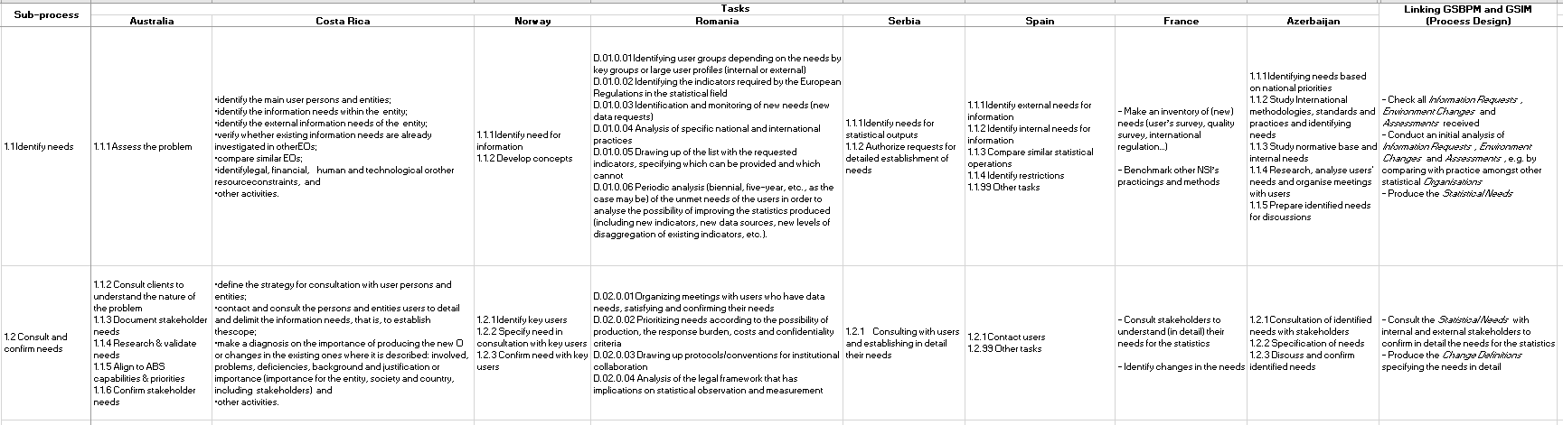
GSBPM „Tasks” task team
(Example of GSBPM „task” level activities from countries)
Different level of granularity, local settings, etc.

Slide 17
Future directions
Ensuring integrated view of our models in practice:
  Revision of existing models that take input directly from lessons learned from the community, the use of our models and the task teams (example: GSIM).
  Investing resources into developing common foundations that help us to understand how the models work together and provide further practical guidance (example: COOS).
  Moving different ModernStats models closer to each other (example: linking GSBPM and GSIM).
(Re)integration of CSPA into the „big picture”.
Clear revision procedures and principles for our ModernStats models: ModernStats Governance Guidance; available here.

Slide 18
Overview of potential 2022 activities
GSIM Revision
Task teams
Core Ontology for Official Statistics: Phase 2
Defining and detailing GSBPM tasks
CSPA capacity building
Further development of GSBPM OP
Relationship between SDMX/DDI and ModernStats
Group
Project support: Statistical Data Governance Framework
ModernStats World Workshop 2022

Slide 19
Are you interested?
Please consider joining our Task Teams and help us to realise our ambitious work programme!
Excellent opportunity to add your expertise and take part in the modernisation programme!

Slide 20
Acknowledgments
Experts committed to the work of the Supporting Standards Group
Chairs of the task teams
UNECE and InKyung Choi for her invaluable support
You

Slide 21
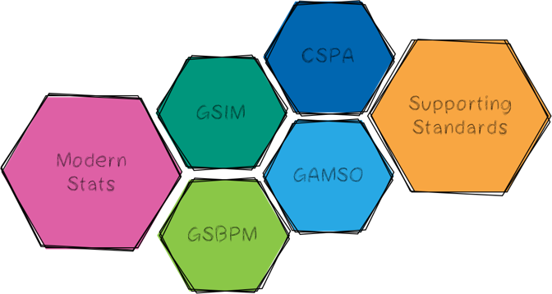
Thank you!
https://statswiki.unece.org/display/hlgbas/Modernisation+Groups

