Slide 1



Blue Skies Thinking Network:
Activities 2021 and
Proposals 2022
11th Annual Workshop of the High-Level Group for the
Modernisation of Official Statistics
15-16 November 2021

Slide 2
Blue Skies Thinking Network
The Blue Skies Thinking Network is the “ideas factory” for the statistical modernisation community. The network provides a research and innovation platform where members can share ideas and look for partners to explore how new innovations to our production process can benefit statistical organisations.
The objective of the Blue Skies Thinking Network is to generate and evaluate proposals for HLG-MOS activities and where needed, to do short time boxed follow-up studies. The network will be an umbrella structure for a core group and short-term task teams to investigate new ideas and opportunities through short evaluation projects supported by the HLG-MOS Executive Board. Any idea that is in line with the HLG-MOS Strategic Framework can be considered. To allow for new innovations, space will also be given to out-of-the-box thinking.

Slide 3
Blue Skies Thinking Network
BSTN Core Team
Monthly (online) meetings to supervise ongoing activities and discuss new ideas
Some to be carried out by BSTN and associates, some by others
2021: seven activities under BSTN umbrella
Proposed and endorsed at HLG-MOS Workshop 2020
Different approaches
Not all of them did materialize
Six activity proposals for 2022
Partly subject to further elaboration

Slide 4
Activities 2021
The power of network data: feasibility studies (Daniel Elazar, ABS)
COVID-19 hotspot joint biosecurity centre platform (Eric Deeben, ONS)
User research for official statistics (Eric Anvar, OECD)
Rapid survey system (Branko Josipović, SORS)
From experimentation to implementation in official statistics (Kate Burnett, StatsCan)
Microdata for understanding falling response rates (Gary Dunnet, StatsNZ)
Facebook-based COVID survey (Barteld Braaksma, StatsNL)
See two-pager with pitches

Slide 5
Activity proposals for 2021
The power of network data: feasibility studies (Daniel Elazar, ABS)
COVID-19 hotspot joint biosecurity centre platform (Eric Deeben, ONS)
User research for official statistics (Eric Anvar, OECD)
Rapid survey system (Branko Josipović, SORS)
From experimentation to implementation in official statistics (Kate Burnett, StatsCan)
Microdata for understanding falling response rates (Gary Dunnet, StatsNZ)
Facebook-based COVID survey (Barteld Braaksma, StatsNL)
See two-pager with pitches

Slide 6
Supply Chain Network Disruption Model
Aim: To reconstruct (B2B supply chain) networks to better understand real-world phenomena and articulate the risks of cascading effects (disruptions) in said networks
Received input from noted academics on the ABS Methodological Advisory Committee
First prototype expected in March 2022
Model relies on some data of business-to-business connections
  So far, most data sources are 2-5 years away from being viable
  Credit risk companies and survey data seem most promising
Exploring collaborations with stats offices (CBS & ONS) and universities (UoM & UQ)
Notes:
CBS = Statistics Netherlands
ONS = Office for National Statistics
UoM = University of Melbourne
UQ = University of Queensland

Slide 7
Joint Biosecurity Centre (UK)
In Collaboration with JBC:
Built a Secure, collaborative Google Cloud Platform
  Support Secure Research Service overflow
  Learning for Integrated Data Service
Developing
  Early warning model – pharma data, waste water
  Risk model – work place, mobility, travel type, other socio-demographic indicators
  Novel approach to incidence – flight paths

Slide 8
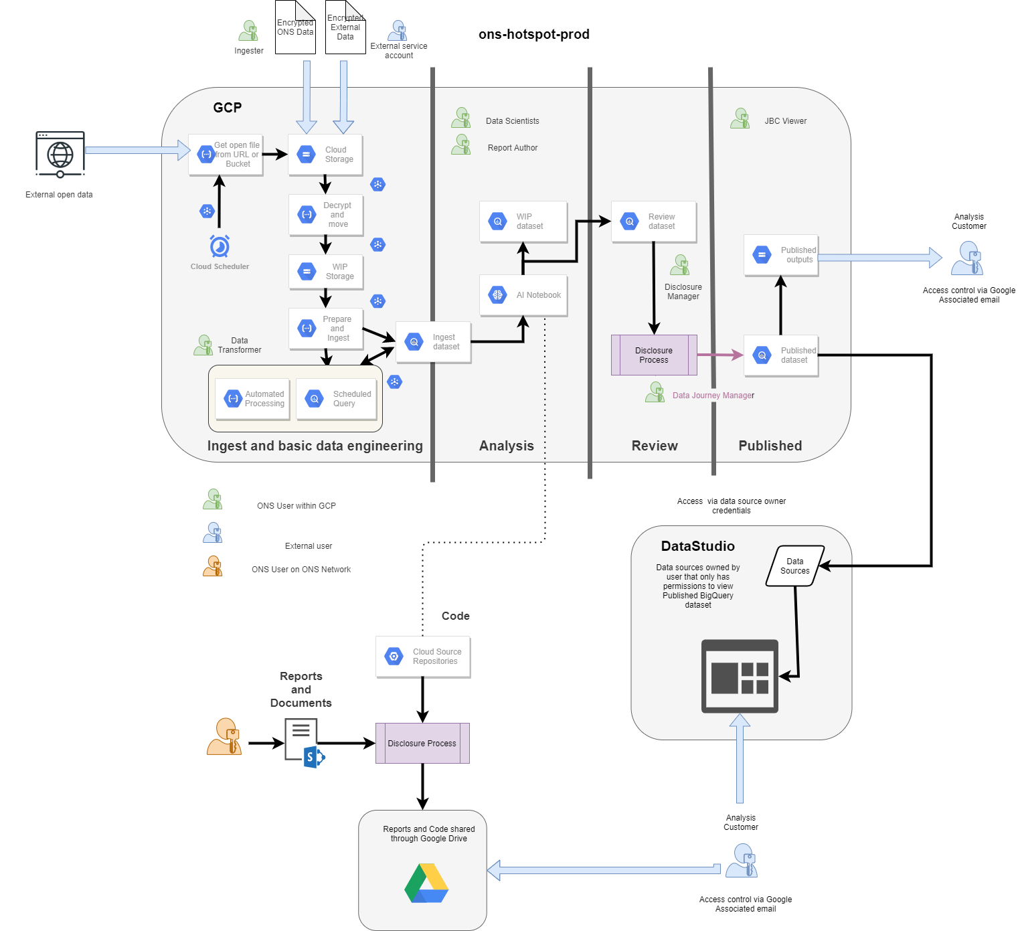
COVID-19 Hotspot Joint Biosecurity Centre Platform (JBC)
The JBC was created in helping to break the chains of COVID-19 transmission
through expert analysis and insight, enabling evidence-based decisions at a national and local level.
ONS Data Science Campus and Digital Service Technology build a Flexible analytical single platform for all data and analysts to work in one place, assured for data security but flexible enough to adapt to changing needs, build in Google cloud for scalability.
Cloud native tools for data management and modelling, outputs are managed and controlled, access is authenticated.
Data processing in Big Query, Python, R or a combination of them all; use the latest, most powerful libraries and modules (including geography and NLP).

Slide 9
Rapid Survey System (Serbia)
To assess economic indicators for a month in advance in areas such as:-
  Industrial production
  Retail trade
  Construction works
Fully automated accessible – phone, tablet, computer or by QR code
Online application made in asp.net and using MVC classes
Developed application to send large number of questionnaires by email
Developed a highly important component is a tool for monitoring the flow of the survey in real-time

Slide 10
From experimentation to implementation in official statistics
Goal: identify common issues that block the transition from R&D to production
Spring 2021: initial discussions on approach
  Limited survey among BSTN members amd associates
15 April 2021: virtual workshop to identify main/common roadblocks
  Culture and IT (open source technologies)
12 July 2021: invited paper session at World Statistics Conference (CA, NL, NZ, UK)
  Very good turnout, we all face similar problems
  Follow-up considered at Q2022
Key reflection: topic too big to handle, progress step-by-step
  Led to Meta Academy project proposal

Slide 11
Activity Proposals for 2022

Slide 12
Activity proposals for 2022
Community on metadata and data virtualization (soapbox)
Digital twins (confirmed)
Follow-up JBC/RSS/… (confirmed)
Microdata for understanding falling response rates (postponed from 2021)
Mobile survey data collection for climate change (TBD)
Nowcasting (TBD)
See document

Slide 13
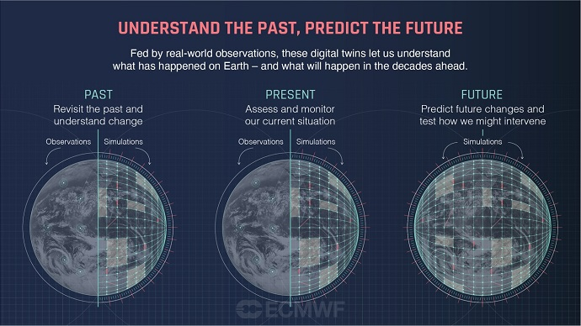
Digital Twins
Digital (often 3D) copy of a real object
  Human body
  City
  The world
Can be used for understanding reality
  Predicting policy effects
  Scenario analysis
Focus often on physical environment
  But in the end it is about human behaviour!
  Clear role for our social and economic data
Activity proposal available
Destination Earth

Slide 14
Collaboration proposal ONS- SORS- OECD
Exploring to workon joint use case the develop:
  Cloud base platform open software based architecture
  Open access to survey data
  Methods, tools and governance framework
Progress in 2021and next steps
  Scope initial idea
  Limited progress due to resource constraints
  Meet with Brank/SORS and Eric/OECD 23/11 to discuss plans for 2022 and start on ToR.
  Plan workshop 2022

Slide 15

That’s it for now- but innovation never stops ☺
Very impressive my dear colleague-
but does it also work in theory?

