Slide 1
The Road Towards OGC APIs for DGGS
Dr Matthew B.J. Purss,
Co-Chair OGC DGGS Domain & Standards Working Groups
29 April 2021

Slide 2
Overview
Brief intro into OGC APIs
Recent Implementation Project exploring DGGS APIs
Moving towards a standard OGC API for DGGS

Slide 3
A Peak into the World of OGC APIs
OGC API Promo Video

Slide 4
OGC API – Common – Part 1: Core
Overview – http://docs.opengeospatial.org/DRAFTS/19-072.html
Web API Guidelines
Web Linking (RFC 8288 )
  Link Elements
  Relation Types
Landing Page /
Conformance classes declaration /conformance
API Description & Documentation (e.g. OpenAPI, /api)

Slide 5
OGC API – Common – Part 2: Geospatial Data
Overview – http://docs.opengeospatial.org/DRAFTS/20-024.html
Link from landing page to /collections
List of Collections of Geospatial data at /collections
  Filters: datetime, bbox; limit query parameters
Each collection can be accessible via multiple APIs
  (e.g. DGGS, Tiles, Features, Coverages)
Collection description at .../collections/{collectionId}
  API-specific sub-resources links (e.g. /items, /coverage, /dggs, /tiles)

Slide 6
OGC API – Common – Part 2: Geospatial Data
Overview – http://docs.opengeospatial.org/DRAFTS/20-024.html
Link from landing page to /collections
List of Collections of Geospatial data at /collections
  Filters: datetime, bbox; limit query parameters
Each collection can be accessible via multiple APIs (e.g. DGGS, Tiles, Features, Coverages)
Collection description at .../collections/{collectionId}
  API-specific sub-resources links (e.g. /items, /coverage, /dggs, /tiles)

Slide 7
What can a DGGS API share with other OGC API?
Allow a DGGS backend to power other DGGS-agnostic APIs
  Transparent to the user except for improved data integration and performance
DGGS-specific API for DGGS-enabled client/server and server/server
  Tacked on to resources from other API to retrieve data or trigger processing for a specific DGGS zone
  New resources for DGGS-centric queries, e.g. listing and describing DGGS zones

Slide 8
Some Recent DGGS API Innovation Projects
2018-19 - PYXIS DGGS API (NRCan Funded)
2020 - OGC Testbed 16 – DGGS Stream (Main funding – NRCan)
2020-21 - Modular OGC API Workflows (NRCan Funded)

Slide 9
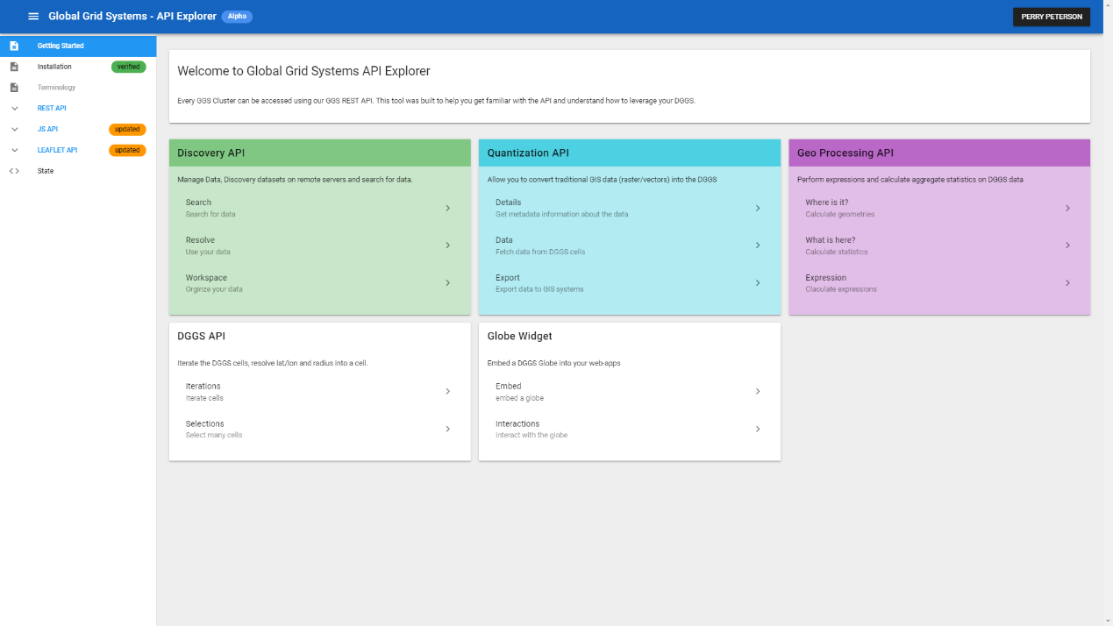
PYXIS DGGS Library and API

Slide 10

Discovery API
Search, discover and manage data source – local and remote endpoints
  Search: This is the main function of the Discovery API. This API returns a list of data source endponts.
  Resolve: Import and prepare data sources for Quantization API.
  Workspace: Organizational structure for imported data sources, DGGS cached data and globes (mashup and analysis).

Slide 11
Quantization API
Convert (sample and quantize) traditional GIS data (raster/vectors) into the DGGS
  Quantize: Samples data into DGGS Cells
  Get Data Details: Returns DGGS related meta-data
  Data Cell Values: Returns data cells values from DGGS dataset

Slide 12
GeoProcessing API - Iterations
Provides access to DGGS Operations
  Iterations:
  Calculations:
  Selections:
  Aggregated Summaries:

Slide 13
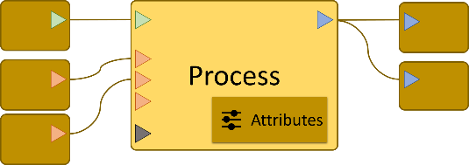
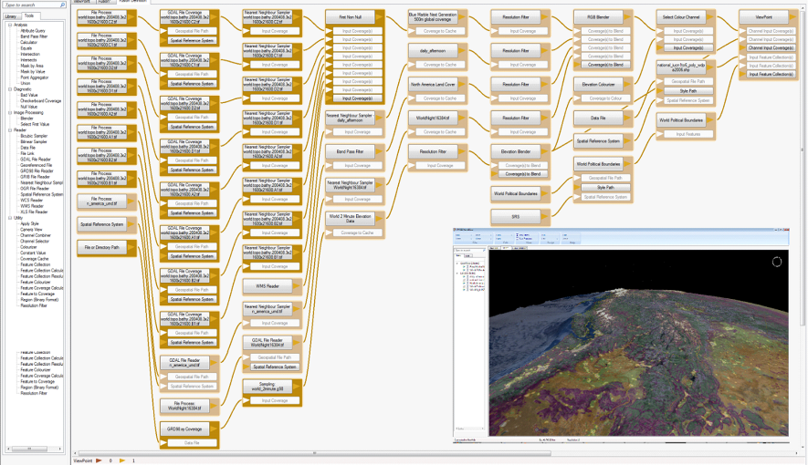
GeoProcessing API
Provides access to DGGS Operations
  Iterations:
  Calculations:
  Selections:
  Aggregated Summaries:

Slide 14
OGC Testbed-16
DGGS Well-Known Text (WKT)
DGGS Spatio-temporal Language
DGGS Topological Functions
DGGS OGC API client/server implementations
  OGC API Processes
  OGC API Features

Slide 15
DGGS – DGGS data – WKT type structure
List of ZoneIDs |  | Directed Lists of ZoneIDs
Type | Examples | Type | Examples
OrdinateList set of nD points | POINT, MULTIPOINT | DirectedOrdinateList nD line vertices | LINESTRING, POLYGON (boundary), TRIANGLE, route, trajectory, timeseries
CellList set of nD regions or spaces | POINT, MULTIPOINT, POLYGON, MULTIPOLYGON, point cloud, raster or WMS image, geo-located social media | DirectedCellList nD connected path | route, trajectory, timeseries, corridor, path
TileList set of tiles or ‘b-box’ | TileSet, DB shard, b-box, jobqueue | DirectedTileList sequence of ‘bbox’ | ordered jobqueue
ZoneCollection collection of other type(s) | MULTILINESTRING, GEOMETRYCOLLECTION | DirectedZoneCollection graph or connected collection of similar or different type(s) | TIN, network (of DirectedOrdinateList or DirectedCellList)
optional | sort by decreasing size, compress

Slide 16
DGGS’s spatio-temporal language
  Operators using Zonal identifier implement topological relations for:
  boundary, distance,
  buffer*, difference*, intersection*, symDifference*, union*,
  contains, touches, disjoint, within, equals, overlaps, withinDistance, intersect,
  relate
  Plus new operators for navigating the resolution hierarchy:
  child*, parent* & sibling*, childOf, parentOf & siblingOf
  Plus new 1D operators borrowed from time can query any dimension:
  (eg above & below in time or before & after in height)
  relativePosition, relatePosition
  operators marked * control the level-of-detail of their result sets, &
  all operators can be constrained to lower dimensionality
  e.g. 2D query on a 3D+T zonal identifier

Slide 17
DGGS: topological functions on ZonalIdentifier
<<query>> (1D) relativePosition(another:ZonalIdentifier, projectTo:DirectPosition[4])
<<query>> contains (another:ZonalIdentifier, projectTo:DirectPosition[4])
crosses (another:ZonalIdentifier, projectTo:DirectPosition[4])
disjoint (another:ZonalIdentifier, projectTo:DirectPosition[4])
equals (another:ZonalIdentifier, projectTo:DirectPosition[4])
intersects (another:ZonalIdentifier,projectTo:DirectPosition[4])
overlaps (another:ZonalIdentifier, projectTo:DirectPosition[4])
touches (another:ZonalIdentifier, projectTo:DirectPosition[4])
within (another:ZonalIdentifier, projectTo:DirectPosition[4])
withinDistance(another:ZonalIdentifier, dist:Distance, projectTo:DirectPosition[4])
parentOf (another:ZonalIdentifier, inheritID:Boolean, projectTo:DirectPosition[4])
childOf (another:ZonalIdentifier, inheritID:Boolean, projectTo:DirectPosition[4])
siblingOf (another:ZonalIdentifier, inheritID:Boolean, projectTo:DirectPosition[4])
<<set>> buffer (dist:Distance, projectTo:DirectPosition[4])
difference (another:ZonalIdentifier, rangeRefine:refinementLevelRange, projectTo:DirectPosition[4])
intersection (another:ZonalIdentifier, rangeRefine:refinementLevelRange, projectTo:DirectPosition[4])
symDifference(another:ZonalIdentifier,rangeRefine:refinementLevelRange, projectTo:DirectPosition[4])
union (another:ZonalIdentifier, rangeRefine:refinementLevelRange, projectTo:DirectPosition[4])
parent (inheritID:Boolean, levels:Integer, projectTo:DirectPosition[4])
child (inheritID:Boolean, levels:Integer, projectTo:DirectPosition[4])
sibling (inheritID:Boolean, levels:Integer, projectTo:DirectPosition[4])
<<reference>> (1D) relatePosition(another:ZonalIdentifier, relate:RelativePosition, projectTo:DirectPosition[4])
<<reference>> relate (another:ZonalIdentifier, matrix:CharacterString, projectTo:DirectPosition[4])

Slide 18
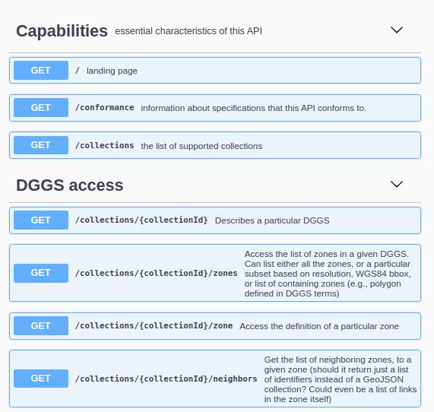

DGGS – OGC API defined and implemented

Slide 19
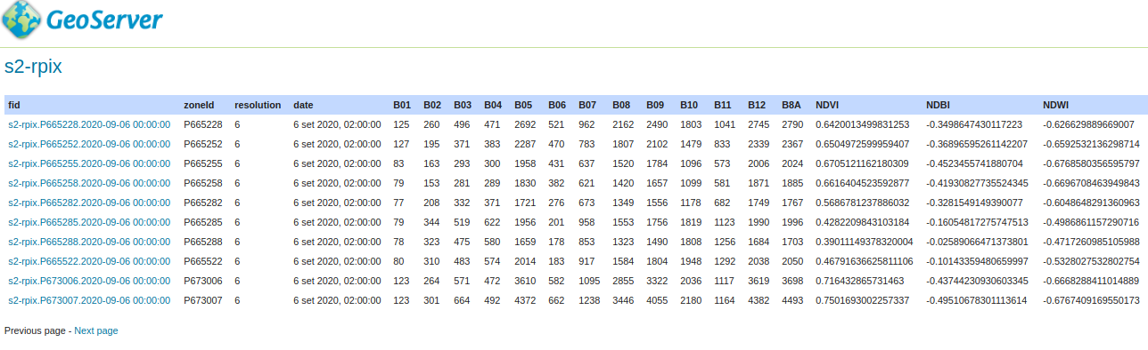
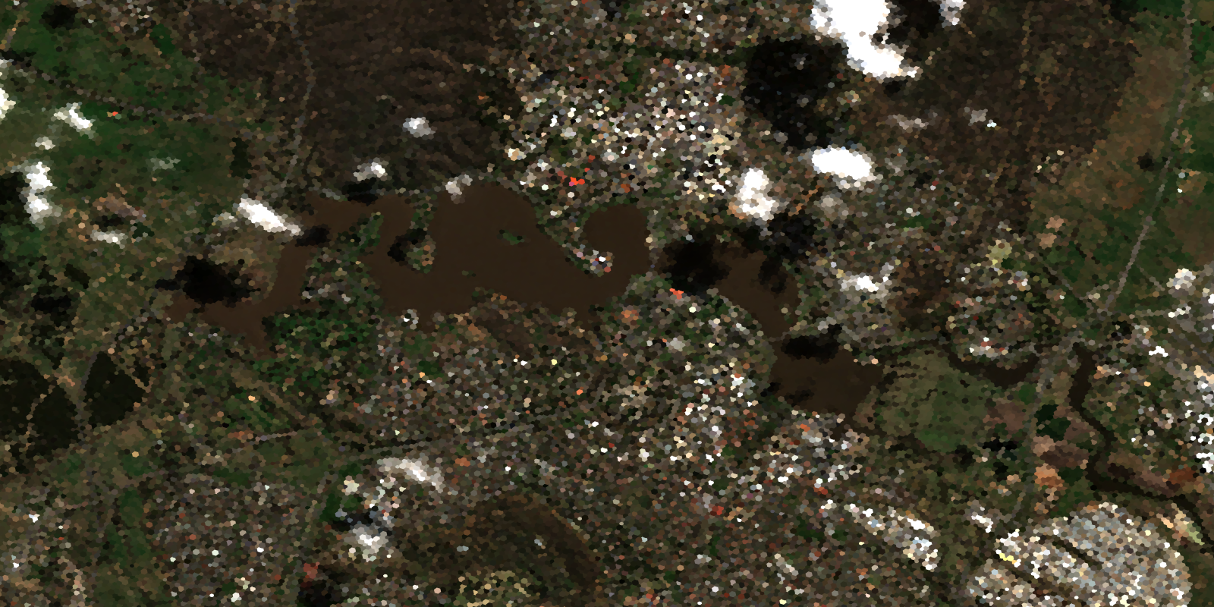
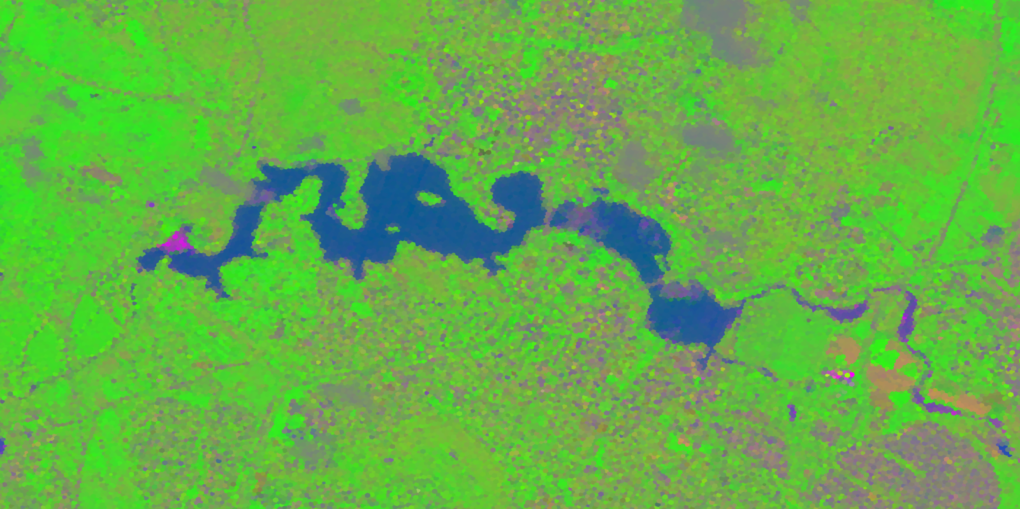
OGC API Processes results with Sentinel 2
Sentinel 2: B04, B03, B02 & NDBI, NDVI, NDWI

Slide 20
Modular OGC API Workflows
OGC API Workflow
OGC API Server
OGC API Server
OGC API Server
OGC API Server
DGGS / Tiles Collection
Feature Collection
Coverage Collection
Query / Function Parameter
OGC API Process

Slide 21
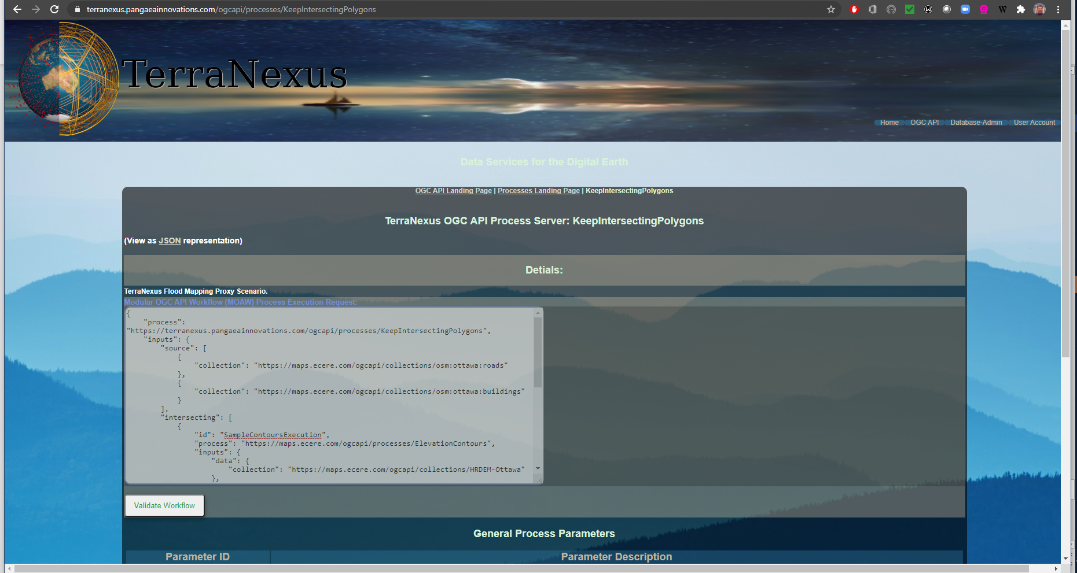
DGGS and Modular OGC API Workflows…

Slide 22
Abstraction of DGGS Behind OGC APIs
{
"process": "https://terranexus.pangaeainnovations.com/ogcapi/processes/KeepIntersectingPolygons",
"inputs": {
"source": [
{
"collection": "https://maps.ecere.com/ogcapi/collections/osm:ottawa:roads"
},
{
"collection": "https://maps.ecere.com/ogcapi/collections/osm:ottawa:buildings"
}
],
"intersecting": [
{
"id": "SampleContoursExecution",
"process": "https://maps.ecere.com/ogcapi/processes/ElevationContours",
"inputs": {
"data": {
"collection": "https://maps.ecere.com/ogcapi/collections/HRDEM-Ottawa"
},
"distance": {
"value": 2
},
"minHeight": {
"value": -100
},
"maxHeight": {
"value": 50
},
"geometryType": {
"value": "lines"
}
}
},
{
"collection": "https://maps.ecere.com/ogcapi/collections/AllOttawa_MajorContours_2m",
"filter": "ELEVATION<50"
}
]
}
}
Inputs
Nested Process/Workflow
OGC API Feature Collections

Slide 23
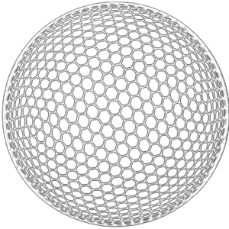
DGGS Next Steps
cf - OGC 20-039 OGC Testbed-16:
DGGS and DGGS API ER¹
Mature DGGS Reference Library Implementations
Explore and elaborate DGGS Common
for OGC APIs
Explore opportunities and limitations of
DGGS driven analytics &
Elaborate DGGS specific OGC APIs
Implement OGC Registries for DGGS implementations and data services
Note 1: OGC 20-039: https://docs.ogc.org/per/20-039r2.html

Slide 24
Contact info@ogc.org to schedule a meeting for an in-depth discussion with OGC staff and join our community today!

