Slide 1
Comments on the
“Degree of Urbanization” & why fine resolution census data are essential
Deborah Balk
Deborah.Balk@baruch.cuny.edu
Remarks prepared for Coffee Talk Webinar for the UN Economic Commission for Europe
25 March 2021

Slide 2
Understanding Urbanization
Is essential
  Most of the future population growth will take place in the cities and towns of the global south
Rigorous comparisons across countries (and within) is critical, and until recently, not possible
  Recent efforts very important in establishing concepts and measures for this comparison
  Recent efforts are start not an end point
Population data remain at the backbone of such efforts.
  Legitimacy based on locally-rooted efforts that also allow for global comparison

Slide 3
NSO data are the backbone!
The data collected by national statistical offices (NSO) matter. A lot.
  Population counts at the finest spatial scale
  Other attributes, too
    on country-specific urban delineations
    Age-sex
Satellite and other ancillary data are also valuable but the quality and utility of DoU depends of data collected by NSOs

Slide 4
Inputs to Degree of Urbanization
GPW + GHSL = GHS-POP → DOU
  GPW = Gridded Population of the World (CIESIN)
  GSHL = Global Human Settlement Layer (JRC)

Slide 5
Population Data & Models
Source: MacManus, Balk, et al., forthcoming

Slide 6
Urban RS-based Depictions
Source: MacManus, Balk, et al., forthcoming

Slide 7
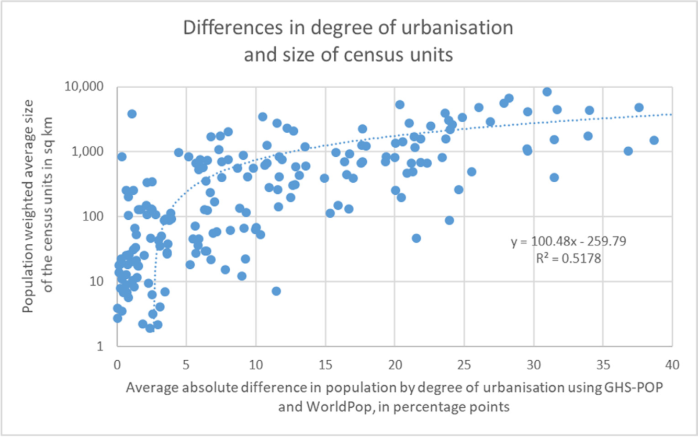
Spatial Resolution of Population Data Matter
Dijkstra et al., 2020

Slide 8
Understanding the differences are critical
Source: Balk, Leyk et al., forthcoming

Slide 9
Recommendation
Censuses: invest (collect) and make publicly available the finest resolution census units possible
  Non-census countries: same hold for admin data
Collect information other than pop counts, in particular countries’ own urban classification
  Can be very helpful in validation and predictions
Equivalency in units that change over time
  Intrinsically tricky but desirable b/c units that change status over time are often modified.
  But these may well be the most dynamic units

Slide 10
Extra

Slide 11
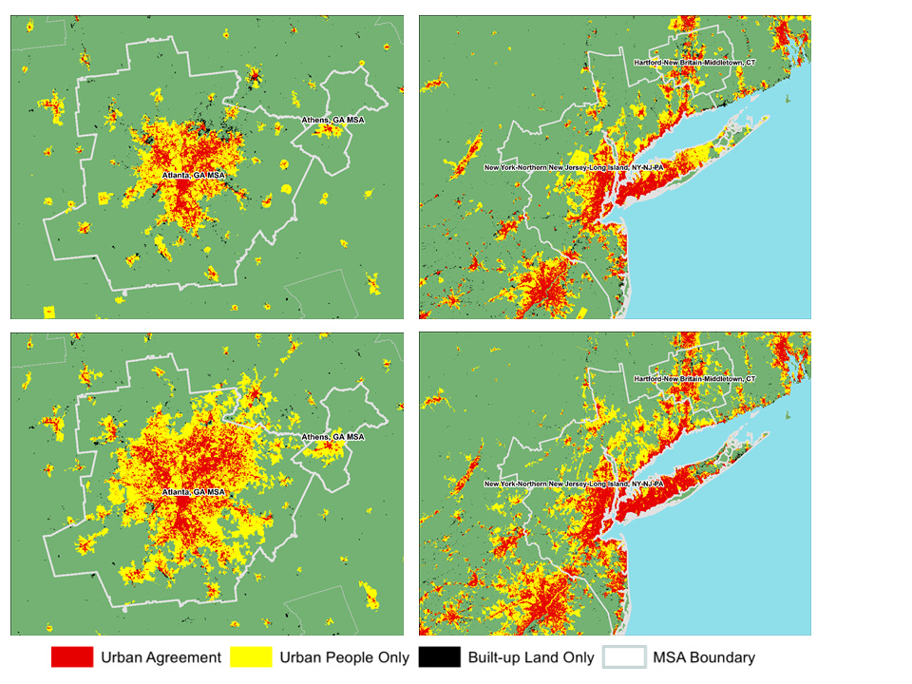
Validation studies will help understand how and where to use DoU
Balk et al., 2018; Leyk et al., 2019

Slide 12
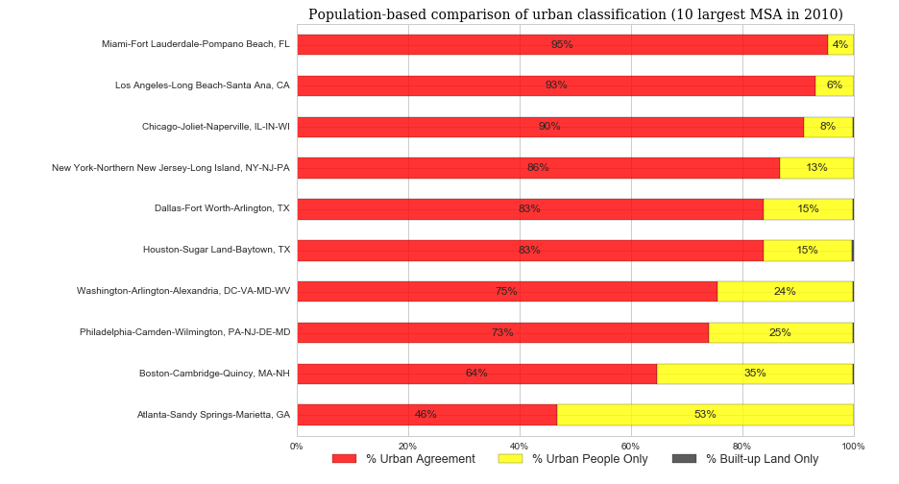
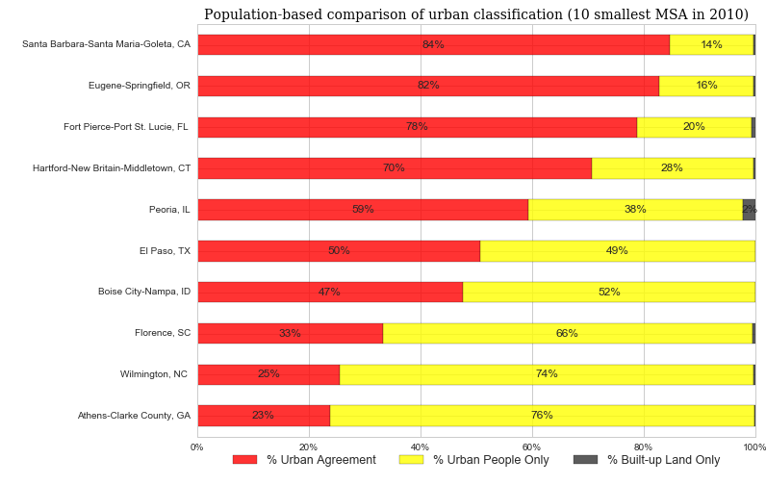
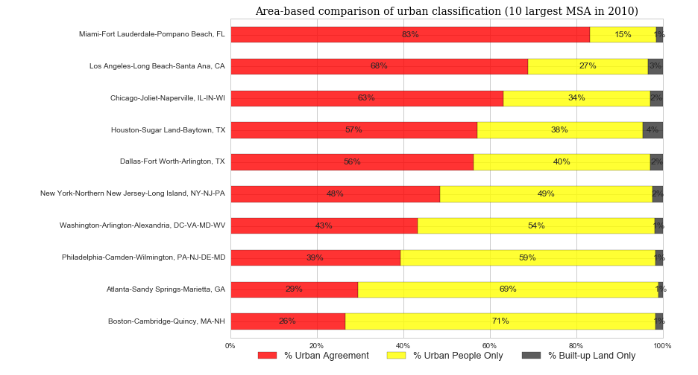
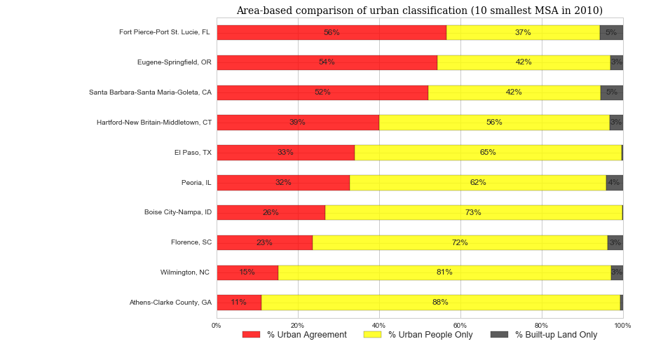
Capturing urban depends on city-size

Slide 13
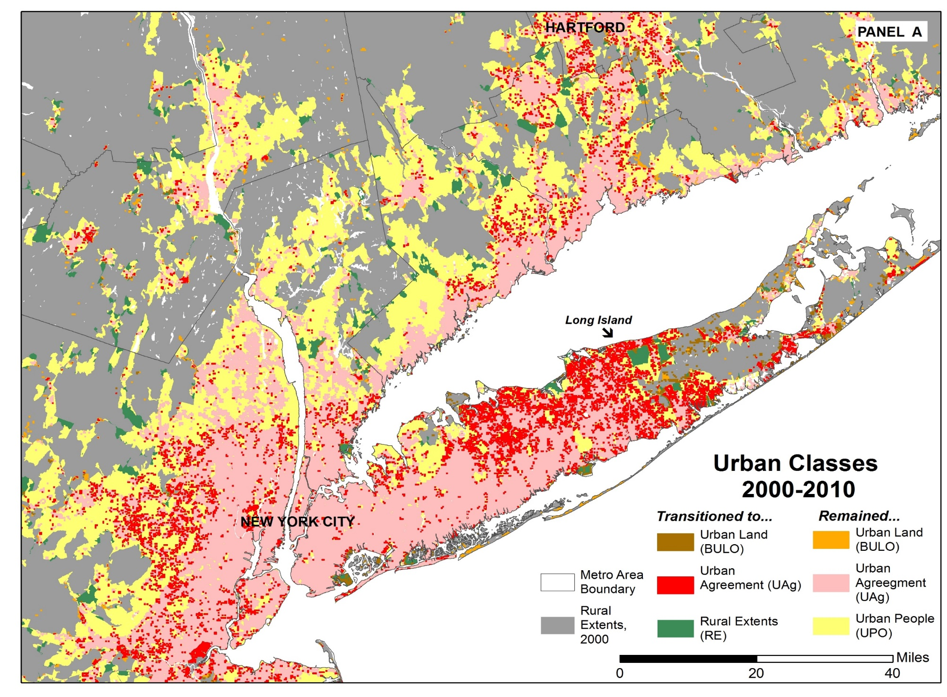
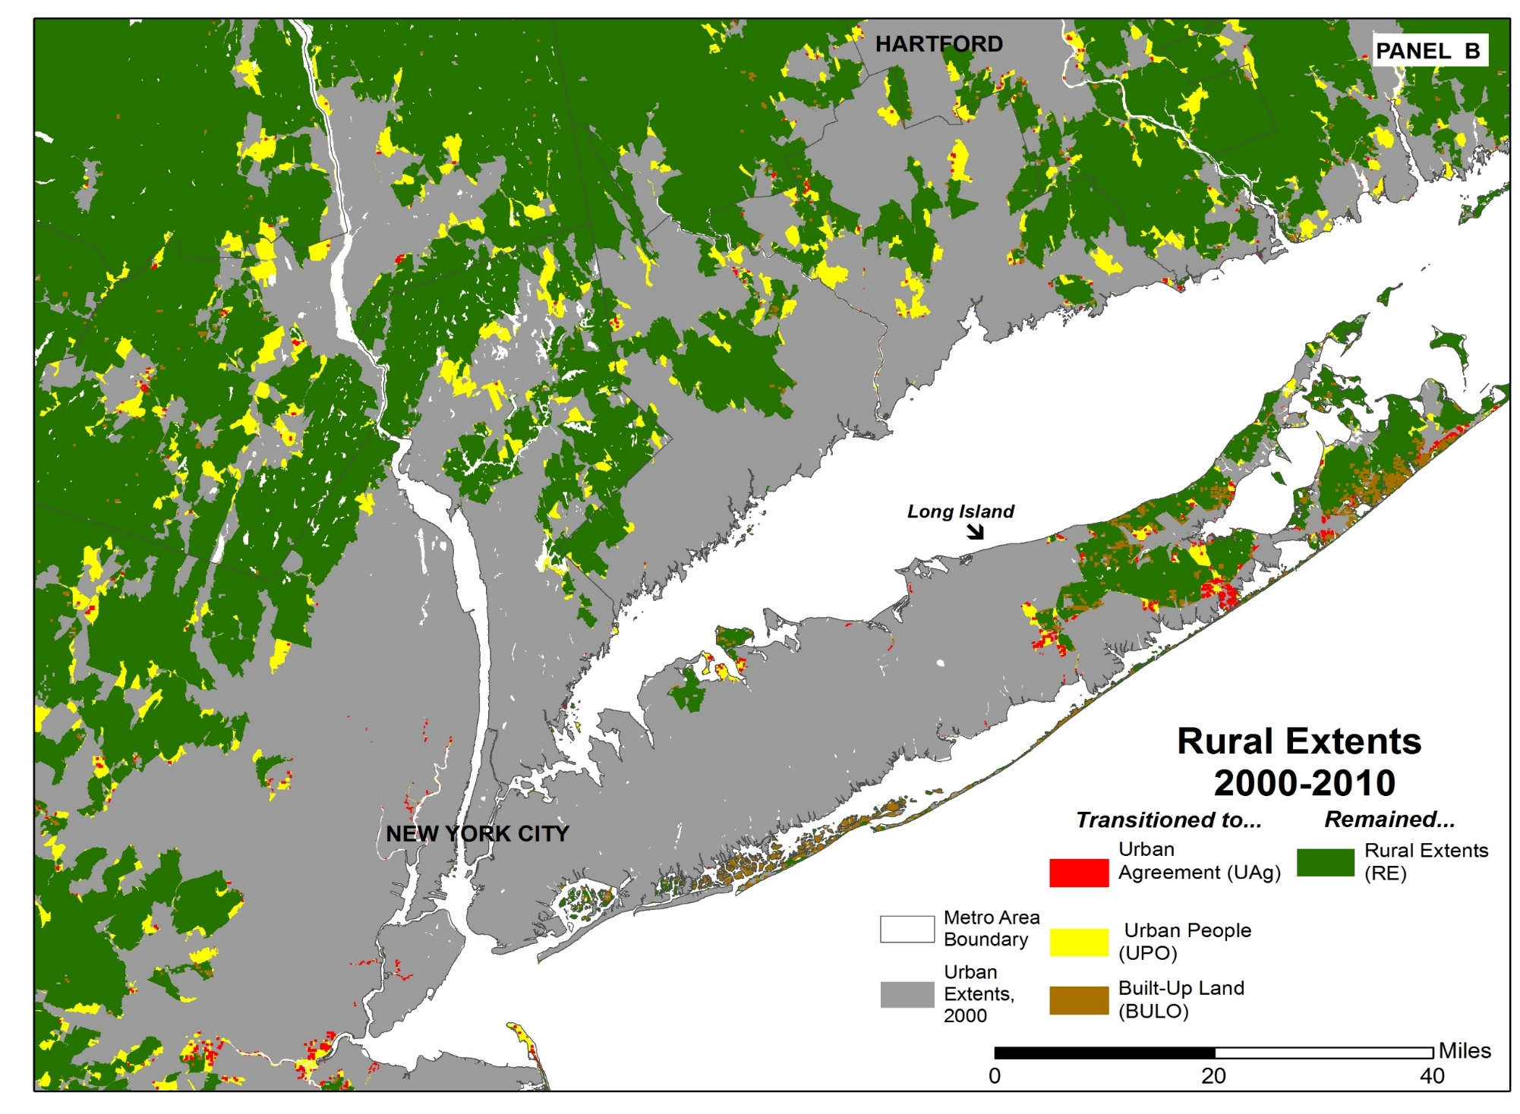
Changes in Urban Classification

Slide 14
Changes in built-up predict official transition to urban classification
Source: Jones, Balk and Leyk, 2020

