Slide 1
Generic Statistical Data Editing Model (GSDEM)
Version 2.0, June 2019. WS-MOS 19.11.2019
Daniel Kilchmann
(Swiss Federal Statistical Office)

Slide 2
Background (1)
GSBPM
  “…describes and defines the set of business processes needed to produce official statistics.”
  “…should […] be seen more as a matrix, through which there are many possible paths”.
GSIM
  “…information object framework supporting all statistical production processes…”.
Standard way to understand and develop statistical data editing (SDE) processes?
Need for common reference framework for the staff working in SDE area to better share ideas, processes, and services.

Slide 3
Background (2) - GSDEM
Generic Statistical Data Editing Model (GSDEM)
  Version 1.0: Released in October, 2015.
  Update to align with revisions of other HLG models and reflect progress in editing and imputation.
  Great opportunity to prepare a supporting document for project managers, methodologists and IT…
  revision → 7 months.
  Latest version, June 2019.

Slide 4
Authors
Version, 11 people | Country | 2. Version, 12 people | Country
Saara Oinonen, Pauli Ollila, Marjo Pyy-Martikainen | Finland | Alexander Kowarik | Austria
Emmanuel Gros | France | Darren Gray | Canada
Marco Di Zio, Ugo Guarnera, Orietta Luzi | Italy | Katrin Walsdorfer | Germany
Li-Chun Zhang | Norway | Fabiana Rocci, Simona Rosati, Giorgia Simeoni | Italy
Jeroen Pannekoek | Netherlands | Olav ten Bosch, Jeroen Pannekoek (advisor) | Netherlands
Tetyana Kolomiyets, Steven Vale | UNECE | Daniel Kilchmann | Switzerland
 |  | Fern Leather | U.K.
 |  | InKyung Choi, Taeke Gjaltema, Salome Studer | UNECE

Slide 5
GSDEM – Chapter description
Executive summary.
Background and Introduction of fundamental definitions.
Description of most common methods and functions using a generic terminology to explain data editing functions (review, selection, treatment).
Description of metadata needed to define and describe the data editing functions → fostering automation and better control of the data editing process.
Description of the elements defining a SDE process flow representing the sequencing of the different process steps.
General proposals of most common flow models with the aim to help users to develop, assess and understand SDE processes.

Slide 6
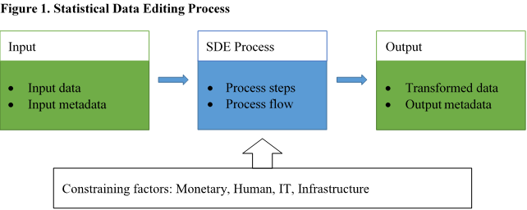
2. Background: SDE process
Grouping of data editing activities to form a "fixed segment“: one point
of entry and one point of exit.
E.g. GSBPM Sub-processes 5.3 “review and validate” and
5.4 “edit and impute”.

Slide 7
3. SDE function types
Review
  Functions that examine the data to identify potential problems.
Selection
  Functions that select units or fields within units for specified further treatment.
Treatment
  Functions that change the data in a way that is considered appropriate to improve data quality.
  The modification of specific fields within a unit (i.e. filling in missing values or changing erroneous ones) is referred to as imputation.

Slide 8
3. SDE function types examples
Review
    value plausibility;
    logical consistency;
    plausibility of macro-level estimates.
Selection
    unit selection for specific treatment;
    selection of influential outlying values for specific treatment;
    selection of variables for treatment by specific imputation methods;
    localising erroneous values among those that are inconsistent.
Treatment
    imputation of missing or discarded (erroneous) values;
    correction of systematic errors;
    adjustment for inconsistencies.

Slide 9
4. SDE metadata types
Process input metadata
    Information objects describing the SDE process input (conceptual/structural metadata: units, variable, value domain, data set, record…).
    additional information needed to apply SDE functions: auxiliary data and parameters.
Process steps and process flow metadata
    Information objects describing SDE process itself.
      For each process step: functions and methods.
      Routing among process steps: process controls.
Process output metadata
    Information objects describing the SDE process output.
    Other metadata produced by SDE process:
      Quality information for input and output data.
      Information how the process has run (not directly related to data quality → paradata).

Slide 10
5. SDE process flow models
Design elements of SDE process flow models
Structural business statistics
      cross sectional sample surveys;
      high number of mostly quantitative variables.
Short-term business statistics
      panel surveys with few variables;
      short production process;
      Output: indices and variation values at aggregated levels.
Business census …
Household statistics …
Statistics through data integration …

Slide 11
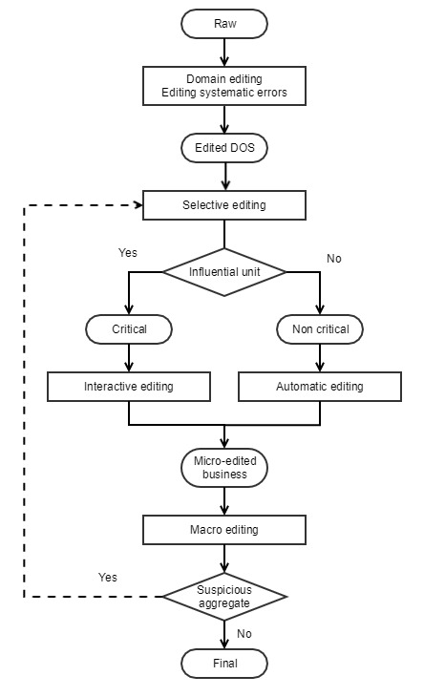
5. SDE process flow model 1)

Slide 12
GSDEM – Conclusions
SDE standardization and sharing of tools and of knowledge is enhanced through a common framework.
Support from management and willingness of the staff is needed.
Offices applying GSBPM and GSIM are in a good position to adopt GSDEM.
Communication: UNECE wiki, SDE Workshop 2020, etc.
Promote, use and enjoy GSDEM!
https://statswiki.unece.org/display/sde/GSDEM

Slide 13
Thank you for your attention

