Slide 1
Core Skills

Slide 2
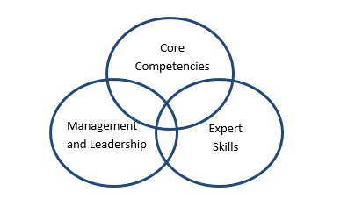
Competency Framework

Slide 3
Competency Framework
Management & Leadership
  Vision and strategy
  Empowering
  judgement/decision making
Core Competencies
  Self-awareness
  Change
  Resilient
  Innovation
  mastery of context
  Accountability
  Adaptability
  client focused

Slide 4
Group Work
Review contents (focused)
Examples of success/ good practice

