Slide 1
The idea of data repositories
Janusz Dygaszewicz
Statistics Poland

Slide 2
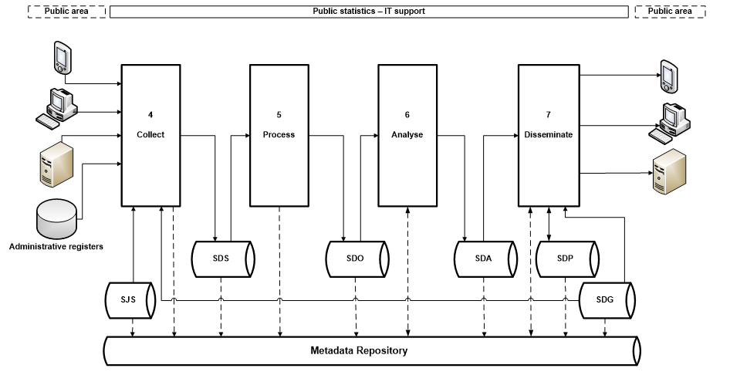

Slide 3
Data repositories supporting GSBPM implementation
List of data repositories:
  a statistical units repository (SJS)
  a raw data repository (SDS)
  an operational data repository (SDO)
  an analysis data repository (SDA)
  a geospatial data repository (SDG)
  a publication data repository (SDP)
  a metadata repository (SMS)

Slide 4
THANK YOU

