Slide 1
NARAStat & NARA-PC
Now? From now on?
Yulla Choi
Statistics Korea

Slide 2
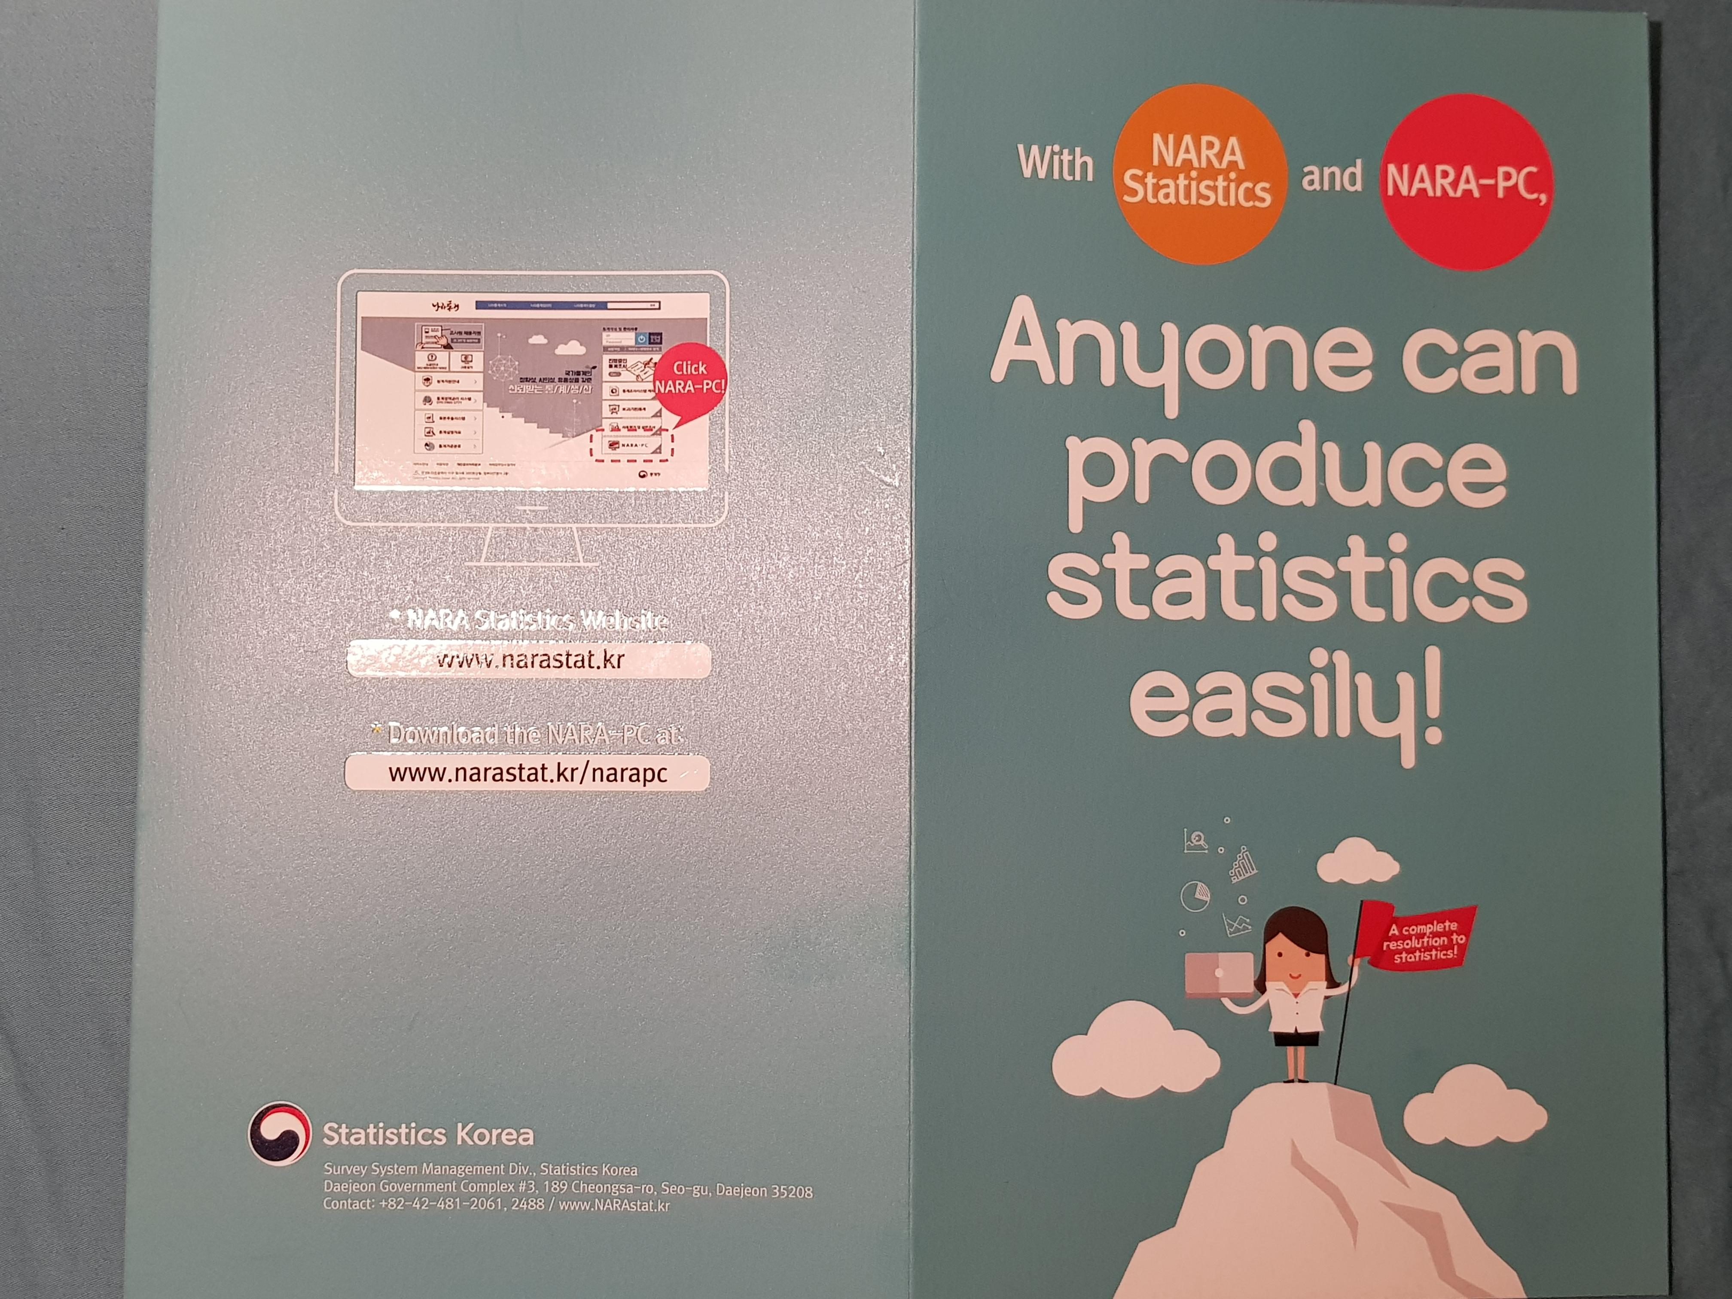

Slide 3
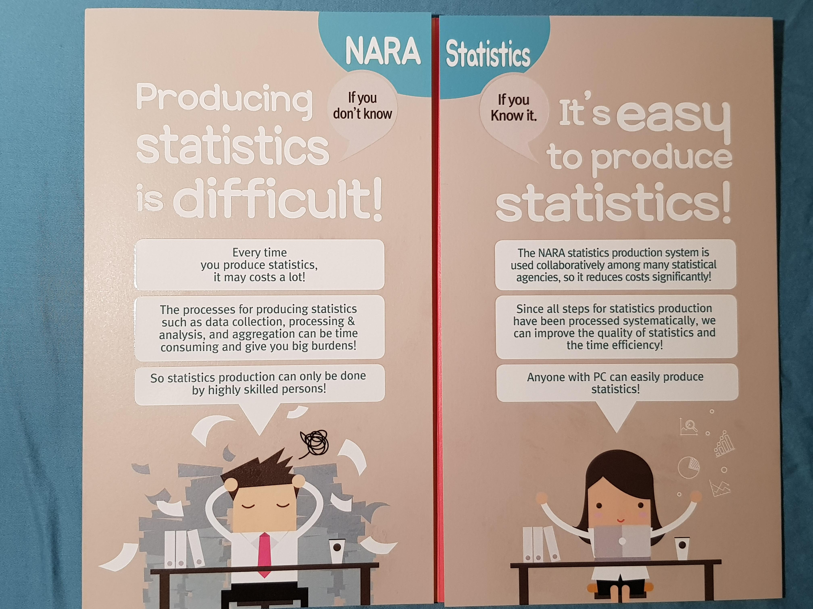

Slide 4
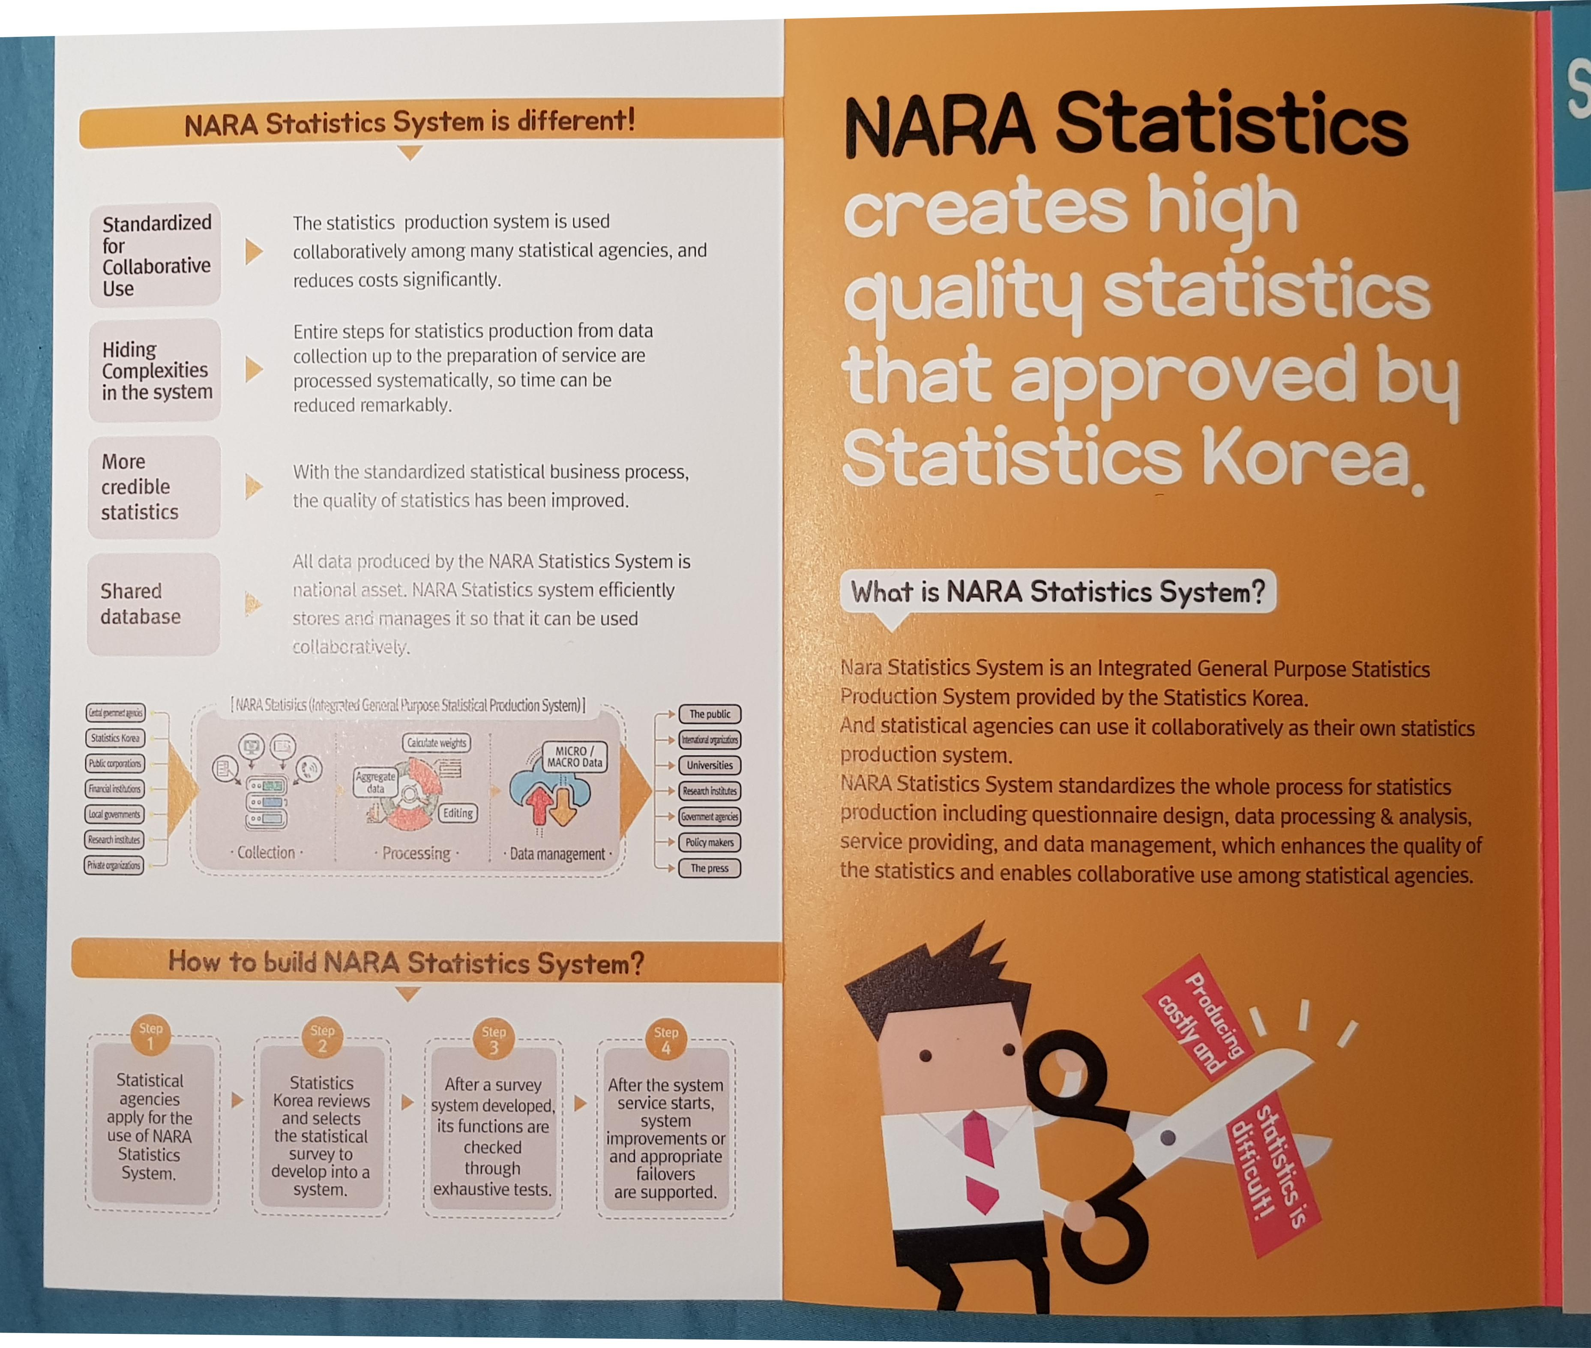

Slide 5
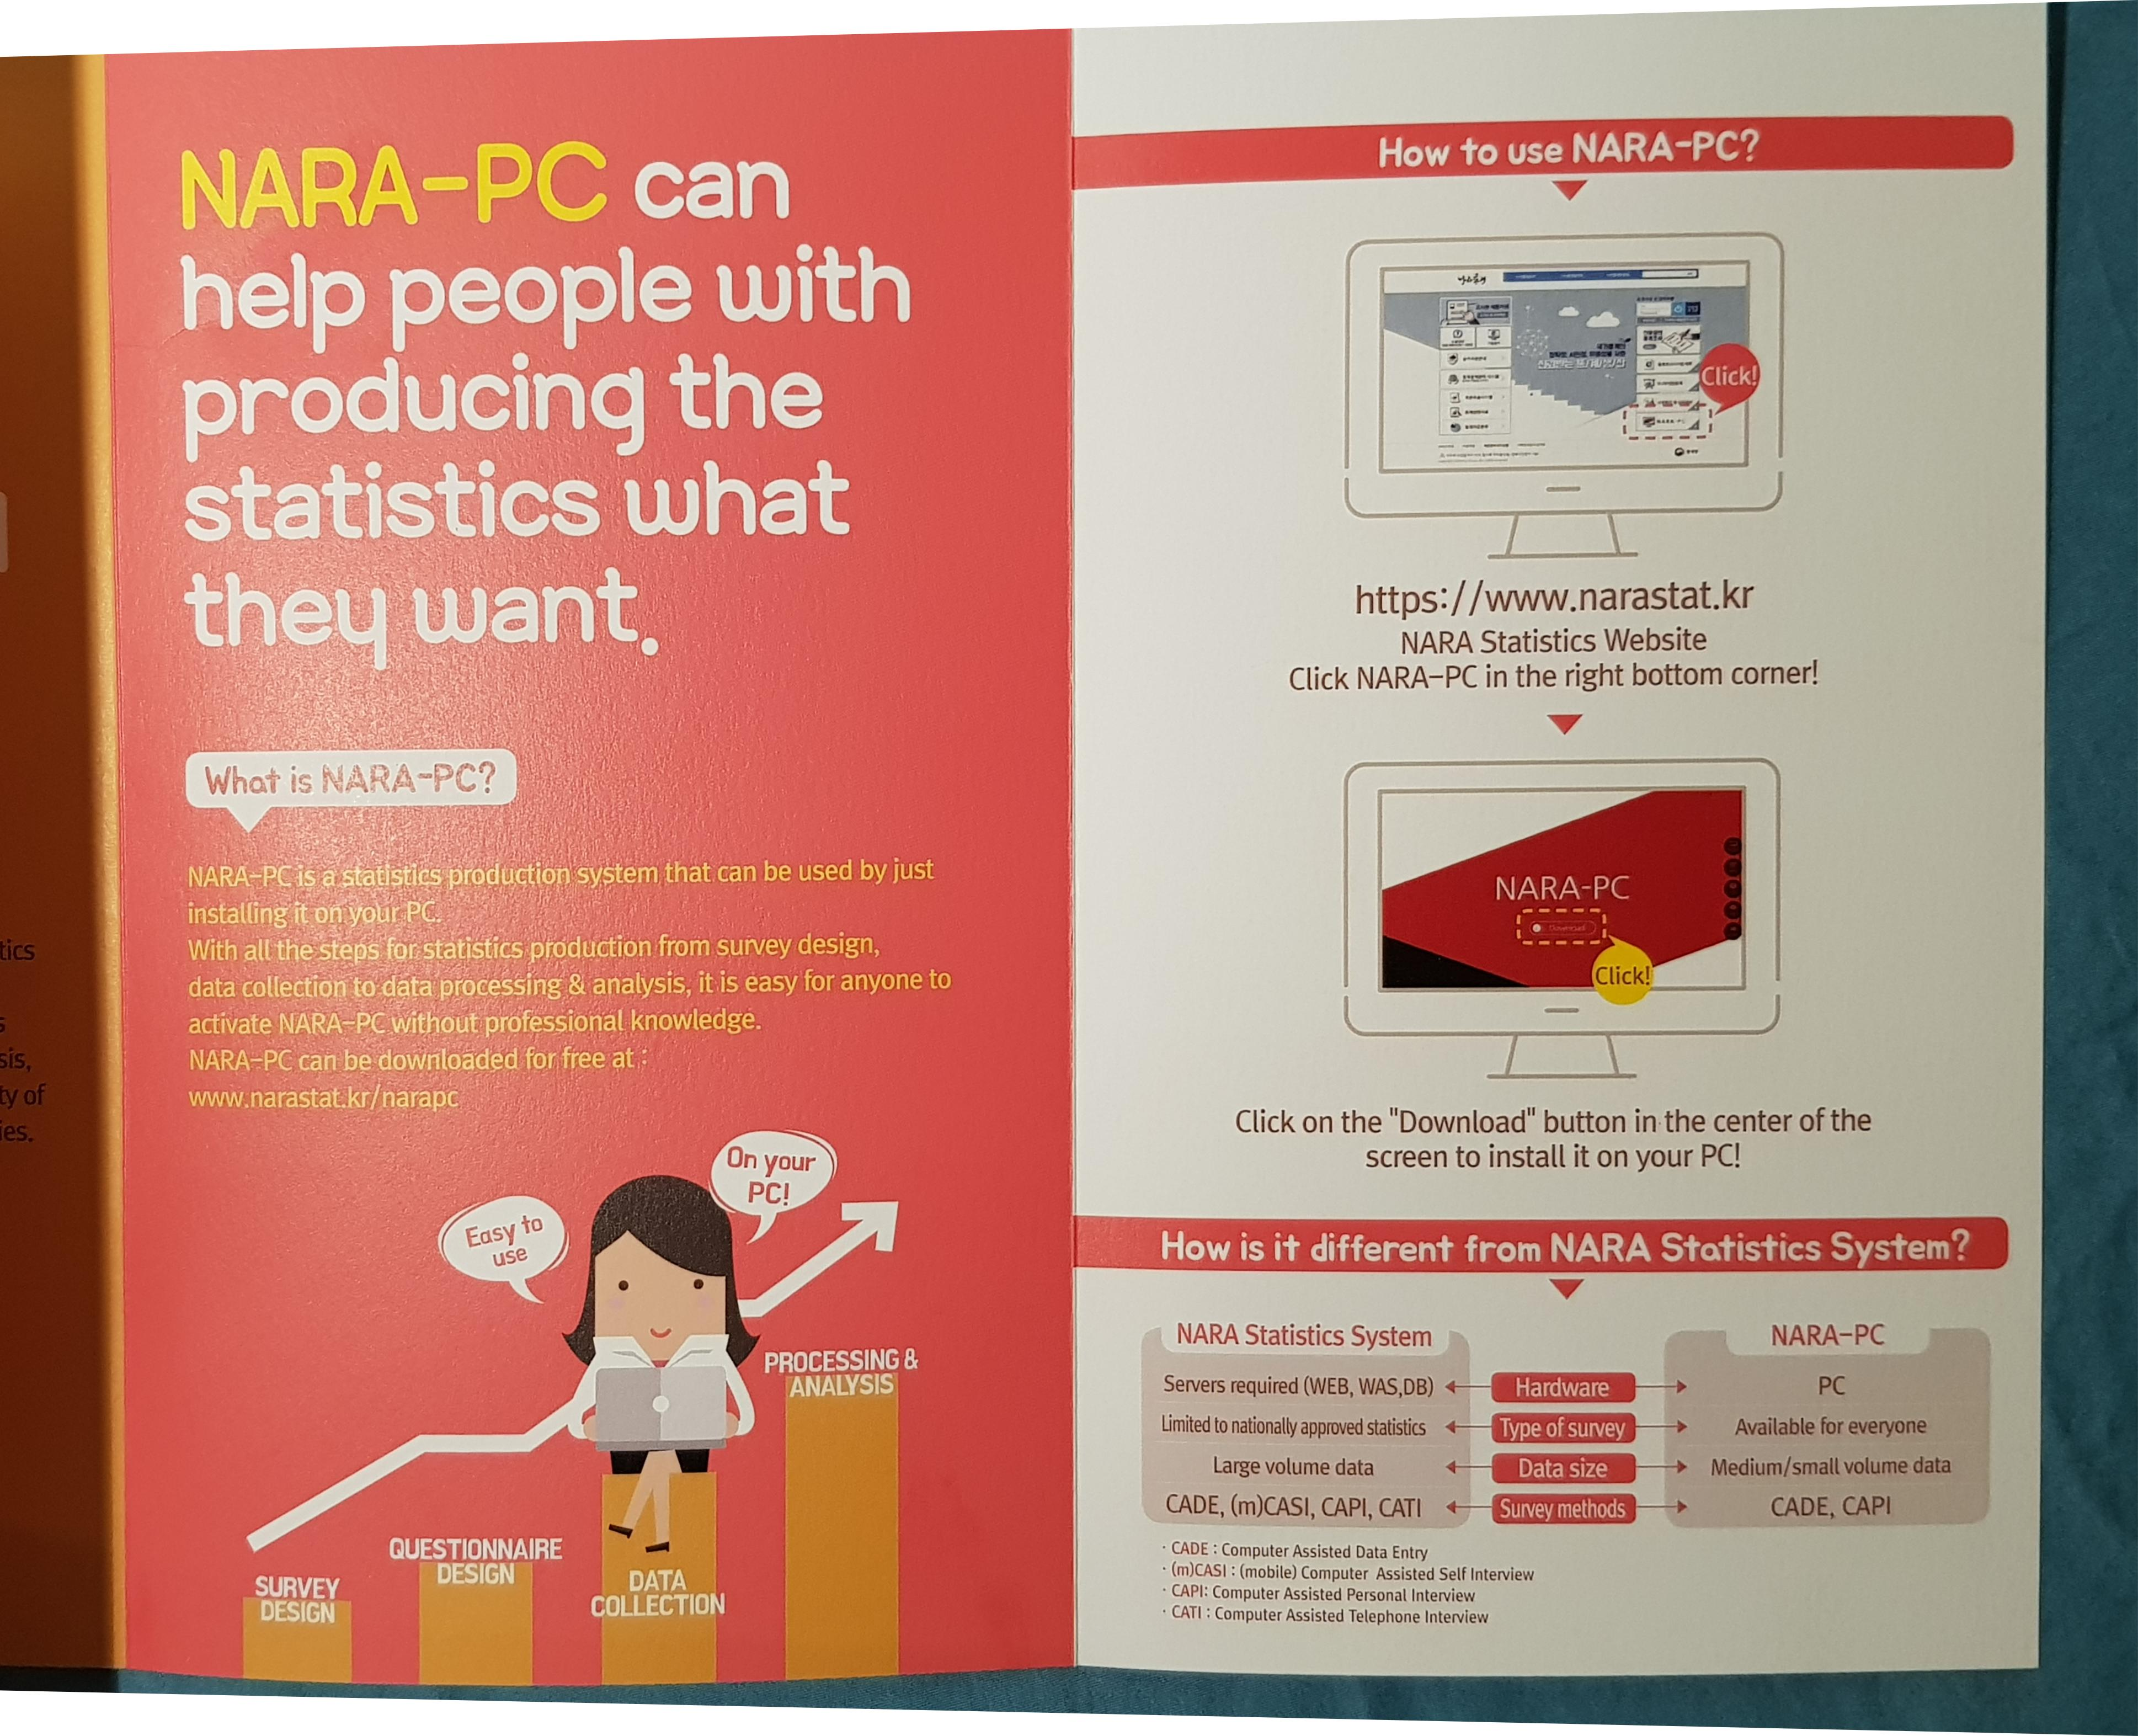

Slide 6
Issues and a suggestion
Limitations of common functions available to support various statistics : especially for Editing & Imputation
Almost impossible to reuse items among different statistical surveys : Absence of well-defined metadata
Restrictions on systems optimized for survey statistics
: No consider on new data such as administrative or big data
Information Strategy Planning in 2019 to evolve into V3.0
=> How about working together for Successful Usecase?

