Slide 1
Risk Management in Statistical Organizations
Notes:
Effective risk management is fundamental to the success of modernization in national statistical
organisations (NSOs), in that it concerns both organisation and production processes. Actually, Risk management, on the one hand, points at strengthening organization governance on the whole by supporting the decision-making process when selecting priorities; on the other hand, it points at identifying, analysing and removing the uncertainties that can put obstacles in the way of change and development.
The UN Guidelines on Risk Management in Statistical Organizations give NSOs, interested in internally implementing a risk management system, a reference based on the practices developed within the UNECE organizations and containing some key features: effective development, sustainability (in terms of resources and complexity), alignment with change management processes.
This training module supports the implementation of the Guidelines and is structured consistently with the ISO 31000:2018 standard architecture; this standard is widely accepted internationally as well as used by most public organisations when implementing Risk management systems.

Slide 2
Module 4: Risk Identification, Assessment and Treatment
‘Risk identification is the process of determining risks that could potentially prevent the program, enterprise, or investment from achieving its objectives. It includes documenting and communicating the concern’
‘Risk assessment is the determination of quantitative or qualitative estimate of risk related to a well-defined situation and a recognized threat’

Slide 3
There are many ways to identify risk….
Through daily work
Through a specific workshop – at strategic or operational level
Through formal assurance reviews – i.e. quality review programme, audit
Through stakeholder feedback
Through project and programme management
Through benchmarking with other organisations
Notes:
Risk Identification Techniques
The Management of Risk – Practitioners Guidance identify several different ways of identifying risks within organizations and these include:-
Checklists
Checklists are useful aids as repositories of organizational learning. They provide a mechanism to ensure that risks identified on previous similar activities are not overlooked for the current activity
Prompt List
Prompt lists commonly stimulate thinking about the sources of risk in the widest context through the provision of risk categories and sources of risk from within an organization and in the external environment.
Cause & Effect Diagrams
Also known as fishbone diagrams, this technique helps in the understanding of causes or sources of uncertainty that may give rise to risks.
Group Techniques
(including brainstorming, nominal group technique & Delphi technique)
Group workshops can be rich sources of ideas but can also introduce systematic bias to the process so strong facilitation is required. Brainstorming relies on the spontaneous generation of ideas but are not necessarily collected at this stage. Nominal group technique uses anonymous opportunities to submit ideas (using post-it notes). The Delphi technique is a way of eliciting a response through a remote method to preserve anonymity and mitigate conformity pressures.
Questionnaires
These provide prompts for participants and are a useful way of engaging more remote stakeholders
Individual Interviews
Some stakeholder will warrant an individual interview to discuss the activity, their assumptions and the risks they perceive. Can be useful for engaging senior stakeholders to protect their time and prevent them from influencing a group session

Slide 4

Risk Identification Exercise
It is Spring and there is a royal wedding to be planned. The Royal Family wants the wedding to be a success because the country has been in the doldrums and needs a country-wide event to reinvigorate the population.
As the project managers we are responsible for the events that take place on the day of the wedding. We are not responsible for the events that take place prior to and after the wedding.
There is a huge amount of planning to be completed but with the decisions we make we inherently create potential risks. Please identify risks emanating from the arrangements made from each wedding variable.
Notes:
Ground Rules
Everyone to participate
No risks should be rejected. Part of the fun is think up things that could happen that are a bit on the absurd side.
The participants must limit the risks to those that can occur on the day of the wedding.
The participants must be reminded that when they identify a risk it should be stated in a way that it can be quantified.
Wedding Ceremony
Who is going to officiate?
Wedding music during the ceremony
Food
Catering food in the welcoming area, the wedding area, the entertainment area
Catering a sit down dinner after the wedding
Main wedding cake and mini wedding cakes for each table
Beverages
Providing alcoholic and non-alcoholic drinks in all areas
Entertainment
Small band music prior to the wedding
Dance music after the wedding
Bruno Mars and his backup band
The Montreal Philharmonic Orchestra
Party Favors
Small gift for each of the guests
Larger gift for members of the wedding party
Small gifts for staff
Large gifts for local police
Clothing
Bride’s dress
Groom's clothing
The wedding party
Dressers for hair, make up and clothing
Location
The wedding is to take place Barbour Castle which is on 10 acres of landscaped lawns and gardens in London, England
VIP Transportation
Special transportation for distinguished guests:
Queen Elizabeth II of Great Britan
The Royal Family
President Putin of Russia
Former Prime Minister David Cameron
Former President Barack Obama
President Donald Trump
114 Members of Parliament
The Beckham Family
Cliff Richard & Elton John
George Clooney & his wife
Oprah Winfrey
Security
Perimeter security from paparazzi
Internal security for unruly guests
Terrorist attacks
Contamination of food and drink
Air security
Parking lots
Medical Care
Emergency medical staff
Emergency infirmary
Private doctor for bride and groom
Decorations
Flowers and decorations inside house
Flowers and decorations outside house
Wedding flowers for Bride
Flowers for wedding party

Slide 5
Risk Identification Exercise
Risk
Notes:
Ground Rules
Everyone to participate
No risks should be rejected. Part of the fun is think up things that could happen that are a bit on the absurd side.
The participants must limit the risks to those that can occur on the day of the wedding.
The participants must be reminded that when they identify a risk it should be stated in a way that it can be quantified.
Risk Identification
Flip chart paper can be used to write down all of the risks that the participants name. It is very important that the principles of brainstorming be used.
That is that ANY risk that is mentioned is allowed to be listed. It is important that the participants be encouraged to add risks to the list that are a bit on the absurd side. This will increase the entertainment value of the exercise.
The facilitator must guide the participants to stay within the scope of the project. That is, the participants should not list risks that are not within the scope of this project. Risks that should be excluded are risks that occur off the wedding property or risks that take place before or after the wedding day.
The facilitator must be careful not to judge the mentioned risks and not allow the other participants to judge the risks. The brain storming session continues until the fist page of the flip chart is filled with identified risks
Ranking the Risks
Looking over the list of risks and their severity, mark the rank of the four or five highest severity risks. There will usually be a break where there will be four or five risks that have a quite high severity and the rest will be noticeably lower. It is not necessary to rank all of the risks.

Slide 6
Risk Treatment and Control
So, we have identified some risks which if they occur could have a major impact. Should we do something about this?
Risk treatment involves developing a range of options for mitigating the risk, assessing those options, and then preparing and implementing action plans.
Risk control is the method by which organizations evaluate potential losses and take action to reduce or eliminate such threats.
Notes:
Ground Rules
Everyone to participate
No risks should be rejected. Part of the fun is think up things that could happen that are a bit on the absurd side.
The participants must limit the risks to those that can occur on the day of the wedding.
The participants must be reminded that when they identify a risk it should be stated in a way that it can be quantified.
Risk Identification
Flip chart paper can be used to write down all of the risks that the participants name. It is very important that the principles of brainstorming be used.
That is that ANY risk that is mentioned is allowed to be listed. It is important that the participants be encouraged to add risks to the list that are a bit on the absurd side. This will increase the entertainment value of the exercise.
The facilitator must guide the participants to stay within the scope of the project. That is, the participants should not list risks that are not within the scope of this project. Risks that should be excluded are risks that occur off the wedding property or risks that take place before or after the wedding day.
The facilitator must be careful not to judge the mentioned risks and not allow the other participants to judge the risks. The brain storming session continues until the fist page of the flip chart is filled with identified risks
Ranking the Risks
Looking over the list of risks and their severity, mark the rank of the four or five highest severity risks. There will usually be a break where there will be four or five risks that have a quite high severity and the rest will be noticeably lower. It is not necessary to rank all of the risks.
The purpose of addressing (treating) risks is to turn uncertainty to the organization’s benefit, by constraining threats and taking advantage of opportunities.
After assigning priority to risks, risk treatment should be identified both for corporate and operational risks, as well as linked to business planning processes. The challenge is to determine suitable responses that form a consistent and integrated strategy,
so that the remaining risk falls within the acceptable level of exposure.
It is worth noting that there is no right response to risk. The response chosen depends on issues such as the organization’s ‘risk appetite’, the impact and likelihood of risk, and costs and benefits of the mitigation plans.
Risk treatment should comply with legal requirements, as well as government and organizational policies. Therefore, decisions concerning whether risk treatment is required may be based on operational, technical, financial, legal, social, environmental or other criteria.
Such criteria should reflect the organization’s context, and depend on its internal policies, goals and objectives, as well as its stakeholders’ needs. In this respect, a team approach is useful to help define the context properly and for well-targeted change management during risk treatment.

Slide 7
The Risk Treatment Process
Risk
Treatment Assessment
Risk
Treatment
Plan
Risk
Treatment Monitoring
Measuring Residual
Risk
Feedback
Notes:
Risk treatment involves a cyclical process of:
a) Assessing a risk treatment: identify and evaluate risk treatment options;
b) Planning risk treatment: prepare a risk treatment schedule and action plan;
c) Monitoring effectiveness for that treatment;
d) Measuring residual risk: deciding whether residual risk levels are tolerable;
e) Feed-back actions: if residual risk is not tolerable, generating a new risk treatment and repeating the process.
a) Risk treatment assessment: an organization should select the best option at its disposal. That involves balancing the costs of implementing each option against the benefits derived from it, with regard to legal, regulatory, and other requirements such as social responsibility. In general, the cost of managing risks needs to be balanced with the benefits obtained. When making such cost versus benefit judgments, the context should be taken into account. It is important to consider all direct and indirect costs and benefits, whether tangible or intangible, and measure them in financial or other terms.
b) Risk Treatment Plan: Treatment should involve, at the operational level, preparing and implementing a related plan. It shows how the treatment options selected will be implemented and should be integrated with the management and budgetary processes. Specifically, the information provided in a treatment plan should include: (a) The reasons for selecting the treatment options, including expected benefits; (b) Who is accountable for approving the plan and who is responsible for implementing it; (c) The actions proposed; (d). Resource requirements, including contingencies; (e) Performance measures and constraints; (f) Reporting and monitoring requirements; (g) Timing and schedule.
c) Risk treatment monitoring: in designing response actions, it is important that the controls put in place are proportional to the risks. Risk analysis assists such a process by identifying those risks requiring attention by the management. Risk control actions will be prioritized in terms of their potential to benefit the organization. Effectiveness of internal control is determined by how much the risk will be either eliminated or reduced by the control measures proposed.
d) Residual risk measurement: If a residual risk persists even after treatment, a decision should be taken about whether to retain this risk or to repeat the risk treatment process. For residual risks that are deemed to be high, information should be collected about the cost of implementing further mitigation strategies.

Slide 8
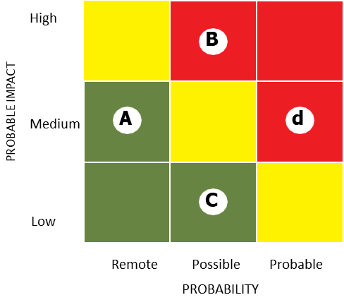
Risk Assessment: Defining the priorities
RISK MATRIX
can effectively summarize the risk assessment results.
shows risks identified placed according to their probability and potential impact, on a background of colors which represent different overall levels of risk.
can be compiled from a larger volume of data, grouping the risk schemes to establish one broad category rating for both inherent and residual risk.

Slide 9
Risk Assessment: Defining the priorities
One risk area may have several schemes associated with it and each scheme may have different inherent and residual risk scores quantitative or qualitative:
quantitative score, each for inherent risk and control risk, can concern the average of the inherent and residual risk scores of all the schemes for that risk;
qualitative scale assigns an overall inherent risk and control risk rating for a risk with several schemes that have different inherent risk and control risk ratings, based on the number of the schemes that are rated High, Medium, or Low.

Slide 10
Risk Scoring Matrix
Risk Exposure Calculator |  | Likelihood
 |  | Rare (1) | Unlikely (2) | Possible (3) | Likely (4) | Almost certain (5)
Impact | Disastrous (6) | 6 | 12 | 18 | 24 | 30
 | Major (4) | 4 | 8 | 12 | 16 | 20
 | Moderate (3) | 3 | 6 | 9 | 12 | 15
 | Minor (2) | 2 | 4 | 6 | 8 | 10
 | Insignificant (1) | 1 | 2 | 3 | 4 | 5
Likelihood x Impact = Exposure (L x I = E)

Slide 11
Risk Identification Exercise
Risk | Likelihood | Impact | Exposure | Rank
Notes:
Ground Rules
Everyone to participate
No risks should be rejected. Part of the fun is think up things that could happen that are a bit on the absurd side.
The participants must limit the risks to those that can occur on the day of the wedding.
The participants must be reminded that when they identify a risk it should be stated in a way that it can be quantified.
When all of the risks have been listed the participants will be asked to evaluate the risks listed. Both the likelihood and the impact of each risk are to be evaluated qualitatively. In qualitative analysis the impact or the probability of each risk can be evaluated as high, medium or low or on a scale of 1 to 6. A value of 1 means that there is either no impact or a very low probability for the risk. A value of 6 means that the probability for the risk is 100%, a virtual certainty. Risks that have an impact or probability of 1 are insignificant and can be eliminated from further consideration. Risks that have a probability of 5 are a certainty and should be included in the project plan.
Evaluate Likelihood and Impact
It is best to evaluate the impact of each risk first. This discussion will expand everyone's understanding of the nature of the risk. For example, someone will probably name rain as a risk. When the impact of the risk is evaluated some participants will name the impact as a 6 and others will say that the impact is a 2. The facilitator can question the two values by saying, “What do you mean by that?” One of the participants may mean that rain is any rain at all, even a small amount while another may say that rain means a really gully washer.
Evaluation of Exposure
Once the Likelihood and impact have been listed on the table, the Exposure can be calculated. This is done by simply multiplying the value for the risk in the impact column by the value in the Likelihood column.
Return to the risks identified in the previous ‘royal wedding’ exercise and score/rank

Slide 12
Risk Assessment – Risk Treatment
There are different response action categories which correspond to key general approaches, not necessarily mutually exclusive, or appropriate in all circumstances.
Tolerate
In these cases the response may be to tolerate the existing level of risk. The actions are:
Risk acceptance: no action is taken to affect likelihood or impact.
Retaining: The risk can be retained by accepting the burden of loss, or benefit of gain, including the acceptance of risks that have not been identified or when there is a failure to identify risks.
Treat
These are actions aiming at limiting the risks to an acceptable level related by:
Removing the risk source.
Risk reduction, taking actions for:
  Changing likelihood action to reduce the likelihood of negative outcomes and/or to increase opportunity,
  Changing the consequences (contingency actions): actions taken to reduce the extent of losses and/or to increase the extent of gains with reference to related opportunities (e.g. continuity plans).
Notes:
There are different response action categories which correspond to key general approaches
for risk treatment. These response action categories are:
TOLERATE. The exposure may be tolerable without any further action being taken or even if not tolerable, the ability to do anything may be limited (or the cost of taking any action may be disproportionate to the potential benefit). In these cases the response may be to tolerate the existing level of risk. This option, of course, may be supplemented by contingency planning for handling the impact that will arise if the risk results in actual events.
The actions related to this kind of approach are:
Risk acceptance: no action is taken to affect likelihood or impact.
Retaining: after risks have been changed or shared, there will be residual risks that
are retained. The risk can be retained by informed decision: acceptance of the
burden of loss, or benefit of gain, from a particular risk, including the acceptance of
risks that have not been identified. Risks can also be retained by default, e.g. when
there is a failure to identify or appropriately share or otherwise treat risks. Moreover,
after opportunities have been changed or shared, there may be residual
opportunities that are retained without any specific immediate action being required
(retaining the residual opportunity).
TREAT Usually, the majority of risks are addressed this way. The purpose of treatment is that whilst continuing with the activity that gives rise to the risk, specific action is taken in order to constrain such a risk to an acceptable level. Actions related to this kind of approach are as follows:
Removing: removing the risk source.
Risk reduction, actions are taken for:
Changing likelihood (mitigating actions): action taken to reduce the likelihood of negative outcomes and/or to increase opportunity, in order to enhance good outcomes.
Changing the consequences (contingency actions): actions taken to reduce the extent of losses and/or to increase the extent of gains with reference to related opportunities. These include setting up pre-event measures and post event responses such as continuity plans.
From the risk management perspective, the first kind of action (changing likelihood) should be preferred as it prevents the risk rather than waiting for the consequences.
Risk treatment options are not necessarily mutually exclusive, or appropriate in all
circumstances. Often a risk response may combine two or more of these strategies to achieve the desired results

Slide 13
Risk Assessment – Risk Treatment
Some risks are not (fully) transferable (e.g. reputational risk). Actions related to this ……………………………………….kind of approach are:
Transferring the risk or a portion of it.
Sharing: another party or parties bearing or sharing some part of the risk outcomes, usually by providing additional capabilities or resources that increase the likelihood of opportunities.
Transfer
Terminate
Some risks will only be treatable terminating the activity.
To avoid the risk, action is taken to stop the activities giving rise to risk by not starting such activities; it cannot occur properly if individuals or organizations are unnecessarily risk-averse.
Take the Opportunity
This option is not an risk solution. This can occur when:
  an opportunity arises to exploit positive impact whether or not action is taken to mitigate at the same time;
  circumstances arise which, whilst not generating threats, offer positive opportunities.
Notes:
TRANSFER For some risks the best response may be to transfer them. The transfer of risks may be considered to either reduce the exposure of the organization or because of another organization (which may be another public organization) judged more capable of effectively managing such risks. It is worth noting that some risks are not (fully) transferable: in particular, reputational risk can hardly be transferred. Relationship with the third party to which the risk is transferred needs to be carefully managed to ensure a successful transfer.
Actions related to this kind of approach are as follows:
Transferring the risk or a portion of it.
Sharing another party or parties bearing or sharing some part of the risk outcomes, usually by providing additional capabilities or resources that increase the likelihood of opportunities, or the extent of gains from them. Sharing positive outcomes can involve sharing some of the costs involved in acquiring them. Sharing arrangements can often introduce new risks, in that the other party or parties may not effectively deliver the required capabilities or resources.
TERMINATE Some risks will only be treatable, or reducible to acceptable levels, by terminating the activity. It is worth noting that such an option can be severely limited in the public sector when compared to the private one.
It can be particularly important in project management.
Avoiding: action is taken to stop the activities giving rise to risk or avoiding the risk by not starting such activities (where this option can be practiced). Risk avoidance cannot occur properly if individuals or organizations are unnecessarily risk-averse. Inappropriate risk avoidance may either increase the significance of other risks or lead to the loss of opportunities.
TAKE THE OPPORTUNITY This option is not an alternative to those above; rather it is an option that should be considered whenever tolerating, transferring or treating a risk. This can occur in two ways: the first is when an opportunity arises to exploit positive impact whether or not action is taken to mitigate threats at the same time. The second is when circumstances arise which, whilst not generating threats, offer positive opportunities.
Taking/increasing: taking or increasing risk in order to pursue an opportunity.
,
An organization can normally benefit from adopting a
combination of treatment options. Implementation of the risk responses selected involves developing a risk plan

Slide 14
Risk Identification Exercise
Risk | Treatment | Likelihood | Impact | Exposure | Rank
Notes:
Ground Rules
Everyone to participate
No risks should be rejected. Part of the fun is think up things that could happen that are a bit on the absurd side.
The participants must limit the risks to those that can occur on the day of the wedding.
The participants must be reminded that when they identify a risk it should be stated in a way that it can be quantified.
Setting Risk Treatment Approach
Going over the four or five highest ranked risks, and starting with the highest ranked one, ask the participants what they would do about it. The participants will give ideas of things that could be done.
Ask them to consider the previous slides where each type of risk treatment approach was highlighted and ask them to consider which one would best fit the risk identified
Encourage them to consider mitigation strategies of reducing the probability or the impact or both. Transfer and avoidance strategies can also be used. The risks that are ranked lower are perhaps risks that could be accepted.
Return to the ‘royal wedding’ exercise and decide on treatment plans.

Slide 15
Risk Assessment – Risk Treatment Process
Risk treatment involves a cyclical process of:
Assessing a risk treatment
Planning risk treatment
Monitoring treatment effectiveness
Measuring
residual risk
Feed-back actions
Notes:
Risk Assessment – Risk treatment process
Risk treatment involves a cyclical process of:
Assessing a risk treatment: identify and evaluate risk treatment options, evaluating costs of implementing each option with regard to legal, regulatory, and other requirements such as social responsibility;
Planning risk treatment, through an action plan including: reasons for selecting the treatment options, accountabilities for approving the plan and implementing it; actions; resource requirements; performance measures; reporting and monitoring; timing and schedule;
Monitoring treatment effectiveness by controls put in place proportionally to the risks. Risk control actions will be prioritized in terms of potential benefits for the organization and analyzed into 4 different controls:
Preventative controls, designed to limit undesirable outcomes
Corrective controls, designed to correct undesirable outcomes that have occurred
Directive controls, designed to ensure that a particular outcome is achieved
Detective controls, designed to identify occasions of occurrence of undesirable outcomes
Measuring residual risk: deciding whether residual risk levels are tolerable based on the collected information about the cost of implementing further mitigation strategies.
Feed-back actions: if residual risk is not tolerable, generating a new risk treatment and repeating the process.

Slide 16
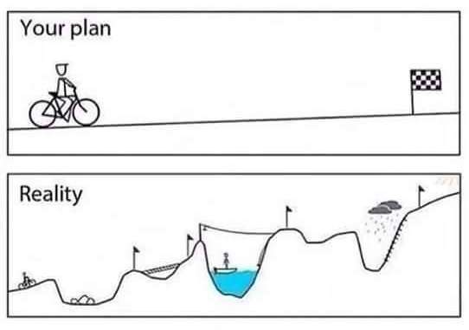
Risk Assessment – Risk Treatment Plans
Contents of a Response Plan
A good risk response plan should be selective and targeted based on a structured, practical approach that efficiently and effectively reduces residual risks to within the enterprise’s risk tolerance.
Once a risk response plan is drafted, it is typically approved by the management responsible for the risk assessment, with oversight by those charged with governance
Some of the features of a response plan may include:
Description of each action item;
Implementation responsibility for each action item;
Implementation timetable.
Estimate of resources need to address each action
Identify a responsible person for coordinating implementation of plan
Implementation should be regularly monitored by management
Notes:
Development of Risk Treatment Plan
Risk Treatment is the process of selecting and implementing of measures to modify risk. Risk treatment measures can include avoiding, optimizing, transferring or retaining risk.
Having identified and evaluated the risks, the next step involves the identification of alternative appropriate actions for managing these risks, the evaluation and assessment of their results or impact and the specification and implementation of treatment plans.
Since identified risks may have varying impact on the organization, not all risks carry the prospect of loss or damage. Opportunities may also arise from the risk identification process, as types of risk with positive impact or outcomes are identified.
Treatment options for risks having negative outcomes look similar to those for risks with positive ones, although their interpretation and implications are completely different. Such options or alternatives might be:
to avoid the risk by deciding to stop, postpone, cancel, divert or continue with an activity that may be the cause for that risk;
to modify the likelihood of the risk trying to reduce or eliminate the likelihood of the negative outcomes;
to try modifying the consequences in a way that will reduce losses;
to share the risk with other parties facing the same risk (insurance arrangements and organizational structures such as partnerships and joint ventures can be used to spread responsibility and liability); (of course one should always keep in mind that if a risk is shared in whole or in part, the organization is acquiring a new risk, i.e. the risk that the organization to which the initial risk has been transferred may not manage this risk effectively.)
to retain the risk or its residual risks;

Slide 17
Risk Identification Exercise
Risk | Rank | Risk Treatment Plan – Mitigating Actions
Notes:
Ground Rules
Everyone to participate
No risks should be rejected. Part of the fun is think up things that could happen that are a bit on the absurd side.
The participants must limit the risks to those that can occur on the day of the wedding.
The participants must be reminded that when they identify a risk it should be stated in a way that it can be quantified.
Risk Identification
Flip chart paper can be used to write down all of the risks that the participants name. It is very important that the principles of brainstorming be used.
That is that ANY risk that is mentioned is allowed to be listed. It is important that the participants be encouraged to add risks to the list that are a bit on the absurd side. This will increase the entertainment value of the exercise.
The facilitator must guide the participants to stay within the scope of the project. That is, the participants should not list risks that are not within the scope of this project. Risks that should be excluded are risks that occur off the wedding property or risks that take place before or after the wedding day.
The facilitator must be careful not to judge the mentioned risks and not allow the other participants to judge the risks.
The brain storming session continues until the fist page of the flip chart is filled with identified risks
Return to the ‘royal wedding’ risks and develop treatment plans.

Slide 18
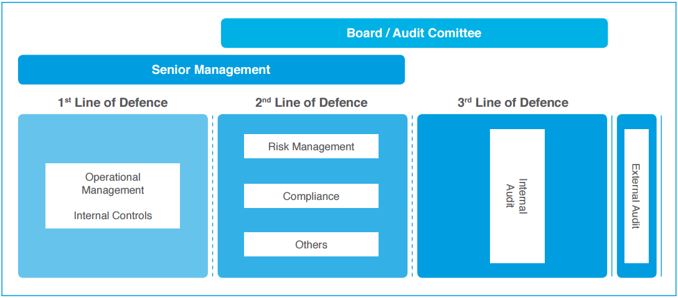
The 3 Lines of Defence (3LOD – ECIIA)
Internal control system is structured on 3 different levels:
the first line, (Risk owners) by operational management who have the responsibility to identify analyze and mitigate risks;
the second line, (Risk Manager) that is the role of the compliance function, with the task of facilitating and monitoring the implementation of effective “risk management” by managers; this level oversees the process of risk assessment and control, ensuring its consistency with business goals;
The third line is played by Audit, which, with a "risk based" approach, provides an adequate assurance on the effectiveness whereby the organization evaluates and controls compliance and adequacy of the other lines.

Slide 19
Risk Alerts
Red Flags are several and depend on the process and the context, for example:
An excessively small number of participants in the invitations to tender;
Abnormal transactions volumes;
Too many exemptions compared with the usual business procedures.
In case of warnings of possible dangerous actions coming from regular routine checks, control tests or other sources, the Controller (eg IA) evaluates whether to initiate further inquiries or to report anomalies by promoting a “targeted investigation”.
Monitoring and evaluation of risk treatment must enable verification (both in the on-going and ex post) whether the actions:
Have been adopted Are efficient Pursue the expected results

Slide 20
