Slide 1
Risk Management in Statistical Organizations
Notes:
Effective risk management is fundamental to the success of modernization in national statistical
organisations (NSOs), in that it concerns both organisation and production processes. Actually, Risk management, on the one hand, points at strengthening organization governance on the whole by supporting the decision-making process when selecting priorities; on the other hand, it points at identifying, analysing and removing the uncertainties that can put obstacles in the way of change and development.
The UN Guidelines on Risk Management in Statistical Organizations give NSOs, interested in internally implementing a risk management system, a reference based on the practices developed within the UNECE organizations and containing some key features: effective development, sustainability (in terms of resources and complexity), alignment with change management processes.
This training module supports the implementation of the Guidelines and is structured consistently with the ISO 31000:2018 standard architecture; this standard is widely accepted internationally as well as used by most public organisations when implementing Risk management systems.

Slide 2
Module 2: Risk Management Process
‘The risk management process is a systematic application of management policies, procedures and practices to the tasks of communicating, establishing the context of, assessing, monitoring and reviewing risks’

Slide 3
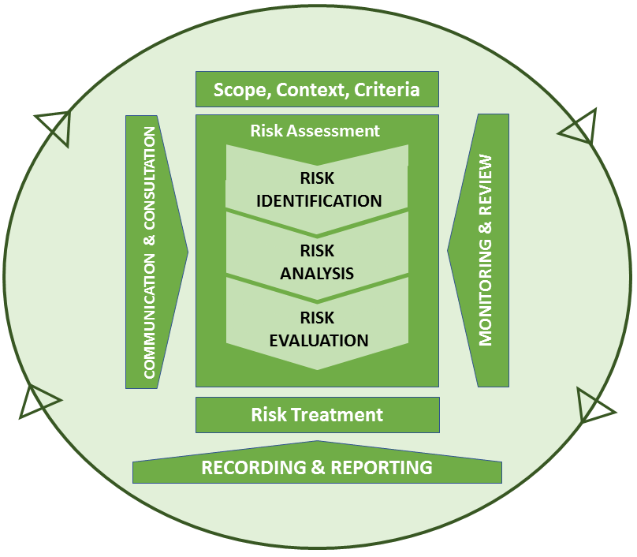
The Risk Management System – ISO 31000:2018
Principles
Framework
Process
Mandate & Commitment (4.2)
Creates value
Integral part of organisational process
Part of decision making
Explicitly addresses uncertainty
Systematic, structured & timely
Based on the best available information
Tailored
Takes human & cultural factors into account
Transparent & inclusive
Dynamic, iterative & responsive to change
Facilitates continuous improvement & enhancement of the organisation
Design of framework for managing risk (4.3)
Understanding the organisation and its context (4.3.1)
Establishing Risk Management policy (4.3.2)
Accountability (4.3.3)
Integration into organisational processes (4.3.4)
Resources (4.3.5)
Establishing internal comms & reporting mechanisms (4.3.6)
Establishing external comms & reporting mechanisms (4.3.7)
Risk assessment (5.4)
Continual improvement of the network
(4.6)
Implementing risk management (4.4)
Implementing risk framework (4.4.1)
Implementing risk mgmt. process (4.4.2)
Monitoring & review of the framework (4.5)

Slide 4
ISO 31000:2018 – Risk Management Process
The risk management process should be an integral part of management and decision-making and integrated into the structure, operations and processes of the organization. It can be applied at strategic, operational, programme or project levels.
There can be many applications of the risk management process within an organization, customized to achieve objectives and to suit the external and internal context
in which they are applied.
The dynamic and variable nature of human behaviour
and culture should be considered throughout the risk
management process.
Although the risk management process is often presented as sequential, in practice it is iterative
Notes:
The risk management process should be an integral part of management and decision-making and integrated into the structure, operations and processes of the organization. It can be applied at strategic, operational, programme or project levels.
There can be many applications of the risk management process within an organization, customized to achieve objectives and to suit the external and internal context in which they are applied.
The dynamic and variable nature of human behaviour and culture should be considered throughout the risk management process.
Although the risk management process is often presented as sequential, in practice it is iterative

Slide 5
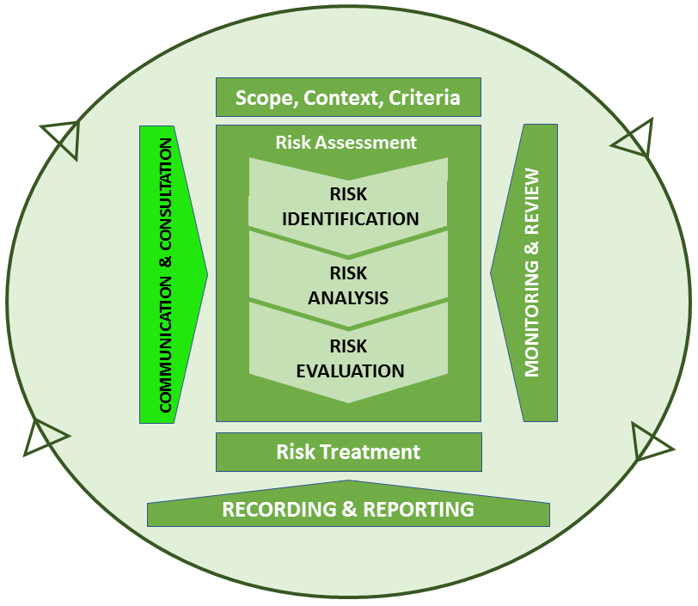
Risk Management Process – The Stages – 1/4
Communication & Consultation
Purpose
To ensure that stakeholders understand the information on which decisions are taken & the reasons why those particular actions are required
Objective
Communicating & consulting with internal & external stakeholders at all stages of the process, regarding: causes, consequences & treatment measures
Risk management creates and protects value
Risk management is transparent and inclusive
Notes:
Communication and consultation
Stakeholders judgments about risk, based on their own perceptions, should be identified, recorded and integrated into the decision making process.
A plan to disseminate and to account for risk management should involve:
Raising awareness about the RM process throughout the organization.
Establishing a team responsible for communicating about risk management;
Engaging internal and appropriate external stakeholders to ensure truthful, relevant, accurate and effective exchange of information, taking into account confidentiality and integrity aspects;
External reporting to comply with legal, regulatory, and governance requirements
Providing feedback on communication, consultation and reporting mechanisms.
Internal communication
Internal communication and consultation mechanisms include the methods and tools through which an organization ensures that everybody within the organization understands:
What the risk strategy consists of;
Which the risk priorities are;
How the accountabilities are assigned, and how the related responsibilities fit into the risk framework (who does what).
More practically, Internal communication:
Assists in embedding the desired behaviors throughout the organization;
Engages staff in risk management activities;
Enhances risk management process transparency, encourages accountability/ownership of risks;
Facilitates cooperation in defining cross-cutting initiatives, a common understanding of concepts, rules and integration of RM in statistical processes, to prioritize control.
External communication
An organization should periodically inform and consult its external stakeholders:
A) About how risks are managed;
B) To deal with stakeholders’ expectations about what the organization can actually deliver;
C) To assure them that the organization will deliver in the way that they expect.
A regular and well-made risk management stakeholder relationship plan should take into account and determine its critical components: dissemination strategy and channels.
Communication tools to share information and promote dialogue with external stakeholders are:
1) Corporate site 4) Other external events
2) Publications and papers; 5) Corporate newsletters
3) Annual meetings 6) Messages in ongoing corporate communications
.
“Communication and consultation” is not a distinct stage in the management of risk, but runs through the whole process.

Slide 6
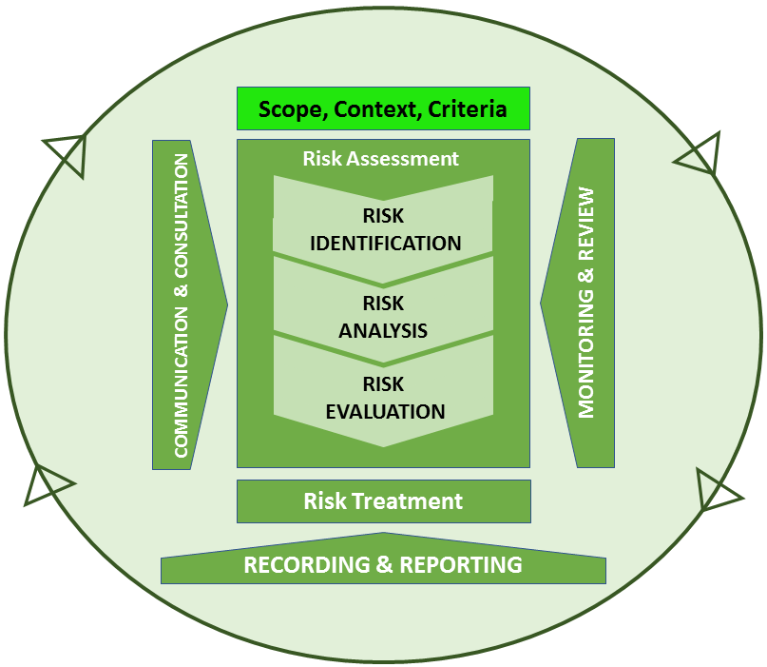
Risk Management Process – The Stages – 1/4
Establishing the Context
Purpose
To set goals & define internal & external parameters for risk management & analysis process criteria
Objective
Analysis of the context in which the organization seeks to achieve the risk management objectives. Internal: organizational culture, processes, structure and strategies; External: objectives and stakeholders’s interests
Risk management is tailored
Risk management takes human and cultural factors into account.
Notes:
Establishing the context
Evaluating the organization’s external context may include, but is not limited to:
The legal, regulatory, environment (international, national, regional or local);
The financial, technological, and economic environment;
Competitive environment analysis;
Relationships with, as well as perceptions and values from, external stakeholders
The analysis of the internal context can be supported by:
Organizational analysis which takes into consideration:
Process mapping.
Governance, organizational structure;
Policies, objectives, and the strategies set to achieve them;
Resources and knowledge (e.g., capital, time, people, processes,);
Information systems;
Relationships with internal stakeholders and the organization’s culture.
.
Process mapping
The process mapping activity entails:
Identifying all routine activities within the scope of the analyzed process;
Grouping the activities into key sub-processes;
Determining the sequence of events, and links between the sub-processes.
The map can be a simple macro-flowchart, showing only enough information to understand the general process flow, or it might be detailed enough to show every single action and decision point.
Process Mapping techniques are:
Macro-level process map that outlines the operational routes of an organization.
Top-down or high-level process map, showing end-to-end processes across the operational areas.
Cross-functional process map, showing roles, inputs, outputs and steps required to complete a specific process within an operational area, to emphasize where people or groups fit into the process sequence, and how they relate to one another throughout the process.
Detailed Process Flowchart, detailing systems, instructions and procedures required to complete steps in processes at level three (Cross-functional process map), and showing inputs, outputs and decision points.
Establishing the external context ensures that stakeholders and their objectives are considered when developing risk management, together with threats and opportunities

Slide 7
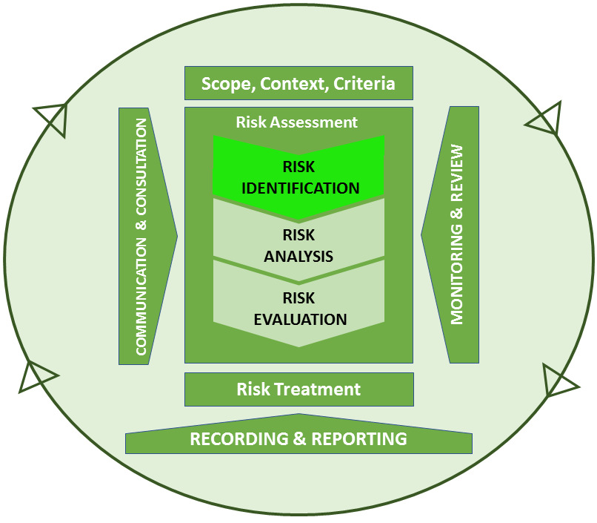
Risk Management Process – The Stages – 2/4
Risk Identification
Purpose
To create a complete list of risks based on events that may create, enhance, prevent, worsen, accelerate or delay the achievement of the objectives.
Objective
to apply the tools and techniques best suited to the objectives of Risk Management, using the available expertise.
Risk management is based on the best available information.
Notes:
Risk identification
Risk identification may require a multidisciplinary approach, since risks may cover a wide
range of causes and consequences
Risk identification methods can include:
a) Evidence based methods, e.g checklists and historical data reviews;
b) Systematic team approaches (a team of experts systematically identifies risks by means of a structured set of prompts or questions (i.e. structured or semi-structured interviews, Brainstorming24, Delphi method25));
c) Inductive reasoning techniques (i.e. preliminary hazard analysis, HAZOP, HACCP);
d) Scenario analysis (i.e. root-cause analysis, scenario analysis as such, cause or consequence analysis);
e) Statistical methods (i.e. Monte-Carlo analysis, Bayesian analysis)
In implementing these techniques the maturity of a risk management system should always
be taken into account. During the experimental phase of the risk management model, the
experience analysis should always be combined with either structured or semi-structured
interview, or a prompt/check list, in order to guide risk owners through the risk analysis.
The experience analysis needs to be based on actual information, through the examination
of data from various systems (e.g. electronic document management systems, non-conformities and IT incidents registration system, time use recording system, as well as a
specific system to record quality features of statistical surveys).
Once the risk management culture is more established throughout the organization, brainstorming and the Delphi technique can replace the interview, the cause/consequence analysis, the check-list or any other simpler kind of scenario analysis.
Factors influencing selection of techniques are:
1. Problem complexity and the methods needed to analyse them;
2. The nature and degree of risk assessment uncertainty, that is based on the
amount of information available and requirements to satisfy objectives;
3. The extent of resources needed in terms of time and level of expertise, data
needs or cost;
4. Whether the method can provide a quantitative output.
The first activity within the risk assessment process is to develop a common set of assessment criteria, to be deployed

Slide 8
Risk Management Process – The Stages – 2/4
Risk Identification
Purpose
To create a complete list of risks based on events that may create, enhance, prevent, worsen, accelerate or delay the achievement of the objectives.
Objective
to apply the tools and techniques best suited to the objectives of Risk Management, using the available expertise.
Risk management is based on the best available information.
Notes:
Risk identification
Risk generally is the uncertainty inherently related to consequences – either positive i.e. opportunity, or negative i.e. threat – of actions and events. It is measured through a
combination of likelihood and impact, including perceived relevance. “Inherent risk” is the exposure arising from a specific risk before any action has been taken to manage it, while “residual risk” is the exposure arising from a specific risk after any action has been taken to manage it, and in case such an action has proved effective.
An organization defines the criteria to be used to evaluate risk significance. Such criteria
should reflect both the stakeholders’ risk perception (based on a set of values/concerns),
and the organization’s values, objectives and resources. Some criteria can be imposed by, or
derived from, legal and regulatory requirements. Risk criteria should be consistent with the
organization’s risk management policy, defined in the risk management framework.
Defining risk criteria involves deciding on:
1 The nature and kind of consequences to be included, and how they will be measured;
2. The way probabilities are to be expressed;
3. How a level of risk is going to be determined;
4. The criteria for determining when a risk needs treatment;
5. The criteria for deciding when a risk is acceptable and/or tolerable;
6. Whether and how combinations of risks will be taken into account.
Risk identification requires analysing several issues:
Source/root cause event: any activity having a potential to increase a specific risk,
whether or not such an activity is under the control of the organization;
Areas of impact: dealing with categorization/prioritization of consequences;
Enablers: the organizational features helping a risk-event to occur;
Events: occurrence of a particular set of circumstances; and
Their potential consequences: potential outcome of an event. A wide range of risk
consequences should be considered, including cascade and cumulative effects.
The above issues can create, enhance, prevent, degrade, accelerate or delay the ability of
either the whole organization, or part of it, to achieve its own objectives.
The first activity within the risk assessment process is to develop a common set of assessment criteria, to be deployed

Slide 9

Risk Management Process – The Stages – 2/4
Risk Identification
Risk identification requires analyzing several issues:
Source/root cause event: any activity having a potential to increase a specific risk;
Areas of impact: dealing with categorization/prioritization of consequences;
Enablers: the organizational features helping a risk-event to occur;
Events: occurrence of a particular set of circumstances; and
Their potential consequences: potential outcome of an event.
The risk management framework includes a hierarchy of risks
Notes:
Risk Hierarchy and Risk Categorization
The risk management framework includes a hierarchy of risks, comprising a variety of risk
levels together with priorities in risk treatment strategies.
- Enterprise or so-called “corporate” risks are strategic (i.e. can significantly impact on
the organization). To manage them is fundamental to the long term viability of the
organization and this must be done under the supervision of the risk committee;
- Portfolio management risks are inherently related to the portfolio of projects as a
whole, and are managed by senior management. Some examples of portfolio risk are:
affordability of the portfolio; lack of capability/capacity to implement the portfolio;
lack of timely availability of skills and human resources;
- Project risks can impact on the projects’ objectives and outcomes, and are managed
by the project risk manager; where appropriate, they will be addressed as part of the
project management framework. Some examples of project risk are: project scope
poorly defined, resources not available when required, quality requirements not
clearly specified.
- Operational risks can impact on a program's objectives and/or outcomes (i.e.
unsuitable skills mix, resources reduced due to budget cuts, outputs not delivered on
time, poor quality outputs) and are managed by the program directors.
While each risk captured may be important for management at the function and business
unit levels, the corporate risk list requires prioritization to focus the attention of the board
and senior management on key risks.
The management of risk at corporate, enterprise and operational levels needs to be integrated, so that the levels of activity support each other. In this way the organization’s risk management strategy will be led from the top, and be embedded in the normal working routines and activities.
The first activity within the risk assessment process is to develop a common set of assessment criteria, to be deployed

Slide 10
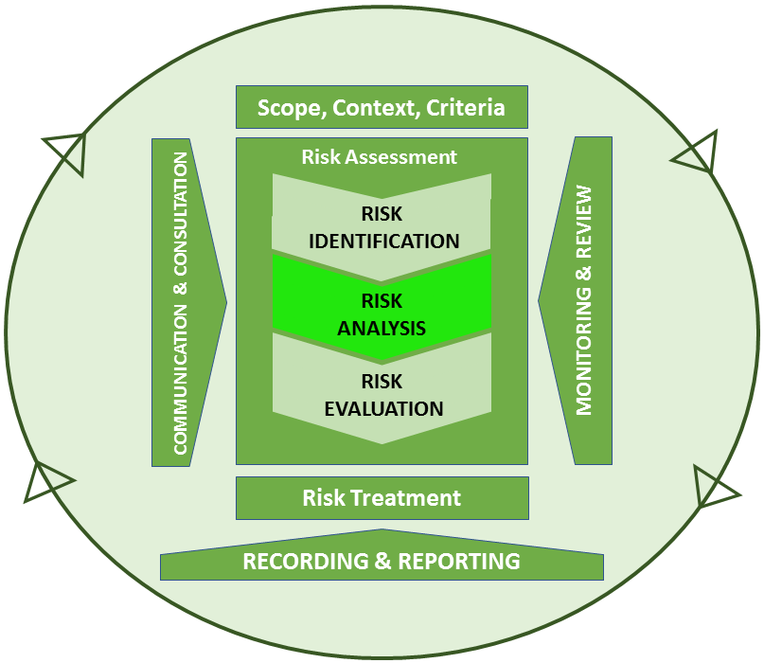
Risk Management Process – The Stages – 2/4
Risk Analysis
Purpose
To provide input to risk assessment and decisions concerning more suitable treatment, especially in cases involving different types and levels of risk.
Objective
Analyzing causes/effects & sources of risk, positive & negative consequences & their probability of occurrence, also based on the efficiency & effectiveness of controls
Risk management is systematic, structured & timely
Risk management explicitly addresses uncertainty
Risk management is an integral part of all organizational processes
Notes:
Risk analysis
Risk analysis involves consideration of risk causes and sources, their positive and negative consequences and the likelihood of such consequences occurring. It normally includes estimation of the range of potential consequences that might arise from an event, situation or circumstance, and their associated probabilities, in order to measure the level of risk.
However, in some instances (such as where the consequences are likely to be insignificant, or probability is extremely low), a single parameter estimate can be enough to make a decision.
In any case, some framework for assessing risks should be developed. The assessment
should draw as much as possible on unbiased independent evidence, should consider the
perspectives of the whole range of those stakeholders affected by the risk, and avoid
confusing a fair risk assessment with any judgment about the acceptability of particular risks.
There are three important principles in assessing risk:
Ensuring that there is a clearly structured process, through which both likelihood and impact are considered;
Recording risk assessment in such a way to facilitates monitoring and identification of risk priorities
Distinguishing between “inherent” and “residual” risk26. The level of risk will depend on the adequacy and effectiveness of existing controls.
Methods used in analysing risks can be:
a. Qualitative: such methods define consequence, probability and level of risk, according to descriptive scales, may combine consequence and probability, and evaluate the resulting level of risk against qualitative criteria.
b. Semi-quantitative: such methods use numerical ratings for consequence and
probability, and combine them to produce a level of risk using a formula. Scales may be linear or logarithmic, or have other relationship; the formulae can also vary.
c. Quantitative: this kind of analysis estimates practical values for consequences and
their probabilities, and produces numerical values for impact, likelihood and level of
risk, using data from a variety of sources.
The first activity within the risk assessment process is to develop a common set of assessment criteria, to be deployed

Slide 11
Risk Management Process – The Stages – 2/4
Risk Analysis
Purpose
To provide input to risk assessment and decisions concerning more suitable treatment, especially in cases involving different types and levels of risk.
Objective
Analyzing causes/effects & sources of risk, positive & negative consequences & their probability of occurrence, also based on the efficiency & effectiveness of controls
Risk management is systematic, structured & timely
Risk management explicitly addresses uncertainty
Risk management is an integral part of all organizational processes
Notes:
Risk analysis
The level of risk is a function of factors, in particular likelihood and impact.
Impact refers to the extent that a risk event may affect an organization. Impact assessment
criteria may include financial, reputational, regulatory, health, safety, security, environmental, employee, customer and operational consequences. Organizations typically
define impact using a combination of such consequences, given that certain risks may impact
the enterprise financially, while other risks may have a greater impact to reputation or
health and safety.
Likelihood represents the weak/strong possibility that a given event will actually occur. Likelihood can be expressed through either qualitative, percent or frequency terms.
Sometimes organizations describe likelihood in more personal and qualitative terms such as
“event expected to occur several times (or not expected to occur) over the course of a
career”.
The level of risk is a function of factors, in particular likelihood and impact

Slide 12
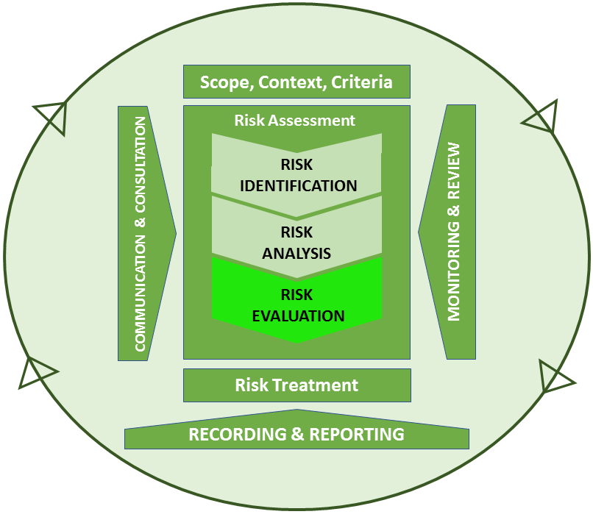
Risk Management Process – The Stages – 3/4
Measurement & Weighting
Purpose
To contribute to decisions on the selection of the risks that need to be treated and the their implementation priorities; to evaluate whether to initiate further analysis or treat the risk maintaining existing controls
Objective
Comparison between the level of risk measured by the analysis, according with the criteria set when establishing the context; consider both the risk tolerance and the duties of compliance
Risk management is part of decision making
Notes:
Risk Evaluation
Risk evaluation involves comparing estimated levels of risk to assessment criteria, in order to identify the most significant risks, or to exclude minor risks from further analysis. The
purpose is to ensure that use of resources will be focused on the most important risks. Care should be taken not to screen out low risks which occur frequently and can therefore have
a significant increasing effect.
The preliminary analysis determines one or more of the following courses of action:
Setting aside insignificant risks (acceptable risks) which would not justify treatment;
Deciding to treat unacceptable risks;
Setting priorities for risk response.
Risk evaluation provides inputs to decisions on whether risks need to be treated, and on the
most appropriate risk treatment strategies and methods. Subsequently, the purpose of risk
evaluation is to assist in making decisions (based on the outcomes of risk analysis) about
which risks need treatment and which priority must be assigned for their treatment.
Risks are related to objectives, so can easily be prioritized for risk response in relation to such
objectives. Unacceptable risks are ranked and prioritized in relation to other risks. Therefore,
the decision about whether and how to treat the risk may depend on costs and benefits
from taking the risk, and costs and benefits from implementing improved controls.
A common approach to prioritizing risks is to divide them into three bands:
An upper band, where the level of risk is regarded as intolerable whatever benefit the activity may bring, and risk treatment is essential whatever its costs;
A middle band, where costs and benefits are taken into account and opportunities balanced against potential consequences;
A lower band, where the level of risk is regarded as negligible, or so small that no risk treatment measures are needed.
Some organizations represent this portfolio as a hierarchy, some as a collection of risks
plotted on a heat map (also risk map or risk matrix).
Risk evaluation involves comparing estimated levels of risk to assessment criteria, in order to identify the most significant risks

Slide 13
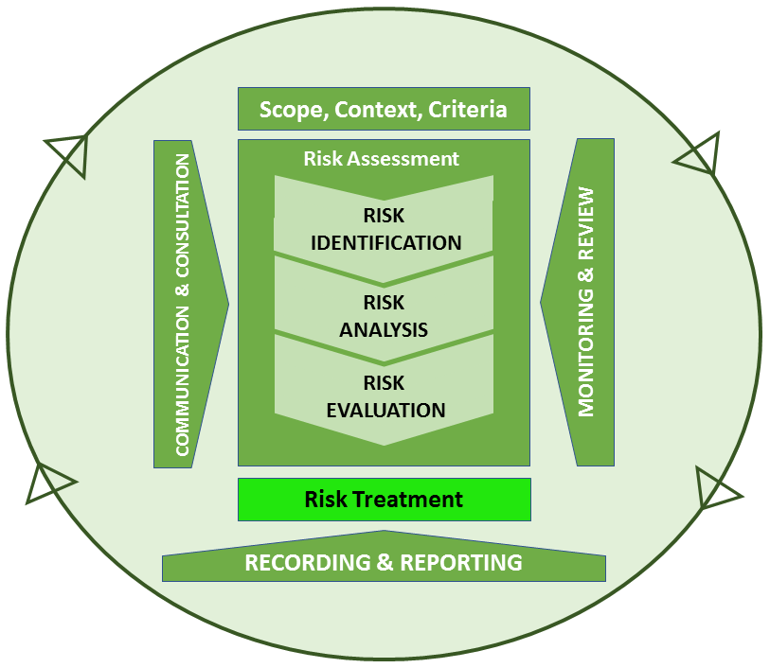
Risk Management Process – The Stages – 4/4
Risk Treatment
Purpose
To define measures on risk not necessarily exclusive or fitting to all circumstances: a) avoid; b) take or increase; c) remove the source; d) intervene on probability; e) change the consequences; f) share; g) maintain
Objective
Treatment evaluation; deciding on the residual risk tolerance; redefining treatment, if the risk is not tolerable; evaluation of the action effectiveness; to provide for the selection of one or more mitigating options
Risk management facilitates continual improvement of the organization
Notes:
Risk Treatment
After assigning priority to risks, risk treatment should be identified both for corporate and
operational risks, as well as linked to business planning processes. The challenge is to
determine a portfolio of suitable responses that form a consistent and integrated strategy,
so that the remaining risk falls within the acceptable level of exposure.
Risk treatment should comply with legal requirements, as well as government and
organizational policies. Therefore, decisions concerning whether risk treatment is required
may be based on operational, technical, financial, legal, social, environmental or other
criteria.
Such criteria should reflect the organization’s context, and depend on its internal
policies, goals and objectives, as well as its stakeholders’ needs. In this respect, a team
approach is useful to help define the context properly and for well-targeted change
management during risk treatment.
It is worth noting that there is no right response to risk. The response chosen depends on issues such as the organization’s ‘risk appetite’, the impact and likelihood of risk, and
costs and benefits of the mitigation plans.
There are different response action categories which correspond to key general approaches
for risk treatment. These response action categories are:
Tolerate, in case the level of risk is below the Risk Appetite;
Treat, aiming at constraining risks to an acceptable level by removing the risk source and/or reducing likelihood or effects
Transfer, reducing the exposure of the organization leaving the risk to another organization considered more capable of effectively managing such risks.
Terminate, in case the risk is only treatable, or reducible to acceptable levels, by terminating the activity, especially at project level.
Take the opportunity, which is not an alternative whenever tolerating, transferring or treating a risk.
The purpose of treating risks is to turn uncertainty to
the organization’s benefit, by constraining threats and taking
advantage of opportunities.

Slide 14
Risk Management Process – The Stages – 4/4
Risk Treatment
Purpose
To define measures on risk not necessarily exclusive or fitting to all circumstances: a) avoid; b) take or increase; c) remove the source; d) intervene on probability; e) change the consequences; f) share; g) maintain
Objective
Treatment evaluation; deciding on the residual risk tolerance; redefining treatment, if the risk is not tolerable; evaluation of the action effectiveness; to provide for the selection of one or more mitigating options
Risk management facilitates continual improvement of the organization
Notes:
Risk Treatment
There are different response action categories which correspond to key general approaches
for risk treatment. These response action categories are:
1. TOLERATE. The exposure may be tolerable without any further action being taken or even if not tolerable, the ability to do anything may be limited (or the cost of taking any action may be disproportionate to the potential benefit). In these cases the response may be to tolerate the existing level of risk. This option, of course, may be supplemented by contingency planning for handling the impact that will arise if the risk results in actual events. The actions related to this kind of approach are:
Risk acceptance: no action is taken to affect likelihood or impact.
Retaining: after risks have been changed or shared, there will be residual risks that are retained. The risk can be retained by informed decision: acceptance of the burden of loss, or benefit of gain, from a particular risk, including the acceptance of risks that have not been identified. Risks can also be retained by default, e.g. when there is a failure to identify or appropriately share or otherwise treat risks. Moreover, after opportunities have been changed or shared, there may be residual opportunities that are retained without any specific immediate action being required (retaining the residual opportunity).
2. TREAT. Usually, the majority of risks are addressed this way. The purpose of treatment is that whilst continuing with the activity that gives rise to the risk, specific action is take nto constrain a risk to an acceptable level. Actions related to this kind of approach are as follows:
Removing: removing the risk source.
Risk reduction, actions are taken for:
Changing likelihood (mitigating actions): action taken to reduce the likelihood of negative outcomes and/or to increase opportunity, to get good outcomes.
Changing the consequences (contingency actions): actions taken to reduce the extent of losses and/or to increase the extent of gains with reference to related opportunities. These include setting up pre-event measures and post-event responses such as continuity plans.
From the risk management perspective, the first kind of action (changing likelihood) should be preferred as it prevents the risk rather than waiting for the consequences.
The purpose of treating risks is to turn uncertainty to
the organization’s benefit, by constraining threats and taking
advantage of opportunities.

Slide 15
Risk Management Process – The Stages – 4/4
Risk Treatment
Purpose
To define measures on risk not necessarily exclusive or fitting to all circumstances: a) avoid; b) take or increase; c) remove the source; d) intervene on probability; e) change the consequences; f) share; g) maintain
Objective
Treatment evaluation; deciding on the residual risk tolerance; redefining treatment, if the risk is not tolerable; evaluation of the action effectiveness; to provide for the selection of one or more mitigating options
Risk management facilitates continual improvement of the organization
Notes:
Risk Treatment
There are different response action categories which correspond to key general approaches
for risk treatment. These response action categories are:
3. TRANSFER. For some risks the best response may be to transfer them28. The transfer of risks may be considered to either reduce the exposure of the organization or because of another organization (which may be another public organization) judged more capable of effectively managing such risks. It is worth noting that some risks are not (fully) transferable: in particular, reputational risk can hardly be transferred. Relationship with the third party to which the risk is transferred needs to be carefully managed to ensure a successful transfer.
Actions related to this kind of approach are as follows:
Transferring the risk or a portion of it.
Sharing: another party or parties bearing or sharing some part of the risk outcomes, usually by providing additional capabilities or resources that increase the likelihood of opportunities, or the extent of gains from them. Sharing positive outcomes can involve sharing some of the costs involved in acquiring them. Sharing arrangements can often introduce new risks, in that the other party or parties may not effectively deliver the required capabilities or resources.
4. TERMINATE. Some risks will only be treatable, or reducible to acceptable levels, by terminating the activity. It is worth noting that such an option can be severely limited in the public sector when compared to the private one. It can be particularly important in project management.
Avoiding: action is taken to stop the activities giving rise to risk or avoiding the risk by not starting such activities (where this option can be practiced). Risk avoidance cannot occur properly if individuals or organizations are unnecessarily risk-averse. Inappropriate risk avoidance may either increase the significance of other risks or lead to the loss of opportunities.
The purpose of treating risks is to turn uncertainty to
the organization’s benefit, by constraining threats and taking
advantage of opportunities.

Slide 16
Risk Management Process – The Stages – 4/4
Risk Treatment
Purpose
To define measures on risk not necessarily exclusive or fitting to all circumstances: a) avoid; b) take or increase; c) remove the source; d) intervene on probability; e) change the consequences; f) share; g) maintain
Objective
Treatment evaluation; deciding on the residual risk tolerance; redefining treatment, if the risk is not tolerable; evaluation of the action effectiveness; to provide for the selection of one or more mitigating options
Risk management facilitates continual improvement of the organization
Notes:
Risk Treatment
There are different response action categories which correspond to key general approaches
for risk treatment. These response action categories are:
5. TAKE THE OPPORTUNITY. This option is not an alternative to those above; rather it is
an option that should be considered whenever tolerating, transferring or treating a
risk. This can occur in two ways: the first is when an opportunity arises to exploit
positive impact whether or not action is taken to mitigate threats at the same time.
The second is when circumstances arise which, whilst not generating threats, offer
positive opportunities.
Taking/increasing: taking or increasing risk in order to pursue an opportunity.
Risk treatment options are not necessarily mutually exclusive, or appropriate in all circumstances. Often a risk response may combine two or more of these strategies to achieve the desired results. An organization can normally benefit from adopting a combination of treatment options. Implementation of the risk responses selected involves developing a risk plan, outlining the management processes that will be used to manage risk or opportunity to a level set up by the organization’s ‘risk appetite’ and culture.
Risk treatment involves selecting one or more options for modifying risks, and implementing
those options. Once implemented, treatments provide or modify controls: any action taken
to address a risk forms part of what is known as “internal control”.
The purpose of treating risks is to turn uncertainty to
the organization’s benefit, by constraining threats and taking
advantage of opportunities.

Slide 17
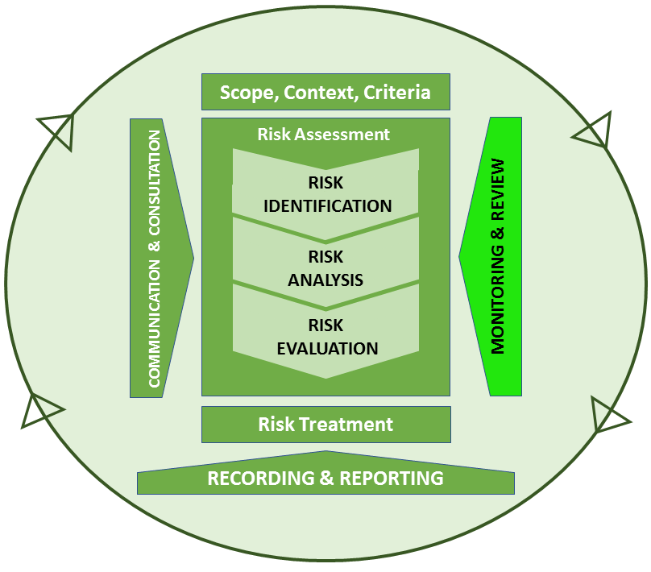
Risk Management Process – The Stages – 4/4
Monitoring & Review
Purpose
a) to check the effectiveness and efficiency of the controls considered by the system design and by the process; b) to gather information to improve the assessment; c) to detect changes of context, parameters and risks; d) to review the treatment and priorities; e) to identify emerging risks
Objective
a) Analysis of the events, changes, successes and failures; b) periodically check of the framework, the process and results; c) evaluation of the treatment owner's responsibilities, for the purposes of their appreciation or sanction applications
Risk management is dynamic, iterative and responsive to change
Notes:
Monitoring & Review
Monitoring processes should encompass all the features of risk management to:
Ensure that controls are effective and efficient;
Detect any changes in existing risks reviewing risk treatments and priorities;
Identify emerging risks
Monitoring and review are two different and complementary activities, since monitoring
involves the routine surveillance of actual performance against expected (or required)
performance, while review involves periodic checking of the current situation for changes in the internal/external context.
The overall responsibility for monitoring and review activities relies on the board and top
management: the way the top management reacts to the results of monitoring program will
affect the actions of employees.
Monitoring should be an integral part of risk management, and it owns to the managers who are responsible for control the responses to risks.
This phase concerns:
Environment scanning by risk owners, to monitor changes in risks or in context;
Risk treatment plan monitoring by risk owners;
Control monitoring by control owners and risk officers, through performance indicators and key risk indicators, according to the quantitative thresholds described in the risk appetite statement
Monitoring and review activities can also be considered in terms of a hierarchy.
Responsibilities can vary according to the kind of risks monitored (corporate, operational, project):
corporate risks are monitored by senior managers (i.e., directors or heads of dept);
operational risks are monitored at business unit level;
project risks are monitored within the project management system.
Risk management is dynamic, iterative and responsive to change. As risks and priorities
change, risk treatments should be monitored as a part of the risk management process.

Slide 18
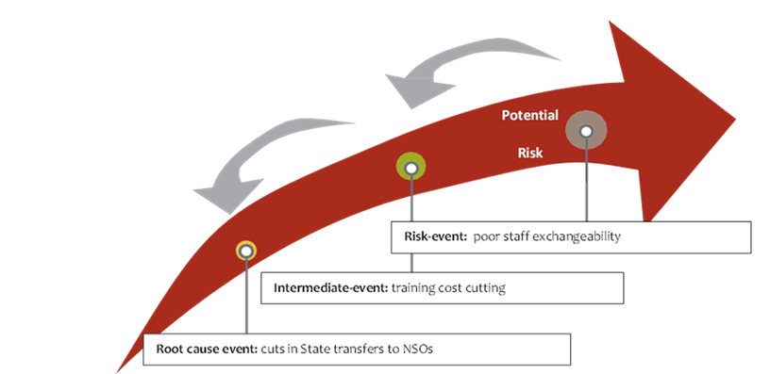
Key Risk Indicators
identification of a key-risk indicator related to the objective “Enhancing
job rotation” is assisted by developing a cause-effect chain between
an event that can negatively impact on a particular objective, and its root cause
Key performance indicators (KPIs) are crucial to the successful management of an organization by identifying underperforming aspects as well as those areas that need increased resources.
Key risk indicators (KRIs) provide timely leading-indicator information about emerging risks. providing an early signal of increasing risk exposures and may represent key ratios that track as indicators of evolving risks and potential opportunities, which signal that actions need to be taken.
Notes:
Key risk indicators
Key risk indicators (KRIs) are used for monitoring risk treatment actions.
Key risk indicators are metrics used to provide an early warning on increasing risk exposures
in different areas within an organization. In some instances, they may represent key ratios
that are tracked by management throughout the organization as indicators of evolving risks,
and potential opportunities, that alert on the need for actions to be taken. Others may be
more complex, and involve aggregation of several individual risk indicators into a multidimensional score about emerging events, that may lead to new risks or opportunities.
KRIs are typically derived from specific events or root causes, internally or externally
identified, that can prevent performance goals from being achieved. Linkage of top risks to
core strategies helps pinpoint the most relevant information that can serve as an effective
leading indicator of an emerging risk.
An effective method for developing KRIs begins by analysing a risk-event that has affected
the organization in the past (or at present), and then working backwards to pinpoint
intermediate and root cause events that led to the ultimate loss or lost opportunity. The
closer the KRI is to the root cause of a risk-event, the more likely that the KRI will provide
management time to take positive action to respond to such an event.
Effective KRIs often result from being developed by teams including professional risk
management staff, and business unit managers with a deep understanding of the
operational processes subject to potential risks. Ideally, these KRIs are developed in
cooperation with strategic plans for individual business units, and can then embed
acceptable deviations from the plan which fall within the overall risk appetite of the
organization.

Slide 19
Key Risk Indicators
identification of a key-risk indicator related to the objective “Enhancing
job rotation” is assisted by developing a cause-effect chain between
an event that can negatively impact on a particular objective, and its root cause
Key performance indicators (KPIs) are crucial to the successful management of an organization by identifying underperforming aspects as well as those areas that need increased resources.
Key risk indicators (KRIs) provide timely leading-indicator information about emerging risks. providing an early signal of increasing risk exposures and may represent key ratios that track as indicators of evolving risks and potential opportunities, which signal that actions need to be taken.
Notes:
Key risk indicators
The development of KRIs that can provide relevant and timely information, to both the
board and senior management, is a significant component of effective risk oversight. It is
also important to consider the frequency of reporting the KRIs. The appropriate time horizon depends on the main user of a specific KRI. For operational managers, real-time reporting may be necessary. For senior management, where a compilation of KRIs that highlight potential deviations from organization-level targets is the likely goal, a less frequent (e.g., weekly) status report may be enough. At the board level, the reporting is often aggregated to allow a broader analysis. Management can then use such analyses to identify information related to the root cause event, or intermediate event that might serve as a key risk indicator related to either event. When KRIs for root cause events and intermediate events are monitored, management is in the best position to identify early mitigation strategies to begin to reduce or eliminate the impact associated with an emerging risk event.
KRIs do not manage or treat risk, and can lead to a false sense of safety if poorly designed.
An important feature of any KRI is the quality of the available data used to monitor a specific
risk, and attention must be paid to the source of information, either internal to the organization or drawn from an external party. Sources of information to inform decisions
about the choice of KRIs may be available; for example, internal data may be available
concerning prior risk events which can be informative about potential future exposures.
Nevertheless, internal data is often unavailable for many risks — especially if not previously
encountered. In addition, risks likely to have a significant impact may often arise from
external sources, such as changes in economic conditions, interest rate shifts, or new
regulatory requirements/legislation. Therefore, KRIs may be based on external data, given
that root cause and intermediate events may arise from outside the organization.
A well-designed KRI should:
1) Be based on established practices or benchmarks;
2) Be consistently developed across the organization;
3) Provide an unambiguous and intuitive view of the highlighted risk;
4) Allow for measurable comparisons across time and business units;
5) Provide opportunities to assess the performance of risk owners on a timely basis;
6) Consume resources efficiently.

Slide 20
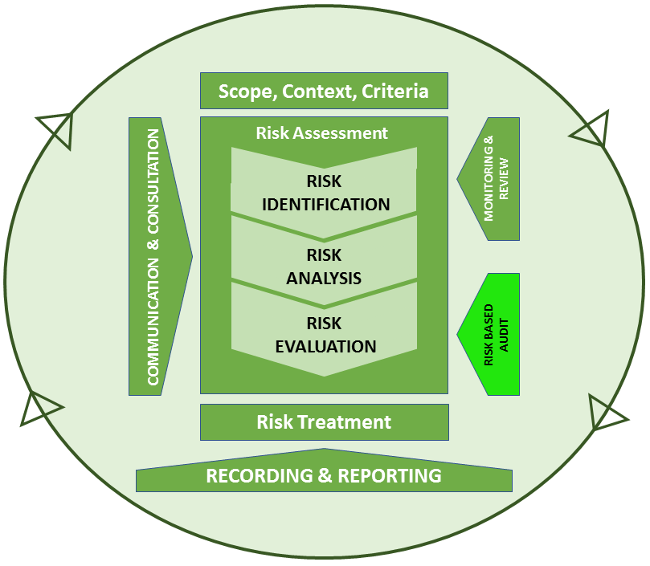
Risk Based Audit
The Risk Based Audit (RBA) objectives are:
Assurance for the risk management strategy;
Assurance for management of risks/controls and for the adequacy of the processes designed to constrain residual risk to the risk appetite;
Assurance for the adequacy of the review/assurance process;
Preparation of summary report to the risk Committee;
Monitoring of the progress of audit recommendations
Notes:
The internal control framework, which includes the risk management framework and the
internal audit framework, differentiates among three levels of control:
- Internal control (preventative or subsequent), deployed within the risk management
framework, under the responsibility of management (risk owners), aiming to prevent
or reduce the consequences related to risk occurrence
- “Compliance” level, aiming to help and monitor an actual risk management
implementation by risk-owners; such a level oversees risk assessment and control processes also ensuring their consistency with organizational goals (risk management unit)
- “Risk based audit”, ensuring an effective deployment of audit resources to assess management of those risks related to the actions of an organization, by examining and evaluating the adequacy of the risk management system and internal controls, processes and management. Therefore, internal audit monitors and shows the progress of implementation of audit recommendations and improvements in the audited area.
The Risk Based Audit (RBA) objectives are as follows:
Assurance for the risk management strategy: to ascertain the extent to which all line
managers review the risks/controls within the scope of their own responsibility; to evaluate the adequacy of risk management policy and strategy for achieving their objectives
Assurance for management of risks/controls: to encompass all the key risks as well as enough of the other risks to support confidence in the overall opinion reached; to evaluate the adequacy of the risk management processes designed to constrain residual risk to the risk appetite
Assurance for the adequacy of the review/assurance process: quality assured to engender confidence in the review process; to identify limitations in the evidence provided, or limitations to the depth/scope of the reviews undertaken; to identify gaps in control and/or over control, and provide opportunities for continuous improvement; to support preparation of internal audit summary report to the risk committee/chief statistician

Slide 21
Risk Based Audit
The Risk Based Audit (RBA) objectives are:
Assurance for the risk management strategy;
Assurance for management of risks/controls and for the adequacy of the processes designed to constrain residual risk to the risk appetite;
Assurance for the adequacy of the review/assurance process;
Preparation of summary report to the risk Committee;
Monitoring of the progress of audit recommendations
Notes:
a) Object: procedures, processes and internal service charters, risks selected according to priorities but: risks within risk appetite, risks not requiring audit in the short term, risks otherwise audited, tolerable risks.
b) Audit Plan: internal audits to be carried out in the short term are managed according to an annual plan that is endorsed by the board, and shared with the organizational divisions involved. Such a plan shows, with reference to any action: i) the audit lifespan, ii) the team composition, iii) the accountabilities, iv) the audit tasks (according to procedures, contractual requirements, etc.), v) the documents required, vi) the lead times. The annual plan is prepared for a single year on the basis of the strategic plan, according to risk assessment. Therefore, audit planning takes into account the results of previous audit studies, as well as management assessment of current levels of risk related to specific organizational programs.
c) Audit run-up, consisting of some actions that are preliminary to actual audit, such as:
a) formal assignment of duties; b) definition of the activity plan; c) identification of documents needed to define the audit range of reference and intervention; d) communication on audit start; e) kick-off meeting with the staff involved.
d) Audit implementation, actual audit, consisting of: i) operational meetings; ii) preliminary assessment of criticalities; iii) check of suitability and accordance with the risk management or quality system; iv) drawing up recommendations and possible mitigation actions. Audits can be used to assist risk managers in assessing the effectiveness of controls for each risk. An assessment could be made on whether the controls are adequate to reduce the level of risk (i.e., to reduce the risk from extreme/high to medium or low), or whether additional treatments/controls are required.
e) Reporting. Auditing ends with a meeting for sharing the main results. An audit report is drafted that contains: i) its findings, ii) actions performed, iii) criticalities found, and suggestions proposed, iv) possible action plan, in cooperation with the unit/division involved. Following the assessment of the control effectiveness for each risk, proposals for additional treatment strategies to reduce the level of risk will emerge, and some of the treatment strategies proposed during this process will be suitable for inclusion in the internal audit plan (feed-back).
f) The follow-up is aimed at checking the actual implementation of response actions
related to any remarks or recommendations.
The RBA management cycle is carried out through the following
six steps:

Slide 22
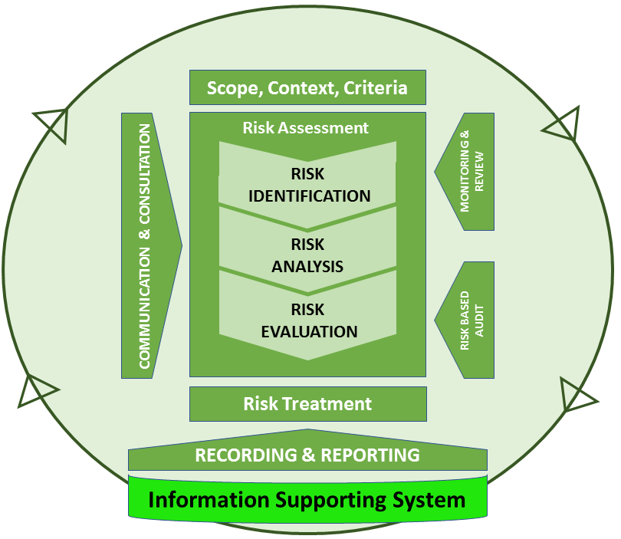
Risk Management Information System
Risk management information systems should be able to:
Record details of risks, controls and priorities, and show any changes;
Record risk treatments and related resource requirements;
Record details of incidents and loss events, and the lessons learned;
Track accountability for risks, controls and treatments;
Track progress and record the completion of risk treatment actions;
Trigger monitoring and assurance activity.
Notes:
An organization should document how it manages risk. Information about risks, and the
output from all applications of the risk management process, should be recorded in a
consistent and secure way, establishing the policies and procedures required to access, use and transfer information as a part of an information management plan
The organization should identify adequate resources in terms of information systems and
document management systems, so that capability information is relevant, reliable, timely, secure and available. This requires the maintenance of proper records and processes which generate a flow of timely, relevant and reliable information.
Therefore, each stage of the risk management process should be recorded properly. Record management is an important aspect of good corporate governance: it supports activities and decisions, as well as ensuring accountability to present and future stakeholders.
The quality of an information & document mgmt system depends on the following principles:
Information across the organization should be consistent, to allow for efficient flow;
Standardizing the definitions of terms and taxonomies ensures that different parts of the organization do not have different understandings of information, or are not operating on conflicting sets of information;
It is not necessary to have a single record management system across the organization, as long as management designs and operates multiple systems to allow an efficient consolidation, exchange and integration of information.
At the operational level, the organization should first determine the definitions, classifications and procedures needed to identify and manage risk information, as a part of an information management plan. Subsequently, as core sub-practices, it should set up ‘risk management records’ through the following steps:
o Defining and maintaining a risk management classification scheme and methodology;
o Defining an ongoing process for risk management information inventory and classification, including characteristics such as: type, preservation requirement, retention requirement, disposal requirement, availability requirement, operational/strategic value, data owner, source of information (data base/application, email, spreadsheet, etc.), confidentiality requirement, and associated organizational processes and policies.
The organization should periodically consider changes to the classification structure,
and its underlying definitions and classifications, as necessary.

Slide 23
Risk Management Information System
The quality of an information and document management system depends on:
consistent Information across the organization;
standardizing definitions to ensure that information are understanding and not conflicting;
managing systems allowing an efficient consolidation, exchange and integration of information;
an information management plan set up by:
  defining and maintaining a risk management classification scheme and methodology;
  defining an ongoing process for RM information inventory and classification, including characteristics as requirements, data owner, sources (database, spreadsheet, etc.), processes and policies.
Notes:
The whole risk management process should be documented through a web-based tool
which allows risks and treatments to be delegated and escalated among the organizational levels, and also makes it possible to connect a risk to a specific goal or activity in the operational plan of the agency (or the departments’ own action plans).
Risk identification, analysis & measurement should be carried out within a specific tool
through four steps:
1. Qualitative assessment (risk identification and risk analysis). The risk management information tool should record the assessment of risk in a way that assists the monitoring and identification of risk priorities. Risk assessment should be documented in a way which records these processing phases. Documenting risk assessment reveals an organization’s risk profile which: facilitates identification of risk priorities (in particular to identify the most significant risk issues with which senior management should concern themselves); records the reasons for decisions made about what a tolerable exposure is and is not; facilitates recording of how it is decided to address risk; allows all those concerned with risk management to see the overall risk profile, and how their areas of particular responsibility fits into it; facilitates review and monitoring of risks.
2. Prioritization;
3. Risk measurement;
4. Monitoring risk treatment actions. Staff members/managers who are responsible for risk treatment actions have to periodically report (e.g., monthly, quarterly, yearly) on the implementation/execution of actions within the tool.

Slide 24
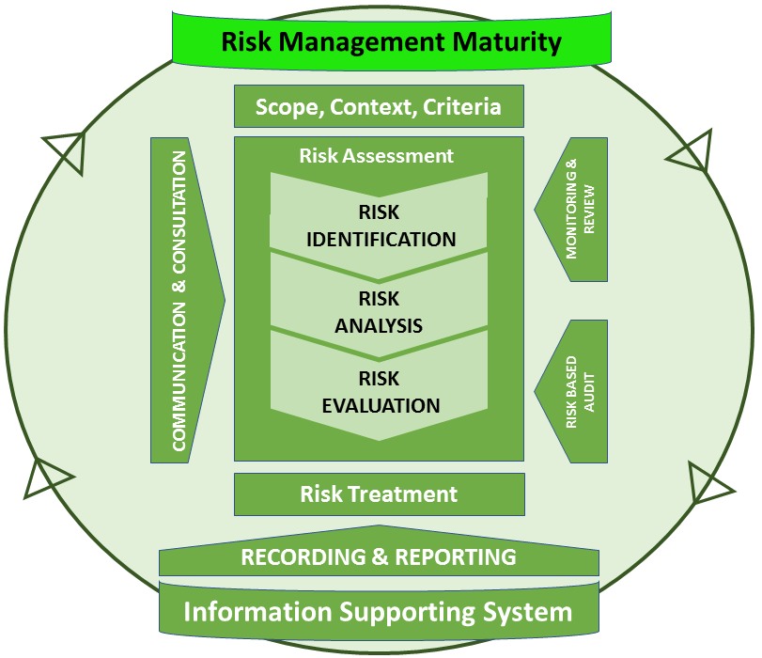
Risk Management
Maturity Model
The Risk Maturity Model (RMM) outlines key indicators and activities that comprise a sustainable, repeatable and mature enterprise risk management (ERM) program.
Taking the risk maturity self-assessment, organizations benchmark how inline their current risk management practices are with the RMM indicators.
Once completed, each organization is provided with a maturity score for their program, starting at the earliest stage and lowest risk maturity level, Ad-Hoc (Level 1), and progressing to the most advanced, risk maturity level, Leadership (Level 5)
Notes:
Risk Management Maturity
In order to enable benchmarking between implementation levels of risk management in
organizations, researchers, public agencies, professional associations and standards bodies
tried to define their own risk management model. This type of tool contains the fundamental elements of effective risk management processes, and depicts the evolutionary scale from a basic approach to an embedded and holistic one. It allows NSOs to gauge progress in developing the necessary risk management capabilities, and to assess the
effectiveness of risk handling and impact on delivering successful outcomes. It also promotes
a common language and understanding. A phased approach allows the NSO: to measure
where it currently is; to set goals for where it wants to go; to plot a path to get there, focusing its efforts for improvement on areas of identified weakness. Furthermore, a maturity model can serve as a recognition program within the organization: attainment of a maturity level can be considered as a performance indicator.
Moreover, given that:
There is no optimum maturity level that would be considered as appropriate for every
organization (it depends on its external context, size, internal culture, people, history,
complexity of the organizations’ activities, etc.); and
The same entity could present heterogeneous levels of maturity with reference to
different organizational areas (any risk management linked processes and activities can
be more developed than others);
The maturity of an organization’s risk management system can be categorized into clusters,
that range from having no formal process, to fully integrated into all aspects of the entity.
Risk management capability is a broad spectrum, ranging from the occasional informal
application of risk techniques to specific projects, through routine formal processes applied
widely, to a risk-aware culture with proactive management of uncertainty. In view of this,
core areas/items are graded using a four-point scale, designed to take into account that each
maturity level is a defined position in an achievement hierarchy, which establishes the
attainment of certain risk management capabilities. This hierarchy is based on different
stages of progressively mature organizational behaviour

Slide 25
Risk Management
Maturity Model
The Risk Maturity Model (RMM) outlines key indicators and activities that comprise a sustainable, repeatable and mature enterprise risk management (ERM) program.
Taking the risk maturity self-assessment, organizations benchmark how inline their current risk management practices are with the RMM indicators.
Once completed, each organization is provided with a maturity score for their program, starting at the earliest stage and lowest risk maturity level, Ad-Hoc (Level 1), and progressing to the most advanced, risk maturity level, Leadership (Level 5)
Notes:
Risk Management Maturity
LEVEL 1:
a) There are no risk management processes in place. The organization does not feel the need for managing risk, and does not use structured approaches for this purpose: it is not carrying-out pre-planning activity, but is reacting to situations and risk issues after they occur with no proactive thought.
b) The organization is not able to distinguish between positive and negative risk.
c) Management processes are repetitive, with no attempt to learn from the past and to prepare for future threats.
d) There might be a belief that most important risks are known.
e) The effects of risky events might be identified, but not linked to goals, and risk events are
not associated with their process sources.
f) No attempt is made to develop mitigation plans.
g) There is no culture of control, but one of resistance to change prevailing. There is
emphasis on protecting physical and financial assets
To move from Level 1 to Level 2, the organization needs to recognize the value of risk management, and to became aware of its potential benefits. To this end, a disruptive event or external factors – such as stakeholders’ influence, government pressure, etc. – may trigger a more proactive approach towards risk, and an awareness that some form of structured system needs to be put in place to deal with uncertainty.

Slide 26
Risk Management
Maturity Model
The Risk Maturity Model (RMM) outlines key indicators and activities that comprise a sustainable, repeatable and mature enterprise risk management (ERM) program.
Taking the risk maturity self-assessment, organizations benchmark how inline their current risk management practices are with the RMM indicators.
Once completed, each organization is provided with a maturity score for their program, starting at the earliest stage and lowest risk maturity level, Ad-Hoc (Level 1), and progressing to the most advanced, risk maturity level, Leadership (Level 5)
Notes:
Risk Management Maturity
At LEVEL 2:
1) Top management are aware of the need to manage uncertainty and risk, and have made
basic resources available to improve.
2) A risk strategy has been identified, and a risk management policy has been drawn up.
3) Key people are conscious of the need to assess and manage risks, and they understand
risk concepts and principles.
4) Some stand-alone risk processes have been identified, and the related risk mitigation activities are sometimes identified but not often executed.
5) Risk management mainly focuses on past events.
6) Corporate culture has little risk management accountability, with process owners not well defined or communicated.
7) Risk culture is enforced by policy still interpreted, nevertheless, as compliance.
8) A pilot training programme has been implemented, and a core group of people have the
skills and knowledge to manage risk.
9) Programs for compliance, quality management, process improvement and so on still
operate independently, and have no common framework, causing overlapping risk
assessment activities and inconsistencies.
10) Controls are mainly based on departments and finances.
11) Consistent planning and tracking of performance is missing. Qualitative risk assessments
are unused or informal.
Summarizing, although the organization is aware, at some level, of the potential benefits of
managing risks, there is no effective widespread implementation process, and it is up to an
interested individual manager to pursue good practices. There is limited evidence that risk
management is being effective in at least the most relevant areas.

Slide 27
Risk Management
Maturity Model
The Risk Maturity Model (RMM) outlines key indicators and activities that comprise a sustainable, repeatable and mature enterprise risk management (ERM) program.
Taking the risk maturity self-assessment, organizations benchmark how inline their current risk management practices are with the RMM indicators.
Once completed, each organization is provided with a maturity score for their program, starting at the earliest stage and lowest risk maturity level, Ad-Hoc (Level 1), and progressing to the most advanced, risk maturity level, Leadership (Level 5)
Notes:
Risk Management Maturity
At LEVEL 3:
a) Organizational processes are identified, and risk ownership is clearly defined and well
communicated to all staff.
b) Authorities, roles and responsibilities are identified, and appropriate resources allocated
agreement exists on a risk framework, and operating guidance is available.
c) Senior managers take the lead to ensure that approaches for addressing risk are being
developed and implemented in all key and relevant areas.
d) Events are associated with their process sources.
e) Emphasis is on developing a series of proactive action plans, to deal with events that may
impact the organization and its stakeholders, to better respond to identified issues, and
to consider measures reducing the likelihood of undesirable events and their consequences.
f) More weight is given to pre-emptive planning.
g) Qualitative assessment methods are used to determine what deeper needs exist for use
of quantitative methods, analysis, tools and models.
This phase provides the opportunity to increase awareness for a large portion of the
organization. There is clear evidence that risk management is being effective in all relevant
areas. By the end of this stage, a culture of risk management is taking hold within the
organization, and includes the management of opportunities.

Slide 28
Risk Management
Maturity Model
The Risk Maturity Model (RMM) outlines key indicators and activities that comprise a sustainable, repeatable and mature enterprise risk management (ERM) program.
Taking the risk maturity self-assessment, organizations benchmark how inline their current risk management practices are with the RMM indicators.
Once completed, each organization is provided with a maturity score for their program, starting at the earliest stage and lowest risk maturity level, Ad-Hoc (Level 1), and progressing to the most advanced, risk maturity level, Leadership (Level 5)
Notes:
Risk Management Maturity
At LEVEL 4:
1) The management of risk is everyone’s responsibility, and the risk management system is
enforced at every level: it is embedded in all organizational processes and strategies, and
is a formal part of goal setting and achievement.
2) Accountability is embedded into all processes, support functions, lines and locations, as a
way to achieve goals.
3) A risk-based approach to achieve goals is used at all levels.
4) A terminology and classification for collecting risk information is fully implemented.
5) Risk and performance information is collected from all areas, to identify dependencies
and root cause indicators’ frequency; moreover, it is actively used to improve all
organizational processes.
6) Mitigation measures are determined, and a method to quantify effectiveness is understood.
7) Risk mitigation is integrated with assessment (carried out with quantitative analysis,
tools and models supporting qualitative methods) to monitor effective use.
8) Measures ensure downside and upside outcomes of risks and opportunities are aggressively managed.
9) Standardized evaluation criteria of impact, likelihood and controls’ effectiveness are
used to prioritize risk for follow-up activity.
10) Frontline employees’ participation and documents risk issues’ or opportunities’
Significance are promoted. Process owners regularly review and recommend risk indicators that best measure their areas’ risks.
11) The results of internal adverse event planning are considered to be a strategic opportunity.
12) Career development and compensation include incentives for effective risk management.
13) The organization measures the effectiveness of uncertainties and seizing risky opps.
14) Deviations from plans or expectations are measured against goals.
15) A clear, concise and effective approach to monitoring progress toward risk management
goals is communicated regularly with business areas.

Slide 29


