Slide 1
Risk Management in Statistical Organizations
Notes:
Effective risk management is fundamental to the success of modernization in national statistical
organisations (NSOs), in that it concerns both organisation and production processes. Actually, Risk management, on the one hand, points at strengthening organization governance on the whole by supporting the decision-making process when selecting priorities; on the other hand, it points at identifying, analysing and removing the uncertainties that can put obstacles in the way of change and development.
The UN Guidelines on Risk Management in Statistical Organizations give NSOs, interested in internally implementing a risk management system, a reference based on the practices developed within the UNECE organizations and containing some key features: effective development, sustainability (in terms of resources and complexity), alignment with change management processes.
This training module supports the implementation of the Guidelines and is structured consistently with the ISO 31000:2018 standard architecture; this standard is widely accepted internationally as well as used by most public organisations when implementing Risk management systems.

Slide 2
Module 1: The Concept of Risk Management
1) an unwanted event which may or may not occur.
2) the cause of an unwanted event which may or may not occur.
3) the probability of an unwanted event which may or may not occur’

Slide 3

The Definition of Risk
According to the ISO risk definition, risk is “effect of uncertainty on objectives”.
“An effect is a deviation from the expected. It can be positive, negative or both, and can address, create or result in opportunities and threats”.
Uncertainty is “the lack of information about the understanding or knowledge of an event, its consequences and likelihood”.
“Objectives can have different aspects and categories, and can be applied at different levels”.
Risk is often expressed in terms of a combination of the consequences of an event (including changes in circumstances) and the associated likelihood of occurrence”
ccc
a
Risk:
Combination of the likelihood of an event
and its effects
Inherent Risk:
Risk without any intervention
Before any risk treatment is put in place, the event
involves an "inherent risk", ontologically related
to the activity that could determine the event itself
Once the mitigating action has been put in action,
all that’s left is the "residual risk", whose value
can be equal to, greater or less than the "inherent risk".
Residual risk:
Risk remaining after the treatment, possibly containing risks not identified
Risk treatment:
Selection and implementation of interventions on risk
Notes:
Risk management is an organizational model aimed at developing the quality of management processes; it stands out by analysing the events that have not materialized within the organization. Unlike most managerial systems, risk management doesn’t overlap with other internal controls because it represents a different perspective that cuts across planning and control, performance evaluation system, audit, quality and so on.
Therefore, risk management helps the organizations bring about a higher level of quality of services and products because it supports the decision-making processes, preparing for the difficulties that could hinder the achievement of the strategic goals. In a few words, the main objective of risk management concerns protecting and strengthening:
Values, ethics and sense of belonging
The entity’s tangible and intangible assets
Growth of organizational culture
Leadership and relationship
Effectiveness and efficiency of processes
Resources for strategic priorities
Stakeholder’s satisfaction
That means that risk management is a tool to effectively manage an organization; in fact, it deals with risks and opportunities affecting the creation or the preservation of an entity’s value. risk management is defined as: “a process, effected by an entity’s board of directors, management and other personnel, applied in a strategy setting and across the enterprise, designed to identify potential events that may affect the entity, and manage risk to be within its risk appetite, to provide reasonable assurance regarding the achievement of entity objectives”.
Continued on Next Page >>>>>>>

Slide 4
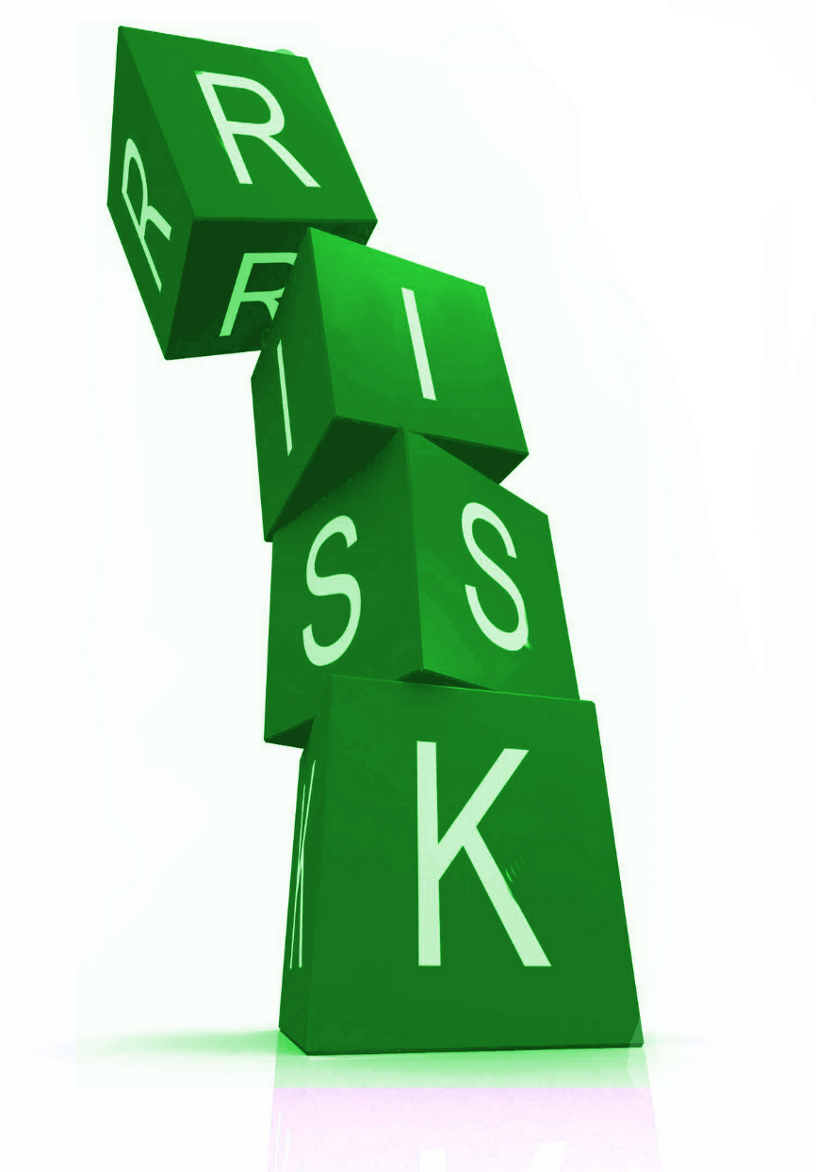
The Definition of Risk
When defining a risk, some issues should be taken into consideration:
A risk statement should be a clear, meaningful and concise statement that describes the risk.
Example: “Increased difficulties in reaching household survey
respondents could adversely impact the quality of our data”.
The statement should describe the event, and the potential impact of that event on the achievement of the organization’s objectives.
Example: There is a risk that (event)....and the consequences are (impact)...
A good risk statement should also include the possible causes (drivers). Examples: There is a risk that (event)...because of (cause)...and the consequences would be (impact)...; Given that...there is a risk that...with the potential impact of....
Notes:
The definition reflects certain fundamental concepts; in particular, risk management is:
A process, ongoing and flowing through an entity
Effected by people at every level of an organization
Applied in strategy setting
Applied across the enterprise, at every level and unit, and includes taking an entity level portfolio view of risk
Designed to identify potential events that, if they occur, will affect the entity and to manage risk within its risk appetite
Able to provide reasonable assurance to an entity’s management and board of directors
Geared to achievement of objectives in one or more separate but overlapping categories
This definition is purposefully broad. It captures key concepts fundamental to how
companies and other organizations manage risk, providing a basis for application across organizations, industries, and sectors. It focuses directly on achievement of objectives established by a particular entity and provides a basis for defining enterprise risk management effectiveness.
Risk management examines the events that have negative impact; they represent the risks which can prevent value creation or erode existing value. There are many risk definitions in the literature and in the standards most recognized at the international level; the standard ISO 31000:2018 defines risk as: “the effect of uncertainty on objectives”, where “an effect is a deviation from what is expected (positive and/or negative), often expressed in terms of a combination of the consequences of an event (including changes in circumstances) and the associated likelihood of occurrence” and the uncertainty is “the lack of information about the understanding or knowledge of an event, its consequences and likelihood”.

Slide 5
Risk Complexity
Risk Profile
Set of risks that could affect all or part of an organization
Risk Perception
How everyone considers risks according to their values & interests
Risk Attitude
Approach to evaluation & prosecution, maintenance, acceptance or risk removal
Risk Appetite
Total amount & type of risk that the organisation decides to pursue, maintain or adopt
Risk Acceptance
Attitude to risk acceptance
Risk Tolerance
Specific mode of acceptance or rejection of risks
Risk Retention
Acceptance of a loss rather than a gain arising from a risk
Risk Profile is the set of risks that could affect all or part of an organization. It results from a comprehensive process that: concerns risk information from several sources; reflects recommendations from managers; envisages a risk questionnaire, revised guidelines, clearer definitions of risk sources and communication strategy.
Notes:
The concept of risk is more complex than the combination of likelihood and effect; it
comprises some issues considered by the cognitive analysis relating to the organization,
including:
Risk Profile: set of risks that may affect all or part of an organization;
Risk Appetite: total amount and type of risks that an organization decides to pursue,
maintain or adopt
Risk Perception, which describes how people perceive risks according to their values
and interests
Risk Attitude. (Existing Risk Profile). If an organization is particularly effective in
managing certain types of risks, it may be willing to take on more risk in that
category, conversely, it may not have any appetite in that area.
Risk Acceptance, which refers to the maximum potential impact of a risk event that
an organization could withstand. Often, appetite will be well below acceptance.
Risk Capacity, which is the maximum level of risk that an organization can assume
without violating the regulatory burden;
Risk Retention, which considers stakeholders’ conservative return expectations and a
very low appetite for risk-taking.
Risk Tolerance, which is the level of variation that the entity is willing to accept
around specific objectives.
All of these issues should be considered to assess the overall risk level of the organization

Slide 6
Risk Components
EXAMPLE: malfunction of computer equipment
Cause
Moisture in the air
Factor
Spark in the computer
Event
Continuous reboot of the system
Action
(Preventative) Check PC placement
Action
(Subsequent) Plan preventative maintenance
Notes:
The identification of the "enabling factors" and the "causes" related to a risk,
could contribute significantly to specifying the context in which the risk can occur, allowing
risk owners, to adopt the necessary preventive measures.
While the enabling factor represents an organizational/social/environmental circumstance
which facilitates a behaviour that could result in a risk, the cause is the reason why the
action has been undertaken. Therefore, the root-cause analysis can help organizations
distinguish risks that could be effectively tackled from those which can only be partially dealt
with.

Slide 7

What is or isn’t a Risk?
The risks must be linked to the objectives
You must pay attention to the risks with generic impact on the objectives, but not relevant for the results
In identifying the risks, you should not confuse them with the impacts
You must avoid defining risks with assertions that are only the opposite of the objectives
The definition of a risk should understand the cause and consequence
Objective: Travelling by train from A to B to arrive on time for a meeting
Not being able to get from A to B in time for the meeting | This is only the opposite of the objective
Be late & miss the meeting | This is the impact of the risk not the risk itself
There isn’t a dining car so I’m hungry | .This does not impact on the objective
I miss the train (so I’m late & I cannot attend the meeting) | This is a risk that I can control making sure that I will arrive early
The bad weather conditions prevent the train from leaving the station | This is a risk that I cannot control but I can manage with an emergency plan

Slide 8
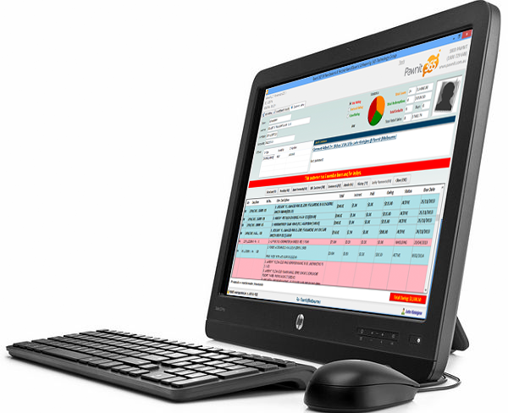
Are you a Risk Seeker or Risk Averse?
Read the excerpts that follow and decide which option you would choose.
A manager is sourcing equipment for a new IT project. The project has to choose between two
vendors, Best Retailer IT and New Retailer IT. To simplify the problem, the project manager decides to
estimate the potential profit of these vendors on the basis of product reliability.
Through research , the manager finds that Best Retailer IT has a 60% chance of providing reliable equipment, and its parts cost £300,000 (this includes costs of installations and maintenance).
There is, a 40% chance that the equipment will fail – in which case, costs can increase to £850,000.
If New Retailer IT is chosen, there is an 80% chance of high reliability at a cost of £750,000 and a 20% chance of failure.
New Retailer IT provides lifelong guarantees and maintenance services.
Would you choose
Best Retailer IT or New Retailer IT?
Notes:
Participant Feedback
If you choose Best Retailer IT, you can consider yourself to be a risk seeker, and if you chose New Retailer IT, you could be considered averse to risk.
Risk seekers will choose the option with the most at stake (40% chance that costs can increase to £850,000) but the most favorable outcome ($300,000 cost).
Risk averse individuals will choose the safest option (80% chance of high reliability at a cost of £750,000) with a life-long guarantee. However, this is the costly option.
As a risk seeker would the following scenario change your mind?
Given the competition from New Retailer IT, Best Retailer IT has proposed the following incentive: a 70% guarantee of providing reliable equipment and parts at a cost of £300,000. There is still however a 30% chance that the equipment will fail – in which case, the costs can increase to $850,000.
Would this change your choice of retailer?
As Best Retailer IT’s guarantees increase, its offer becomes attractive to even the most risk-averse individuals because of the massive savings it offers compared with New Retailer IT.

Slide 9
The Risk Management System
According to the ISO 31000:2018, Risk Management refers to the architecture used to manage risks. This architecture includes Principles, Framework, and Process.
Notes:
A risk management framework (system) provides the infrastructure for delivering, maintaining and governing risk management throughout the organization. As a part of this framework, an organization should set up:
A risk management mandate, that is the board’s statement for setting the direction and priorities for risk management, and through which “who does what” is established, and the proper authorization and necessary resources are given. This is the main expression of the governance of risk, through which the organization’s board engages stakeholders in locating the different responsibilities for managing risks.
A risk strategy, that points out how risk management supports the organization’s overall strategy and related objectives. It takes into consideration the external and internal context, focusing in particular on key stakeholders’ demands.
A risk policy that provides a clear and concise outline of the organization’s requirements for risk management within the organization’s overall approach to governance. It includes the risk appetite statement, the human resources training program for supporting the risk management process, as well as a definition of risk assessment criteria.
An integrated risk approach supports quality management in improving statistical data integrity and quality, through identification, analysis and treatment of risks inherent to statistical and over-arching processes.
The framework assists in managing risks effectively through the application of the risk management process at varying levels and within specific contexts of the organization.
The framework ensures that information about risk derived from the risk management process is adequately reported and used as a basis for decision making and accountability at all relevant organizational levels.
The framework is not intended to prescribe a management system, but rather to assist the organization to integrate risk management into its overall management system.
If an organization's existing management practices and processes include components of risk management or if the organization has already adopted a formal risk management process for particular types of risk or situations, then these should be critically reviewed and assessed

Slide 10
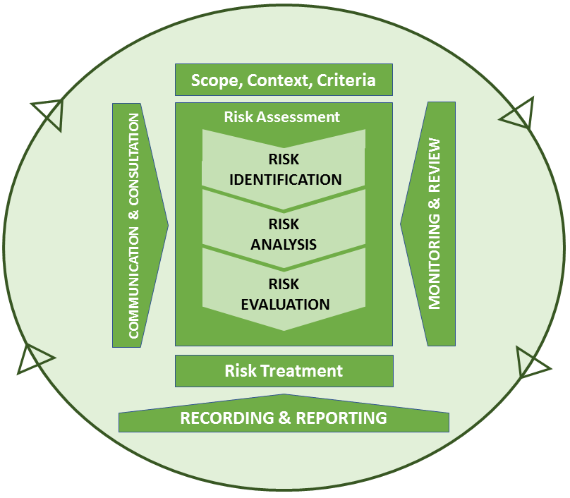
Principles
Framework
Process
Mandate & Commitment (4.2)
Consider culture, values & human behaviors
Use common language and update information
Build Tailor-made tools
Address to real risks
Be Systematic and structured
Promote transparency and staff involvement
Be embedded in decision-making processes
Protect and preserve every asset
Become dynamic and responsive
Design of framework for managing risk (4.3)
Understanding the organisation and its context (4.3.1)
Establishing Risk Management policy (4.3.2)
Accountability (4.3.3)
Integration into organisational processes (4.3.4)
Resources (4.3.5)
Establishing internal comms & reporting mechanisms (4.3.6)
Establishing external comms & reporting mechanisms (4.3.7)
Continual improvement of the network
(4.6)
Implementing risk management (4.4)
Implementing risk framework (4.4.1)
Implementing risk mgmt. process (4.4.2)
Monitoring & review of the framework (4.5)
Notes:
A risk management framework is a set of components that support and sustain risk management throughout an organization.
There are two types of components: foundations and organizational arrangements.
Foundations include your risk management policy, objectives, mandate, and commitment.
And organizational arrangements include the plans, relationships, accountabilities, resources, processes, and activities you use to manage your organization’s risk.
It is not intended to prescribe a management system, but rather to assist the organization to integrate RM into its overall management system.

Slide 11
The Principles The Framework
The Risk Management System – ISO 31000:2018
Consider culture, values & human behaviors
Use common language and update information
Build Tailor-made tools
Address to real risks
Be Systematic and structured
Promote transparency and staff involvement
Be embedded in decision-making processes
Protect and preserve every asset
Become dynamic and responsive
Consists of: 1. Mandate & Commitment; 2. Design of framework for managing risk; 3. Implementing Risk Management; 4. Monitoring and review of the framework; 5. Continual improvement of the framework
is a set of 2 types of components supporting and sustaining risk management throughout an organization: a) foundations (policy, objectives, mandate, and commitment); b) organizational arrangements (plans, relationships, accountabilities, resources, processes)Build Tailor-made tools
assists in managing risks effectively through the application of the RM process at varying levels and within specific contexts of the organizationBe Systematic and structured
ensures that information about risk coming from the risk management process is adequately reported and used as a basis for decision making and accountability at all relevant levels

Slide 12
ISO 31000:2018 – The Framework
Mandate & Commitment (4.2)
Design of framework for managing risk (4.3)
Understanding the organisation and its context (4.3.1)
Establishing Risk Management policy (4.3.2)
Accountability (4.3.3)
Integration into organisational processes (4.3.4)
Resources (4.3.5)
Establishing internal comms & reporting mechanisms (4.3.6)
Establishing external comms & reporting mechanisms (4.3.7)
4.2 Mandate and commitment
The introduction of risk management and ensuring its ongoing effectiveness require strong and sustained commitment by management of the organization, as well as strategic and rigorous planning to achieve commitment at all levels.
Continual improvement of the network
(4.6)
Implementing risk management (4.4)
Implementing risk framework (4.4.1)
Implementing risk mgmt. process (4.4.2)
Monitoring & review of the framework (4.5)
Notes:
Risk management mandate and strategy
A risk management strategy includes definition of the risk management scope and plan, as well as the discussion of risk management philosophy.
Risk philosophy
A risk management philosophy is the set of shared beliefs and attitudes that characterise
how risk is considered in any organisation. It affects how risk management components are applied, including how risks are identified, accepted, and how they are managed.
When the risk management philosophy is not developed, understood, or fully embraced by the staff, an uneven application of risk management across business units, or departments is likely. Even when the philosophy is well developed, cultural differences among units resulting in variation in enterprise risk management application may still be found. Therefore, risk philosophy, risk appetite & risk strategy should always be kept aligned, as one reflects the other. To this purpose it’s necessary to “measure” risk perception by the management staff – as some may be prepared to take more risk, than others – as well as the risk maturity of organizational context, since this latter could be more or less resilient in facing risk.
Mandate
A mandate in risk management expresses itself through an official document that clearly indicates the risk strategy & objectives, the people accountable for them, and authorizes such people to use proper resources for achieving their objectives. Defining and communicating this statement testifies a commitment to implement a risk management system.
Risk management commitment
Risk management design should be mostly contributed to by top management with the
assistance of middle/low management and technical staff particularly during the start-up phase, every organizational level should be involved in order to collect inputs and needs (for example, through ad hoc interviews). Employees know best the most typical risks in their area, and should be both encouraged and engaged to regularly give information about them.
Risk management goals should not only be clearly defined and communicated by top
management, but also discussed within each of NSO’s units. Each unit should have a contact
person who is entitled to coordinate all the risk management activities, in cooperation with
his/her colleagues, including the head of unit.

Slide 13
ISO 31000:2018 – The Framework
Mandate & Commitment (4.2)
Design of framework for managing risk (4.3)
Understanding the organisation and its context (4.3.1)
Establishing Risk Management policy (4.3.2)
Accountability (4.3.3)
Integration into organisational processes (4.3.4)
Resources (4.3.5)
Establishing internal comms & reporting mechanisms (4.3.6)
Establishing external comms & reporting mechanisms (4.3.7)
4.3 Design of framework for managing risk
Understanding of the organization and its context (4.3.1)
Before starting the design and implementation of the framework for managing risk, it is important to evaluate and understand both the external and internal context of the organization, since these can significantly influence the design of the framework.
Continual improvement of the network
(4.6)
Implementing risk management (4.4)
Implementing risk framework (4.4.1)
Implementing risk mgmt. process (4.4.2)
Monitoring & review of the framework (4.5)
Notes:
When designing the framework for managing risk, the organization should examine and understand its external and internal context.
Examining the organization's external context may include, but is not limited to:
— the social, cultural, political, legal, regulatory, financial, technological, economic and environmental factors, whether international, national, regional or local;
— key drivers and trends affecting the objectives of the organization;
— external stakeholders’ relationships, perceptions, values, needs and expectations;
— contractual relationships and commitments;
— the complexity of networks and dependencies.
Examining the organization’s internal context may include, but is not limited to:
— vision, mission and values;
— governance, organizational structure, roles and accountabilities;
— strategy, objectives and policies;
— the organization’s culture;
— standards, guidelines and models adopted by the organization;
— capabilities, understood in terms of resources and knowledge (e.g. capital, time, people, intellectual property, processes, systems and technologies);
— data, information systems and information flows;
— relationships with internal stakeholders, taking into account their perceptions and values;
— contractual relationships and commitments;
— interdependencies and interconnections.

Slide 14
ISO 31000:2018 – The Framework
4.3.2 Establishing risk management policy
The risk management policy should clearly state the organization's objectives for, and commitment to, risk management and typically addresses the following steps
Mandate & Commitment (4.2)
Design of framework for managing risk (4.3)
Understanding the organisation and its context (4.3.1)
Establishing Risk Management policy (4.3.2)
Accountability (4.3.3)
Integration into organisational processes (4.3.4)
Resources (4.3.5)
Establishing internal comms & reporting mechanisms (4.3.6)
Establishing external comms & reporting mechanisms (4.3.7)
4.3.3 Accountability
The organization should ensure that there is accountability, authority and appropriate competence for managing risk, including implementing and maintaining the risk management process and ensuring the adequacy, effectiveness and efficiency of any controls.
4.3.4 Integration into organizational processes
Risk management should be embedded in all organizational practices & processes so that it is relevant, effective & efficient. The risk management process should become part of, & not separate from, those organizational processes.
Continual improvement of the network
(4.6)
Implementing risk management (4.4)
Implementing risk framework (4.4.1)
Implementing risk mgmt. process (4.4.2)
Monitoring & review of the framework (4.5)
Notes:
Establishing risk management policy
To achieve consistency in risk management activities across the organization, the policy should contain a high level overview and description of the risk management process.
The main features of the policy are:
Definition of corporate risk appetite: the board and senior managers set the risk
tolerance level by identifying general boundaries against unacceptable exposure to
risk. The corporate risk appetite is then used to shape tolerance levels down the
organization
Implementation of a risk management standardized process at all levels, to ensure
that risk management is an inherent part of how core-business is run
Top management involvement in risk management framework design
Stakeholders’ empowerment
Definition of risk criteria
Definition of a hierarchy of risks
Implementation of a risk management unit/office
Definition of human resource training policy to support risk management process
Establishing a communication system
Establishing a reporting system
Risk Accountability
Need some narrative here
Integration into organizational processes
Risk management is essential to achieve the organization’s strategic outcome, and such
fulfilment can only be reached by ensuring that risk is included as a routine in all significant
decision-making. This means that risk management should be part of the culture, embedded in every organizational process, including production and supporting processes.
This requires an agreed approach, integrated with corporate strategy, that outlines
exposures, issues and problem areas: integrated risk management should result in a system that is a part of the regular organizational performance review, where the organization not only looks at performance and events, but systematically identifies important gaps, variations and exposures, in order to get ahead of (mitigate) their possible impact.

Slide 15
ISO 31000:2018 – The Framework
4.3.5 Resources
The organization should allocate appropriate resources for risk management (people, skills, competencies, procedures)
Mandate & Commitment (4.2)
Design of framework for managing risk (4.3)
Understanding the organisation and its context (4.3.1)
Establishing Risk Management policy (4.3.2)
Accountability (4.3.3)
Integration into organisational processes (4.3.4)
Resources (4.3.5)
Establishing internal comms & reporting mechanisms (4.3.6)
Establishing external comms & reporting mechanisms (4.3.7)
4.3.6 Establishing internal communication and reporting mechanisms
The organization should establish internal communication and reporting mechanisms in order to support and encourage accountability and ownership of risk.
4.3.7 Establishing external communication and reporting mechanisms
The organization should develop and implement a plan as to how it will communicate with external stakeholders.
Continual improvement of the network
(4.6)
Implementing risk management (4.4)
Implementing risk framework (4.4.1)
Implementing risk mgmt. process (4.4.2)
Monitoring & review of the framework (4.5)
Notes:
Risk management resources
Risk management initiatives can promote employees’ sense of belonging, as well as their own significance within the organization. It provides a systematic mechanism of internal control, that obliges all staff to come together to discuss, and identify issues and solve problems.
Risk management training
To effectively implement a risk management system, an organization should allocate
appropriate resources, suitable human capital as well as ensure that those who are
accountable can fulfil their role by providing them with the training and skills needed. All
staff should be aware of the relevance of risk to achieve the objectives assigned and training
to support staff in risk management should be available.
Roles & responsibilities
Risk management should work at any organizational level, as well as through participation by
the entire staff, according to respective roles and functions.
The governing board is responsible for ensuring the setup of an effective risk management
system throughout the organization
The risk committee/board entity is an oversight entity ruling the risk management system
together with other strategic matters
The risk manager works under the guidance of the committee/board, and is skilled in risk management, and supported by sufficient staff for the size of the organization
Top management is responsible for: ensuring that there is a fit-for-purpose risk management framework, that processes are in place which are adequately resourced and financed
The Head of department/divisions/units must actively manage risks that are part of daily
work through complying with the enterprise risk management framework
All staff must take risks into account when making decisions and are responsible for an
effective management of risks, including identification of them. All staff are responsible for
understanding and implementing risk management policies and processes.

Slide 16
ISO 31000:2018 – The Framework
4.3.5 Resources
The organization should allocate appropriate resources for risk management (people, skills, competencies, procedures)
Mandate & Commitment (4.2)
Design of framework for managing risk (4.3)
Understanding the organisation and its context (4.3.1)
Establishing Risk Management policy (4.3.2)
Accountability (4.3.3)
Integration into organisational processes (4.3.4)
Resources (4.3.5)
Establishing internal comms & reporting mechanisms (4.3.6)
Establishing external comms & reporting mechanisms (4.3.7)
4.3.6 Establishing internal communication and reporting mechanisms
The organization should establish internal communication and reporting mechanisms in order to support and encourage accountability and ownership of risk.
4.3.7 Establishing external communication and reporting mechanisms
The organization should develop and implement a plan as to how it will communicate with external stakeholders.
Continual improvement of the network
(4.6)
Implementing risk management (4.4)
Implementing risk framework (4.4.1)
Implementing risk mgmt. process (4.4.2)
Monitoring & review of the framework (4.5)
Notes:
Establishing reporting mechanisms
An organization should ensure that information about risks derived from the risk
management process is adequately reported, and used as a basis for decision making at all
relevant levels. For this, clear reporting line mechanisms and strong inter-department
knowledge sharing should be established in order to encourage accountability of risk, and to
ensure reports are delivered in an accurate, consistent and timely manner.
Internal Reporting
The organization should establish internal reporting mechanisms in order to support and
encourage accountability and ownership of risk. These mechanisms should ensure that: key
components of the risk management framework, its effectiveness and the outcomes and any
subsequent modifications, are properly disseminated; relevant information derived from the
application of risk management is available at appropriate levels and times; there are
processes for consultation with internal stakeholders.
These mechanisms should, where appropriate, include processes to consolidate risk information from a variety of sources, and may need to consider the sensitivity of the information. Internal risk reports can either be real-time or periodic.
External reporting
Organizations are under increasing pressure for greater transparency, mandated or
voluntary, and a better alignment of externally reported information with that which is
reported internally. Stakeholders expect intensified corporate dissemination regarding risk,
and awareness of the critical role of proper risk management.
In view of this, an organization should provide accurate, timely and high quality reports to meet the external stakeholders’ needs. Specifically, it should periodically conduct a review of the effectiveness of the risk management system and report to stakeholders on that, and a robust assessment of the principal risks, describing them and explaining how they are being managed or mitigated.

Slide 17
ISO 31000:2018 – The Framework
4.4 Implementing risk management
4.4.1 Implementing the framework for managing risk
The organization should: a) define the timing & strategy for implementing the framework; b) apply the risk management policy & process to the organizational processes; c) comply with legal & regulatory requirements; d) ensure that decision making process, including the development & setting of objectives is aligned with the outcomes of risk management processes; e) hold information & training sessions; f) and communicate and consult with stakeholders to ensure that its RM framework remains appropriate
Mandate & Commitment (4.2)
Design of framework for managing risk (4.3)
Understanding the organisation and its context (4.3.1)
Establishing Risk Management policy (4.3.2)
Accountability (4.3.3)
Integration into organisational processes (4.3.4)
Resources (4.3.5)
Establishing internal comms & reporting mechanisms (4.3.6)
Establishing external comms & reporting mechanisms (4.3.7)
4.4.2 Implementing the risk management process
Risk management should be implemented by ensuring that the process outlined is applied through a risk management plan at all relevant levels and functions as part of its practices and processes.
Continual improvement of the network
(4.6)
Implementing risk management (4.4)
Implementing risk framework (4.4.1)
Implementing risk mgmt. process (4.4.2)
Monitoring & review of the framework (4.5)
Notes:
Implementing risk management
The coordination of the risk management process should be centralized: the risk office analyses and draws up information related to each process phase, and proceeds with strategic planning, in coordination with the organization’s board.
The risk committee sets up the criteria to select the most relevant information coming from the risk management information system. Significant risks in terms of impact or strategic level are reported by the office. The risk manager gives directions on translating strategies into risk management objectives, and monitors their achievement. The risk manager therefore finalizes the information received, by adapting it to the organizational context (down to the any single office level), in order to correct possible deviations from strategic priorities.
Implementing risk framework
The organization should implement the risk management framework by:
— developing an appropriate plan including time and resources;
— identifying where, when and how decisions are made across the organization,
— modifying the applicable decision-making processes where necessary;
— ensuring arrangements for managing risk are clearly understood and practised.
Successful implementation of the framework requires the engagement and awareness of stakeholders. This enables organizations to explicitly address uncertainty in decision-making.
Implementing risk management process
The risk management process is an element of the framework, and is derived from the risk
management policy, which it operationalises. The risk management process is a systematic application of management policies, procedures and practices to the tasks of communicating, establishing the context of, assessing, monitoring and reviewing risks. It comprises the following activities:
1) Communication and consultation;
2) Context, Scope & Criteria;
3) Risk Assessment:
a. Identification; b. Analysis; c. Evaluation;
4) Risk treatment;
5) Monitoring and review.
The process should also concern the risk based audit & information system support in all phases.

Slide 18
ISO 31000:2018 – Monitoring and review of the framework
Mandate & Commitment (4.2)
In order to ensure that the risk management system is effective and continues to support organizational performance, an organization should periodically:
measure progress against and deviation from the risk management policy and plan (4.5)
review whether the risk management framework, policy and plan are still appropriate
review the risk management process
review the risk management maturity level and self-assess the level of its risk management development
report on the results of monitoring to the board
Continually improve the framework, based on results of monitoring and reviews (4.6)
Design of framework for managing risk (4.3)
Understanding the organisation and its context (4.3.1)
Establishing Risk Management policy (4.3.2)
Accountability (4.3.3)
Integration into organisational processes (4.3.4)
Resources (4.3.5)
Establishing internal comms & reporting mechanisms (4.3.6)
Establishing external comms & reporting mechanisms (4.3.7)
Continual improvement of the network
(4.6)
Implementing risk management (4.4)
Implementing risk framework (4.4.1)
Implementing risk mgmt. process (4.4.2)
Monitoring & review of the framework (4.5)
Notes:
Monitoring and review of the framework
In order to ensure that the risk management system is effective and continues to support
organizational performance, an organization should:
1. Periodically measure progress against and deviation from the risk management policy
and plan: the framework and processes should be fit-for purpose, and aligned to the
objectives/priorities of the organization, and relevant stakeholders should receive
adequate reporting to fulfil their roles and responsibilities within the governance structure;
2. Periodically review whether the risk management framework, policy and plan are still
appropriate, given the organization's external and internal context: the organization
should ensure that changes to the context, or changes to other factors affecting the
suitability or cost of risk management, are identified and addressed;
3. Periodically review the risk management process: the risk management resources should
be sufficient, and people across the organization should have adequate skills, knowledge and competence, in line with the risk role they are required to perform on a daily basis;
4. Periodically review the risk management maturity level : With a view to achieving
continuous improvement, an organization should self-assess the level of its risk
management development, to point out strengths and weaknesses and design and/or
review a lasting path of growth for the risk management system itself;
5. Periodically report on the results of monitoring to the board: based on the results from
Guidelines on risk management practices in statistical organizations monitoring and review, decisions should be made to improve the organization’s management of risk and its culture, ensuring that the organization is able to learn from risk events
6. Continually improve the framework, based on results of monitoring & reviews (4.6)
The frequent monitoring and review of risk arrangements may identify areas which can be developed and improved. Any such improvement areas will be submitted to the risk committee where they will be discussed prior to being actioned and implemented, if it is believed that they will improve the organisation management of risk and risk management culture.

Slide 19


